Slide 1
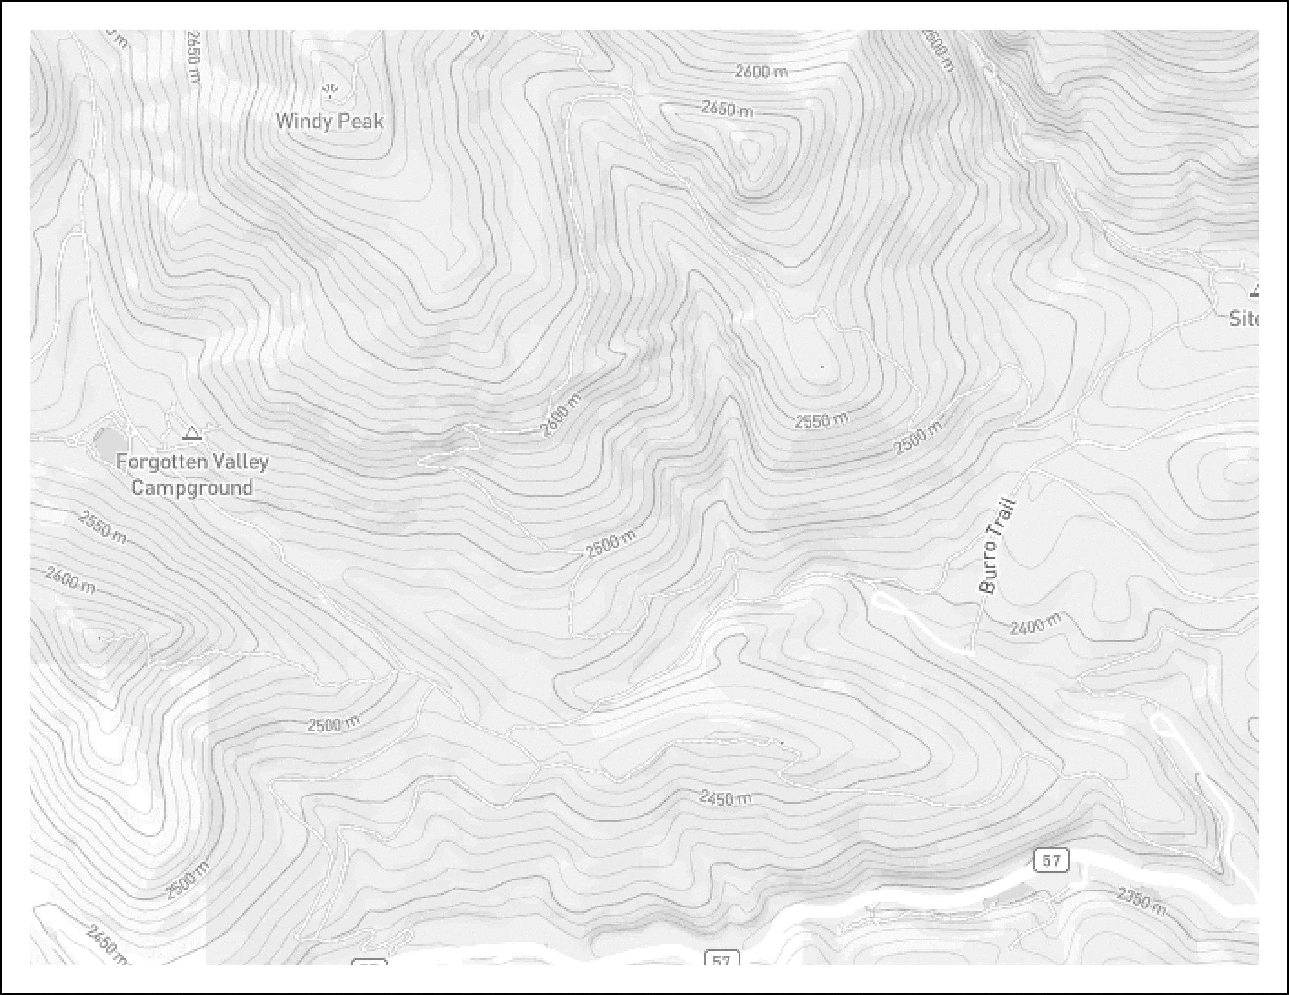
Here is a basemap that you can start working with for your office/final copy of your map
The Basemap is a jpeg that I formatted as the ppt slide background
I adjusted the color and brightness in background formatting settings
Please include:
Title
Legend
North Arrow
Scale bar (you’ll need to calculate this)
Move and adjust this white legend box wherever it fits best.

Slide 2
Put your cross-section here

