Slide 1
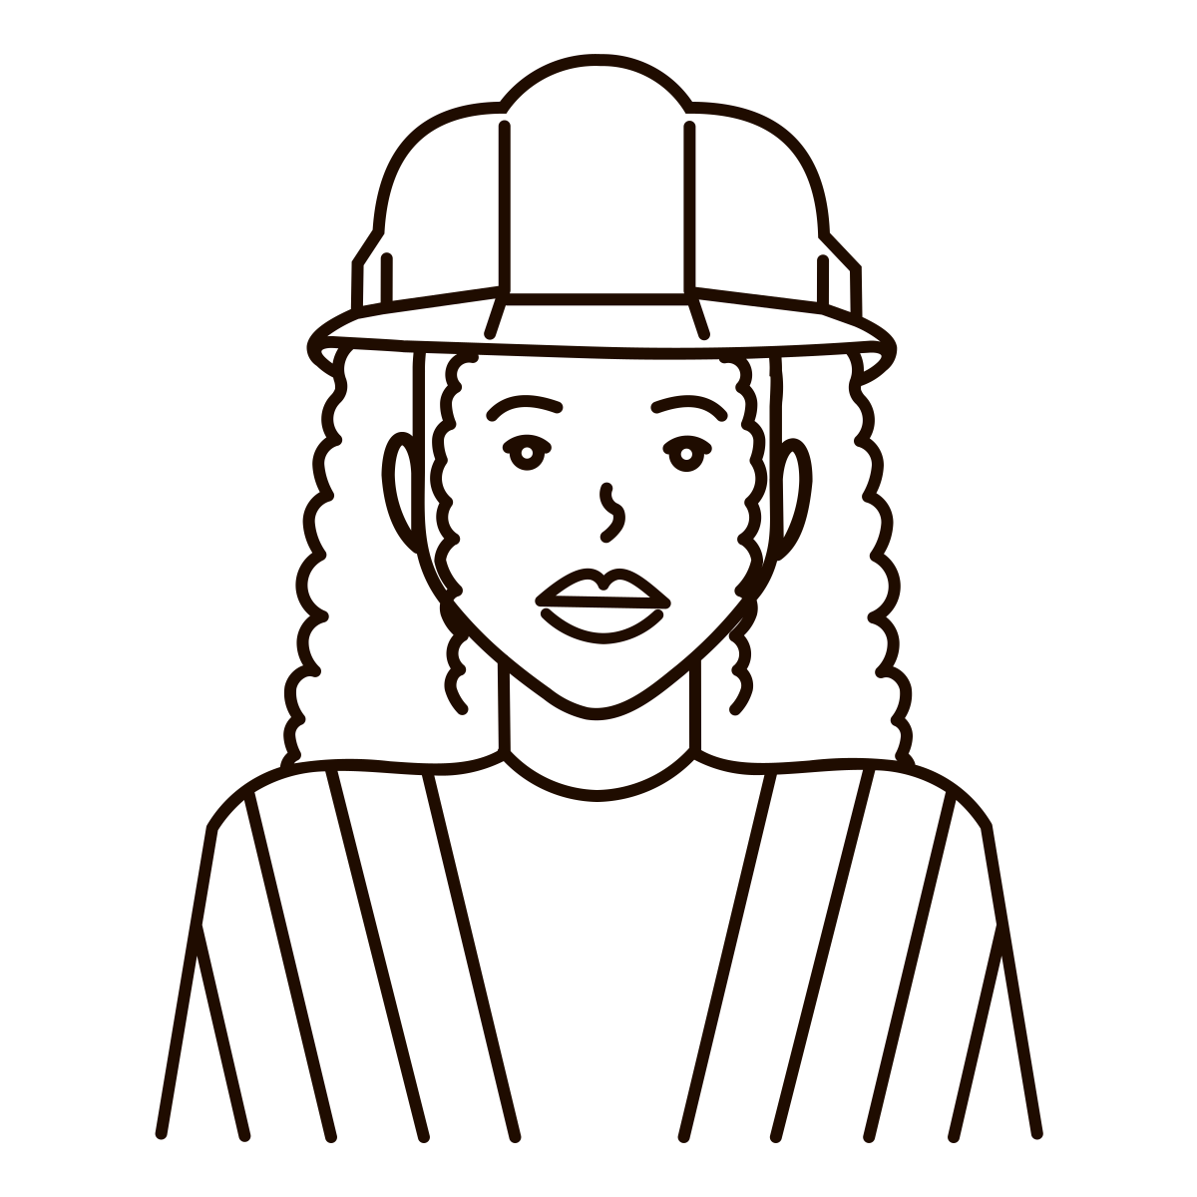
Critical Race Theory and Social Justice in Engineering :
A syllabus to bridge fields of study
Emma Stine (she/her), Ph.D.

Slide 2
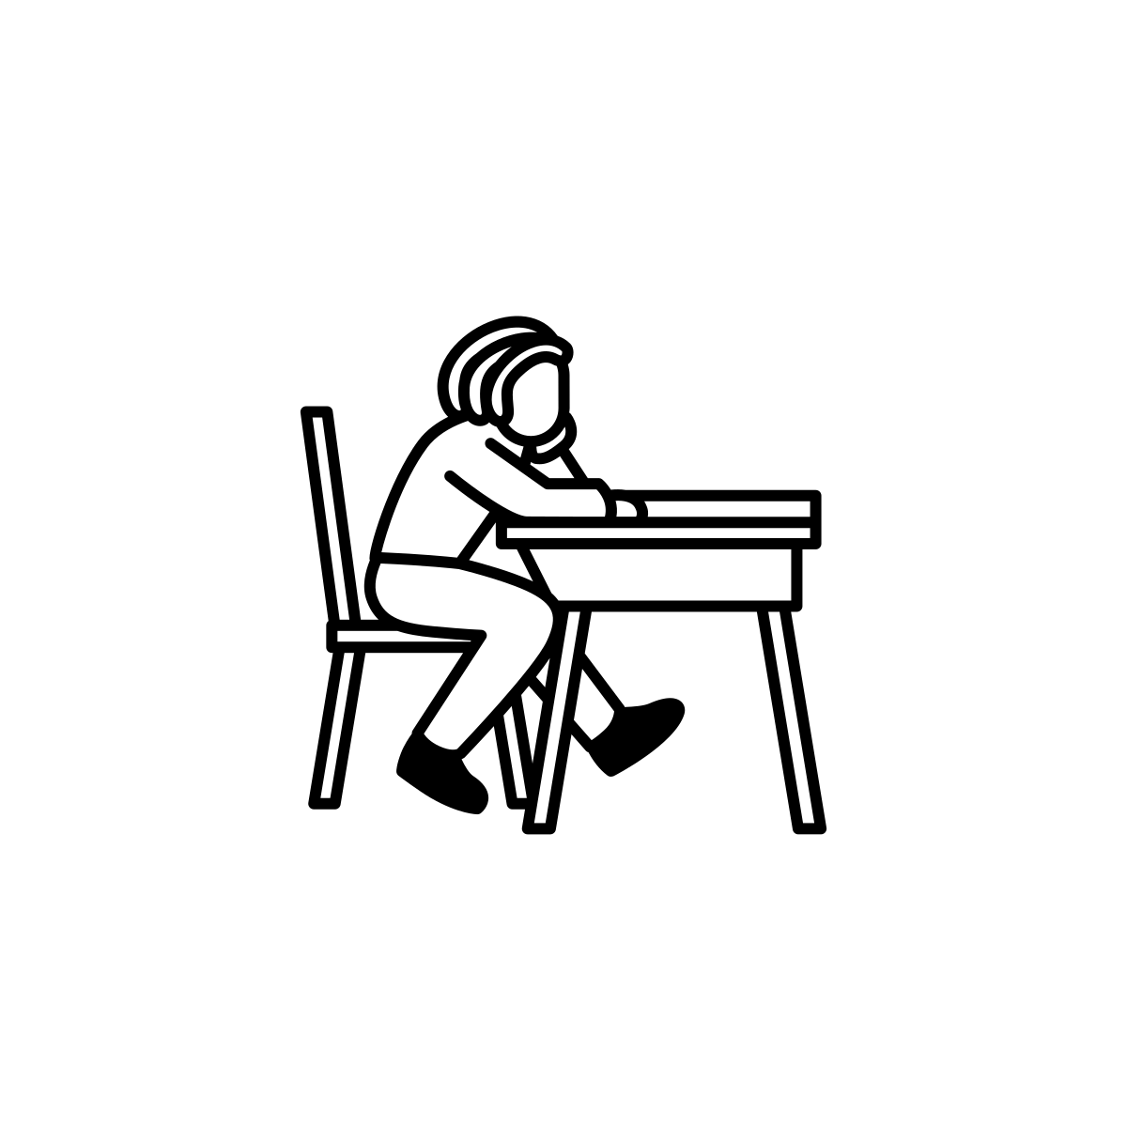
Critical Race Theory (CRT) Scholarship
This growing body of scholarship is designed to identify and dismantle interlocking systems of power, including racism, sexism, and classism, in order to transform structural aspects of society that maintain the subordination of People of Color (D. A. Bell, 1995; Ladson-Billings, 1998). CRT scholarship can be utilized to identify and dismantle the norms and policies within engineering education and industry that impede the field's capacity to engage in social justice work by adhering to the five fundamental tenets of this scholarship.
  The Centrality of race and racism and intersectionality with other forms of subordination
  The Challenge to Dominant Ideology
  Commitment to Social Justice
  The Centrality of Experiential Knowledge
  Interdisciplinary Approach

Slide 3

The Issue
The engineering field minimally utilizes or values scholarship from the field of engineering
Why is this an issue?
Engineers have inadvertently perpetuated institutional and environmental racism through the implementation of infrastructure projects such as wastewater treatment centers, bridges, transportation, and energy supply, where placement and quality often favor privileged communities (Winner, 1980; Yates & Murphy, 2019).
There is a growing interest in rectifying the unjust outcomes within the field and aligning with social justice activism.

Slide 4
The Action Plan
Create a syllabus draft that combines literature on CRT and engineering for good frameworks as well as relevant case studies (done)
Share draft with students, faculty and peers across fields for feedback
Utilized mentors and scholarship to make in-class projects and homework plans more robust
Make the syllabus abide by inclusivity, justice, and accessibility literature
Talk about class interest in job applications
Continue advocating for class, and making class material more robust

Slide 5

Questions?

