Slide 1
JET Capstone Project: Access in the Physics Building
Sara Moore
11/29/2023

Slide 2
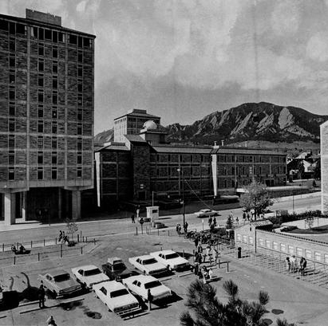
Overview
This is likely my last semester teaching
  I would like to contribute to a project that will have an impact for all future students
Duane (the physics building) has issues
  ADA passed in 1990
  Building completed in 1971

Slide 3
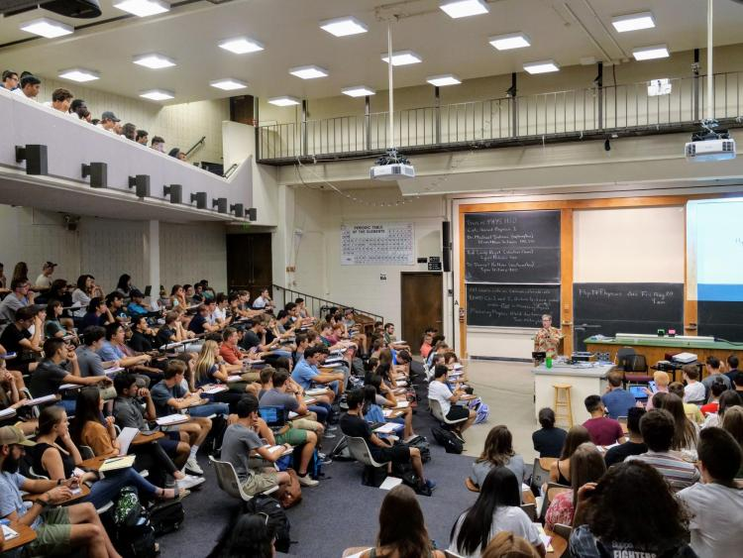
Current Issues
Very few ADA accessible bathrooms
Elevators are confusing
  Often out-of-order
  Cannot access 2nd floor, where junior level classes are
One ADA entrance only
Large lecture halls have limited access
Notes:
- Study about sitting in first few rows

Slide 4
My Project
After talking with professors and building managers leading the efforts to make the building more accessible:
  Report on current state of inaccessibility
    Student testimonials
    Current issues
  Website/Video detailing accessible ways to navigate the building
    Disseminate in lecture halls
    QR codes by/in elevators
    Bathroom doors
    Ideally will help learners and instructors with both permanent and temporary mobility issues

Slide 5
Timeline and Goals
QR codes by the start of next semester
  This will involve initial steps of obtaining building plans
  Detailed explanation of how to navigate to highly used classrooms
Full Report with testimonials and detailed notes by mid-next semester
  Begin advertising for need for testimonials in January
  Talk with building manager to explore how this report could best support existing advocacy

Slide 6
Questions?
Notes:
Video is inclusive for autism
Get attention of media
Contact Julia
Look into building history; create narrative of building being out of touch

