Slide 1

J.E.T
Capstone
Birdie Reznicek
April 18, 2024
Shared Resource for
Inclusive Pedagogy
Context
Opportunity
Goals
Partners
Action Plan & Timeline
Notes:
The gap that exists and perhaps how you came to know it exists
Short-term and long-term goals and purpose of project
Action plan/steps you will take to implement your project
Timeline
Who you might need to involve/partner/ additional resources you might need if applicable

Slide 2

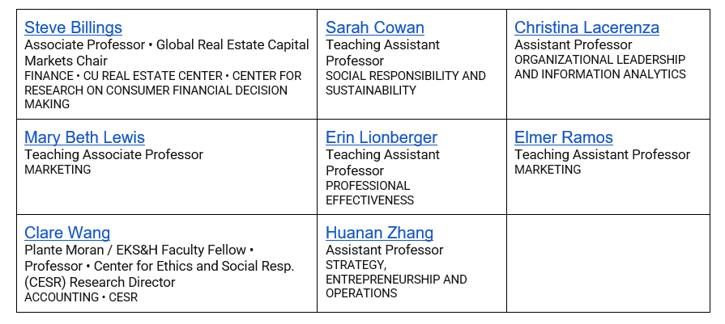
Classroom Inclusion Team (CIT), AY 2023-2024

Slide 3





Context
Gathered Inclusive Classroom Practices by Division
Spring 2023
Recommended Practices
Goals Moving Forward
Moderated a Faculty Panel on Inclusive Classroom Practices
Fall 2023
Attended by faculty & staff
Addressed Faculty Training: how to navigate conflict around DEI in classroom
Spring 2024 meeting
Fall 2025 training

Slide 4
How do we make the Inclusive Classroom Practices:
Easier for colleagues to implement
Ruha Benjamin Resources
Sample DEI Syllabus Statements from other universities
Sample Equity Rubric
Teaching Quality Framework - DEIB
Diversity & Inclusion in Business & Economics, CalPoly Library
…
Shared & Accessible
Shared Canvas? (Partner w/Teaching Excellence Committee?)
Intranet site (Sharepoint)
Shared doc?
…
…

Slide 5
Opportunity
Current Recommendation | Practical Shared Resource
“Revise course materials by adding an inclusion statement in the syllabus.” | Sample DEI Syllabus Statements from other universities Syllabi examples from business courses within Leeds School Divisions
“Schedule five-minutes at the beginning of each class to introduce a DEI-relevant historical hero, show a short video, and summarize with some connection to course content.” | Just Data Lab – Ruha Benjamin Learning for Justice Archives of Justice Stanford Social Innovation Review
“Use material in class that highlight underrepresented groups when possible.” | Diversity & Inclusion in Business & Economics, CalPoly Library
Thank you, Rachana!

Slide 6
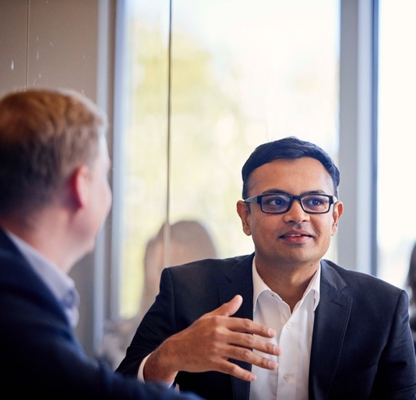
Goals
Maximize conversion of good intentions to actionable adjustments
Lower the implementation hurdle
Facilitate adoption of best practices
Time savings – developing own tools and content is time intensive
More inclusive classroom experiences for students at Leeds

Slide 7

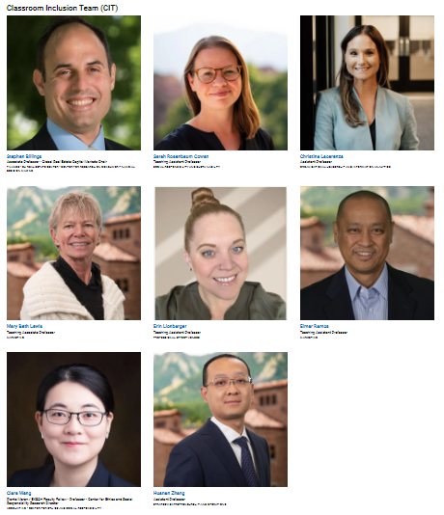


Partners
Leeds Classroom Inclusion Team
Leeds Teaching
Excellence Committee
Melanie Peffer
Canvas resource on good study habits
Center for Teaching & Learning

Slide 8






Action Plan & Timeline
May 14,2024
Summer 2024
Sept. 2024
Develop template for shared toolkit populated with known resources
Continue building shared resource toolkit with C.I.T.
Disseminate toolkit via New Faculty Orientation & faculty mtgs
End of May 2024
August 2024
Spring 2025
Meet with Teaching Excellence Committee to discuss shared platform
Hold FCQ bias training for academic leaders at Leeds
Leverage C.I.T. members in each Division to assess usage & addt’l needs

