Slide 1
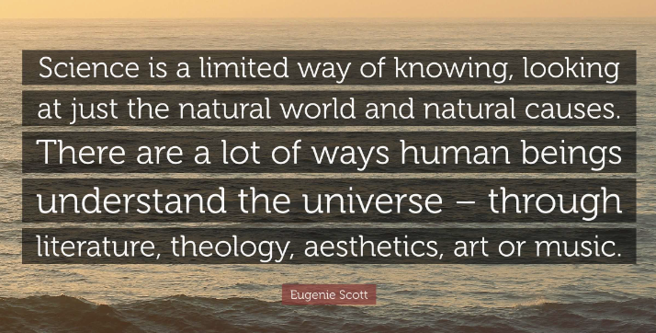
"We been knew: Moving Beyond the p < .05 in Psychology Education"
Transforming psychology teaching by:
– Disrupting what counts as “knowledge”
– Making students co-creators of knowledge
– Centering lived experience alongside research
–Draw from Black feminist epistemologies
Students Learn That:
Their experiences are valid knowledge
They can be scientists AND cultural wisdom holders
Their communities' ways of knowing matter
Through:
Qualitative Projects
Cultural critique of research - delve into psych’s history
Collective learning projects
Dialogic Class Structure
Opening Circle (10 min)
Your knowledge matters
Theory Integration (15 min)
Connecting texts to experience
Critical Dialogue (20 min)
Small group meaning-making
Collective Synthesis (15 min)
Creating new knowledge together
Traditional Teaching
Professor as expert
Empirical knowledge is the only knowledge
Individual achievement
Dialogic Teaching
Professor as facilitator
Multiple knowledge sources
Collective learning

