Slide 1
How Must Education Change
in an AI World?
2026 Newton Fellows Inaugural Changemakers Challenge
Team 5: Sophia Feghali, Jaka Jacklin, Jordan Greenstein, Jared Preyer

Slide 2
How Must Education Change in an AI World?
2026 Newton Fellows Inaugural Changemaker Case Study Competition
Team 5: Sophia Feghali, Jaka (last name), Jordan Greenstein, Jared (last name), Miriam (last name)

Slide 3
Overview
Why Education Matters
The Threat
Systems Analysis
Leadership Lens
Your Solution
Innovation
Implementation Plan
Impact
Feasibility and Risks
Metrics of Success

Slide 4
Why Education Matters
High quality-education: The development of reading and mathematics centered competencies that are in line with the future of real-world industries.
High-quality education bridges potential and opportunity.
It ensures every student, regardless of background, has access to essential skills.
These skills include verbal and quantitative competencies aligned with industry needs.
This preparation helps students enter the workforce and lead within it.

Slide 5
The Threat - Artificial Intelligence

Slide 6
Systems Analysis
Current Jobs
Future Jobs
15% minimum
50%
Educational Rood Causes
Are assimilating AI usage right now
Will be completely replaced by 2030
Traditional education and social efficiency
Makes job preparation paramount
Parents and teachers
Students
AI Implementation Root Causes
60%
Half
Capitalistic values and technological drive means it won’t go away
Concerned about AI in education
Of Gen Z K-12 believe AI skills critical for the future

Slide 7
Threat → opportunity

Slide 8

1. Real-World Application
AI delivers content + tutoring
Personalized learning at scale
Memorization → automated
2. Human Skill Development
Communication
Critical thinking
Decision-making
Emotional intelligence
Rebuilding Education for an AI World
Education shifts from job training → human development
3. AI-Augmented Learning
Real-world projects
Professors → mentors
Group-based problem solving
Notes:
Jordan Greenstein
Slide 6 - Your Solution - Jordan
Clear overview
What are you proposing?
Opening (pause, look at audience)
“Right now, education is built to produce workers. Our solution is to redesign it to develop humans in an AI-driven world.”
Point to the pyramid
“We break this into three layers.”
BOTTOM (AI layer)
“At the base, AI handles knowledge. It delivers content, answers questions, and personalizes learning at scale.
Memorization becomes automated, not the focus.” (pause)
MIDDLE (human skills)
“That shifts the focus to what actually matters, human skills.
Things like critical thinking, communication, and decision-making, which AI can’t replicate.”
TOP (application)
“At the top, students apply those skills through real-world experience.
Projects, mentorship, and team-based problem solving replace passive lectures.”
CLOSE (anchor line, slow down)
“So the system shifts from training people for jobs to developing capable, adaptable humans.” (short pause, then transition) “But this only matters if it can actually be implemented.”

Slide 9

From Idea to Reality
AI handles knowledge → schools develop capability
Phase 2
Phase 3
Phase 1
3–5 Years
Curriculum Shift
Fewer lectures/tests
Project-based learning
Human skills focus
0–2 Years
AI Integration
AI tools for all students
Train teachers
Less memorization
5–10 Years
System Transformation
Schools = learning hubs
Professors = mentors
Students build portfolios
Notes:
Jordan Greenstein
Slide 8 - Implementation Plan - Jordan
How it would work in reality
Timeline or phases
Open
“So here’s how this actually happens in reality.”
PHASE 1 (left side)
“First, over the next 0 to 2 years, we integrate AI into the system.
Every student gets access to AI tools, and teachers are trained to use them, not fight them.
At the same time, we start shifting away from memorization-based grading.”
PHASE 2 (middle)
“Next, over 3 to 5 years, the curriculum changes.
We reduce lectures and standardized testing, and replace them with project-based learning and human skill development.”
PHASE 3 (right side)
“Finally, over 5 to 10 years, the system transforms.
Schools become learning hubs, professors act as mentors, and students are evaluated based on what they can do, not just what they know.”
CLOSE (strong, controlled)
“At that point, AI handles knowledge, and schools focus on building real capability.”
FINAL ANCHOR (if you forget anything)If you blank out, just say:“AI handles knowledge, humans develop judgment, and education needs to reflect that.”

Slide 10
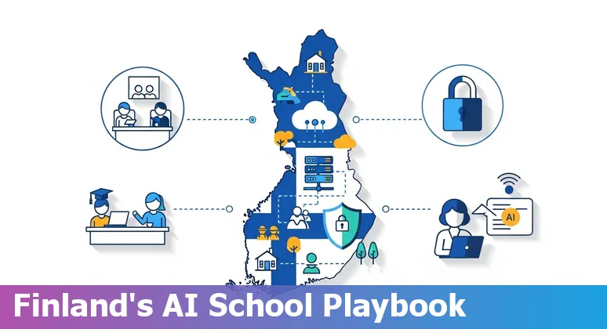
Feasibility and risks
Finland - ViLLE
  AI-integrated support for students, teachers
  Use in > 50% of Finnish schools
  CO’s Computer Science Teacher Education Grant Program
What could go wrong?
  Systematic change
  Multiple stakeholders
  Accessibility of implementation
(UNESCO, 2021)
“AI in Finland must enhance - not replace - critical thinking.”
Notes:
Fundamental cultural shift → slow and unpredictable
Why this solution is realistic:

Slide 11
The impact
Mitigation and Educational Improvement
Who Benefits
Shifts the current educational system.
AI Literacy for students, parents, educators.
Skill development in an AI-evolving society.
Education for fulfillment.
Children
Educators
Community Members
School Districts
Notes:
Shifts to integrate AI as a resource

Slide 12
mETRICS OF sUCCESS
High-quality education bridges potential and opportunity.
  Leadership and readiness to lead
  Real-world and application
  Long-term opportunity after school
It ensures every student, regardless of background, has access to essential skills & equity of access.
  AI Literacy
  Reading & mathematics growth
  Critical thinking/communication/decision making

Slide 13

Leadership
THeory
Collective Leadership
Followership in Leadership
Leadership as a System
Responsibility of the entire system to work together to make this radical shift
Followers of the system need to buy into our new definition for this to be successful
The real leader here is a societal shift in mindset

Slide 14
“Leadership requires vision and boldness. Leadership is about looking over the horizon and creating an actionable vision around that.”
~ Walt Morgan

Slide 15
Innovation
New time = New perspective on education
Astrophysics and creative technology
MCDB
Computer Science
Finance
Research
Change in experimentation
Supportive tool for discovery
Development & Implementation of AI
Research
Curiosity and discovery drives skill
Innovation and fun without worry
Research
Notes:
Fundamental cultural shift → slow and unpredictable
Why this solution is realistic:

Slide 16
In Closing
The education we had in the past is not the education we have today.
We need to seriously reconsider how we define, and practice, education in today’s reality.

Slide 17
Thank you!
2026 Newton Fellows Inaugural Changemakers Challenge
Any questions?

Slide 18

Our company
Mercury is the closest planet to the Sun and the smallest one in the Solar System—it’s only a bit larger than the Moon

Slide 19
Our
evolution
2019
2020
Despite being red, Mars is a cold place
Earth is where we live on

