Slide 1
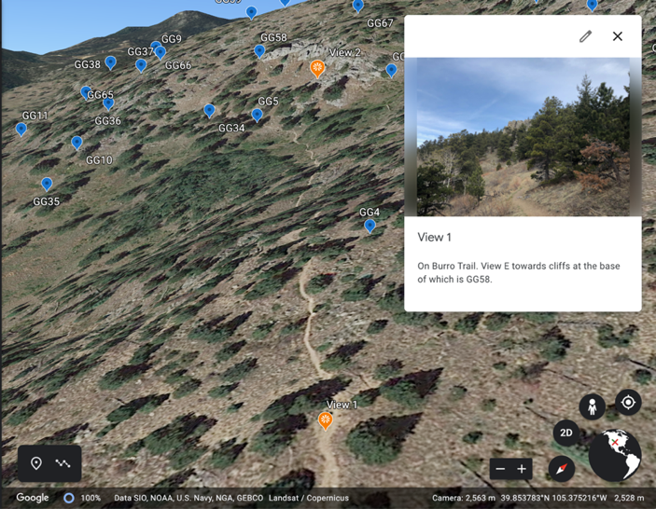
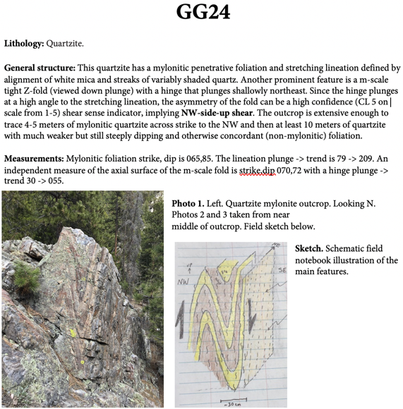
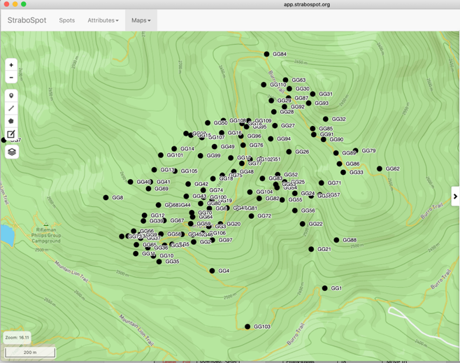
Mapping with Google Earth and StraboSpot
A shape file provided to upload to Strabo to begin the project
Google Earth Web
Station-specific observations and data provided

Slide 2
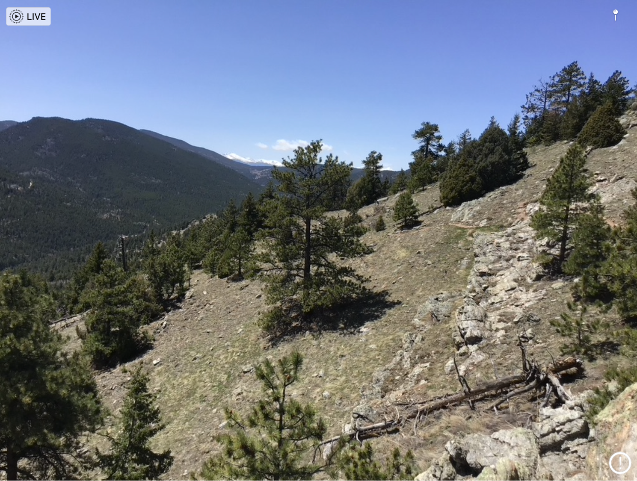
Intro to Coal Creek/Golden Gate mapping area
Or: how do you deal with mapping metamorphic rocks?

Slide 3
Xbg: Boulder Creek granodiorite
Look for big feldspars
Some places is only weakly deformed
Mylonitic in places
Reduced grain size
Foliation
Feldspar porphyroclasts
Look for veins of granite within, can be useful markers

Slide 4
Introduction to units: Xcq
Coal Creek quartzite
Locally Conglomeratic (possible meaning?)
Things to look for:
Bedding orientations
Is there a foliation?
Is the foliation the same orientation as bedding, or different?

Slide 5
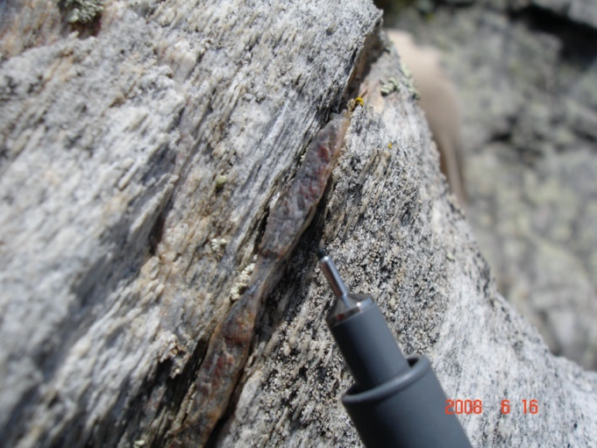
Xcq continued: quartzite
Locally strongly foliated (mylonite). Foliation from the side: look for closely spaced foliation, small grain size
Note folded bedding, axial plane cleavage

Slide 6
Xcs: Coal Creek schist
Outcrops break more easily than quartzite
Minerals vary
Micas (biotite, muscovite)
Andalusite
Garnet
Structures expected
May see bedding (change in texture & minerals)
Foliation likely
Two generations of foliation:
S1, S2

Slide 7
Xcs: Coal Creek schist
Protolith: more clay than the quartzites had (shale, siltstone…)
Andalusite porphyroblasts
Large dark gray crystals
Bedding might be distinguished by compositional layering
Presence or absence of andalusite
More or less quartz-rich layers

