Slide 1
Post-COVID Disengagement
Happy Phatak, Marissa Khan, Omer Widaa, Sam Thompson
Notes:
Omer: We researched a couple of ideas that we considered the biggest threat to quality education and decided to focus our attention on post- covid disengagemnt

Slide 2
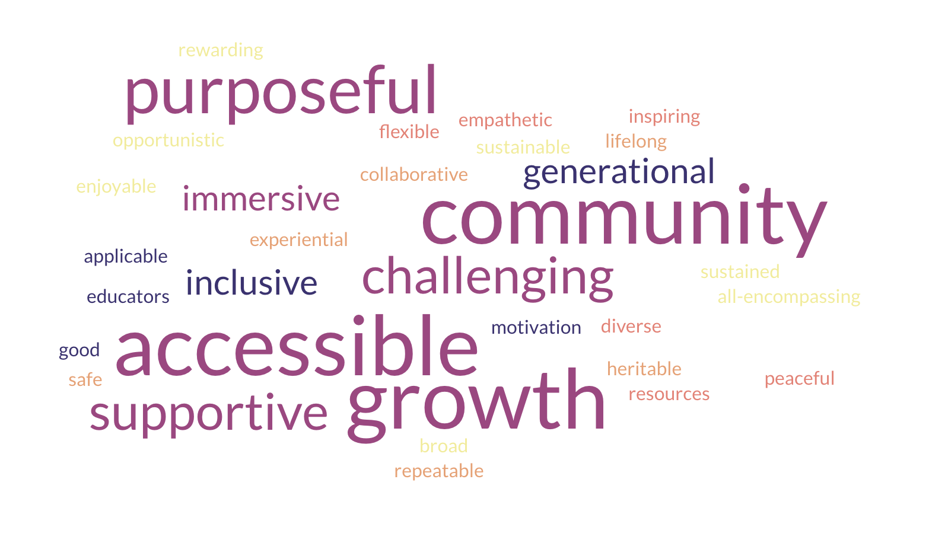
Notes:
Omer: To start off, we wanted to define what high quality education was, so we went with the tried and tested technique of popcorning the words that we associated with high quality education. We had a couple words with the same meaning and you can see some of the biggest contributors here. Mainly we valued community, purposeful, accessibility, and growth. We took these 4, refined them a bit more, and came up with a couple of pillars for high quality educaiton

Slide 3




Pillars of High-Quality Education
Accessible
Purposeful
Community
Growth
Notes:
Omer: Accessibility was one of our pillars because When a student has to struggle just to access information (due to a learning disability, language barrier, or technological/ resource barriers, , they use up their the mental energy just trying to access educaiton rather than use their energy for actual learning
Purposeful: We’ll circle back to this in our threat, but we think that educaiton needs to be purposeful in the way that students need to be invested in their own education and have to value learning and recognize it as a privelage
Community: Humans are inherently social creatures, and some of our getests successes come from collaboration. Teaching and learning can be hard and even vulnerable at times, so having a community to support the learners is foundational to good education
Growth: Growth is important because learning

Slide 4

Why Education Matters
Expands opportunities, creating equitable and inclusive environments
Builds knowledge and critical thinking, applying ourselves to meaningful challenges
Strengthens connection, encouraging collaboration and belonging
Drives progress, fueling personal success and societal advancement
Notes:
Omer:
Education matters because read off the slide basically here

Slide 5
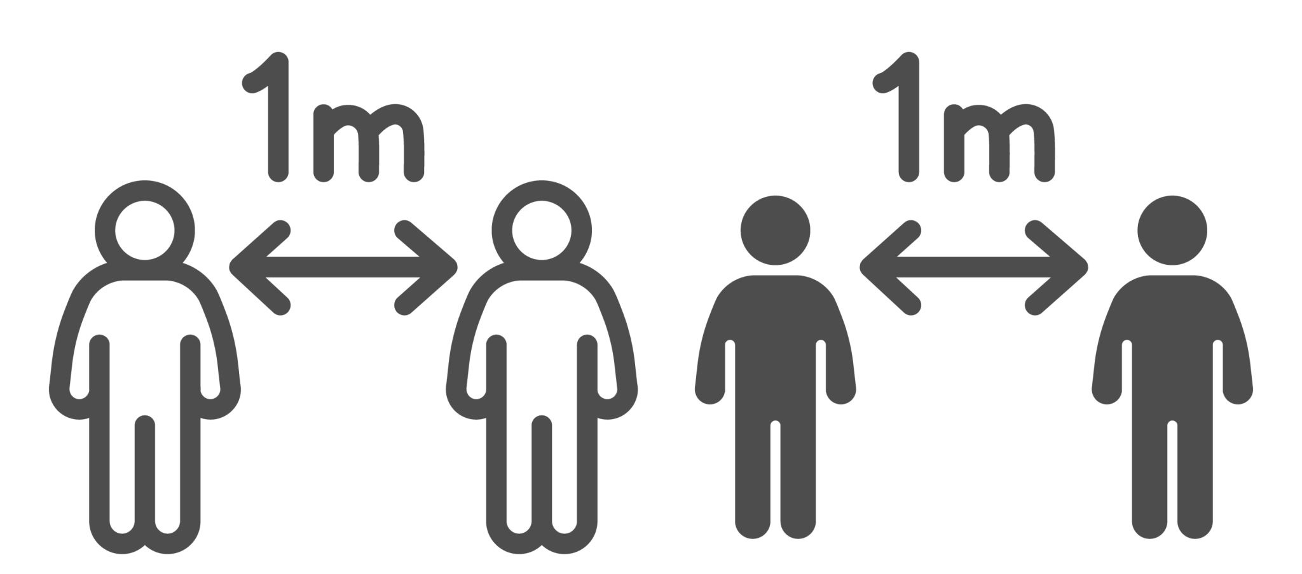
The Threat
Threat: After the COVID-19 pandemic, there have been high levels of disengagement across students and educators leading to:
Loss of emotional and social skills
Academic burnout
Chronic absenteeism
Ultimately threatening both academic performance and the overall well-being of school communities.
Notes:
Marissa
Loss of emotional and social skills- being able to have smooth, casual conversations
Academic burnout- a state of chronic physical, emotional, and mental exhaustion
Chronic absenteeism- missing at least 10% of school days
Threatnes

Slide 6
The Threat
22.7%
of students are chronically absent in 2024–25, meaning nearly 1 in 4 students still miss significant school time.
55%
of undergraduates report struggling to remain engaged during lectures post-pandemic at UC Davis
“I don’t feel like I belong”
was listed in a national Gallup survey as one of the top reasons students considered stopping out of college.
75%
of students who experienced mental health difficulties go to peers instead of institutional staff.
53%
of teachers reported burnout in 2025 nationally
Notes:
Marissa

Slide 7

Root Cause Analysis
1
Lack of Community
2
Technology Overload
Key stakeholders: students, parents, teachers, administrators, legislators
Notes:
Happy
Now that we understand the threat, we wanted to look deeper at why this is happening. We identified two main root causes: 1) a lack of community and 2) technology overload. These don’t exist in isolation, they reinforce each other. When students feel disconnected, they turn more to technology, and that increased screen time further reduces community.
And it is important to note that, this affects multiple stakeholders, not just students, but also teachers, parents, administrators, and even policymakers

Slide 8




Root Cause Analysis: Lack of community
↓ motivation & participation
↓ mental health and wellness
↑ withdrawal & dropout risk
↑ Loneliness = ↓ engagement = ↓achievement
Notes:
Happy
I think this is something a lot of us have actually experienced ourselves. When you don’t feel connected in a class or on campus, it becomes so much harder to care. You stop participating, you stop showing up the same way, and everything just starts to feel kind of meaningless. And then that doesn’t just stay academic - it affects your mental health, your motivation, and your sense of belonging. So it becomes this cycle where loneliness leads to disengagement, and disengagement just pushes you even further from your academic goals

Slide 9
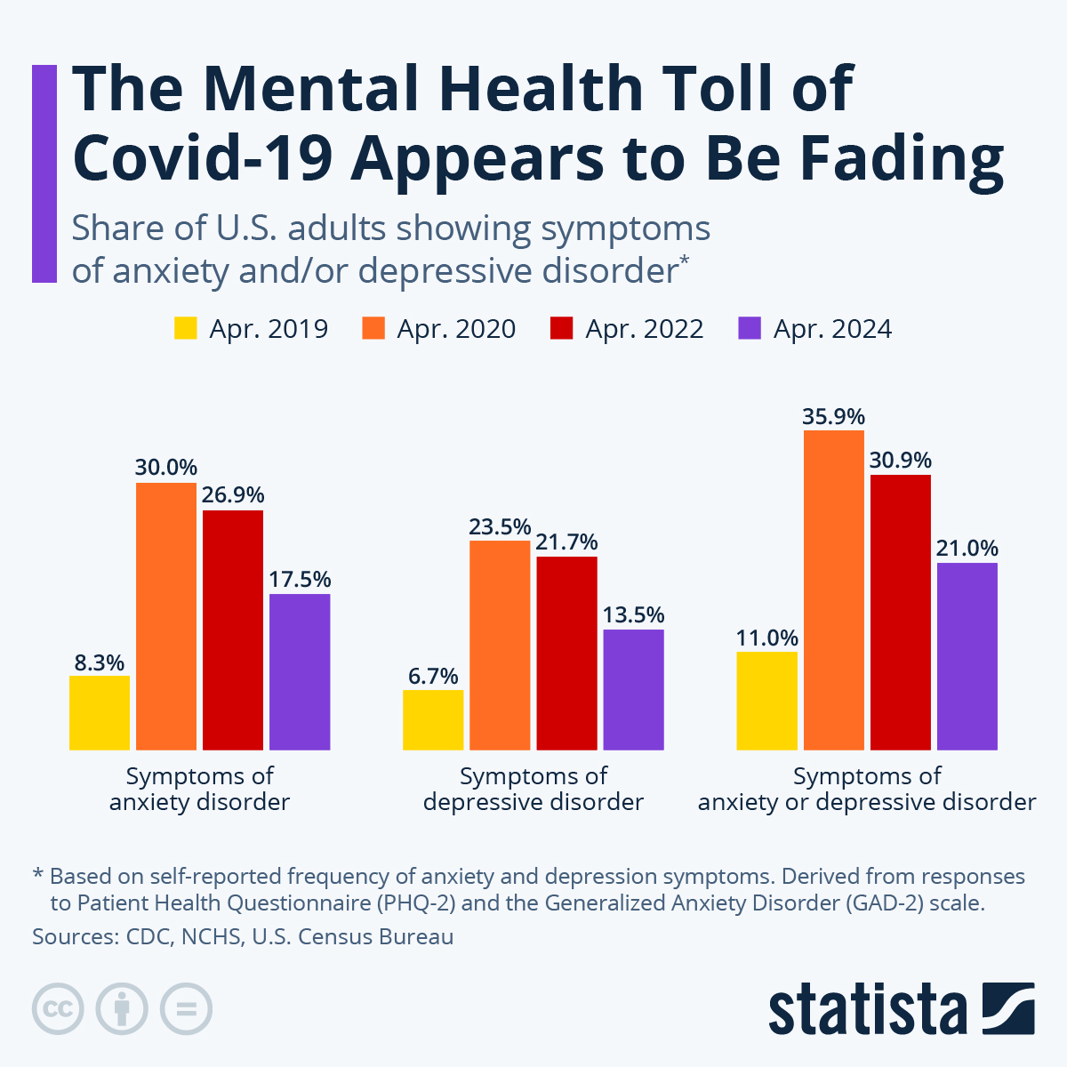
Root Cause Analysis: Lack of community
Declining work quality (~70%) linked to reduced social interaction (72%)
Anxiety and Depression rates nearly doubled
Notes:
Happy
We also see strong data backing this up. Around 70 percent of declining work quality is linked to reduced social interaction, and over 70 percent of students report less interaction overall. At the same time, anxiety and depression rates have nearly doubled. So this isn’t just about grades, this is about a broader decline in both academic performance and student well-being

Slide 10
Root Cause Analysis - Technological Overload
Attention Spans
Learning Performance
Socialization Skills
Dropped from 150 seconds (2004) to 47 seconds (2025).
Blocking internet access improves attention spans.
Frequent short-form video consumption is associated with poorer cognitive functions.
Banning smartphones led to a 6.4% improvement in test scores.
Schools enforcing bans saw significant reductions in chronic absenteeism.
Excessive screen exposure leads to poor sleep quality.
The average teen spends nearly 5 hours per day on social media.
25% of 13-14 year olds spend more than 7 hours per day on social media.
Online interactions do not teach important social skills.
Notes:
Happy
Technology is the second major driver of disengagement. Attention spans have dropped dramatically - from about 150 seconds to just 47 seconds. At the same time, students are consistently spending around 5 hours a day on social media, with some going over seven.
Actually - take a second, pull out your phones, and check your screen time. Is it what you expected? Lower? Or probably higher?
And that’s the point. This constant exposure to short-form content is literally reshaping how we focus. It makes it harder to sustain attention, disrupts sleep, and limits how we build real, in-person social skills.
But what’s interesting is that when schools put even small restrictions on phone use, we see real improvements - higher test scores, better attendance, and more engagement overall. So this isn’t just a personal issue, it’s something structural that we can actually change.
So if your screen time is higher than you wanted, there are things that you can do about it, and changes you can make.

Slide 11
RISE Framework
Reinforced
Initiatives for
Student
Engagement
Class
A model for leaders in education to empower people across every level of organization, taking coordinated action that drives forward meaningful change.
Notes:
Sam
To address these root causes, we’ve developed a framework that works across levels of student interaction. This is a model that starts at the classroom

Slide 12
RISE Framework
Reinforced
Initiatives for
Student
Engagement
School
Class
A model for leaders in education to empower people across every level of organization, taking coordinated action that drives forward meaningful change.
Notes:
Sam
And the school

Slide 13
RISE Framework
Reinforced
Initiatives for
Student
Engagement
Classroom
District
School
Class
A model for leaders in education to empower people across every level of organization, taking coordinated action that drives forward meaningful change.
Notes:
Sam

Slide 14
RISE Framework
Classroom
Community
Reinforced
Initiatives for
Student
Engagement
Classroom
District
School
Class
A model for leaders in education to empower people across every level of organization, taking coordinated action that drives forward meaningful change.
Notes:
Sam

Slide 15
RISE Framework
Classroom
State
Classroom
Community
Reinforced
Initiatives for
Student
Engagement
Classroom
District
School
Class
A model for leaders in education to empower people across every level of organization, taking coordinated action that drives forward meaningful change.
Notes:
Sam
Initiatives across each of these levels are designed to both increase student engagement and empower leaders across these layers of organization to take ownership over student engagement and drive forward change.

Slide 16
Class
Initiative
Owner
How
Why
Measure
Engagement-based learning
Teachers
Problem-based projects
Socratic discussions
Active learning improves exam performance
Student participation rates
Exam scores
High-quality screen time
Teachers
Use screens intentionally
“Screens-down” periods
Higher screen times associated with lower reading and math achievement
Screen time
Notes:
Sam
At the classroom level, we propose two initiatives. First, engagement-based learning. This is to encourage students to interact with each other in collaborative manners, which is shown to improve exam performances. We’ve seen the statistics showing high levels of disengagement in lectures, so we need to meet students where they are at. This can be measured through participation and attendance rates, along with exam scores.
Second, teaching what high-quality screen time looks like to kids young. Students need to be educated on how to use technology in order to be successful in the modern world, but they don’t need to be addicted to their screens. Teachers can begin to teach students what high-quality screen time looks like and promote screen down periods during the day. This can be measured through decreasing the amount of screen time kids spend per day.

Slide 17



School
Initiative
Owner
How
Why
Measure
Buddy program
Teachers, admin
Pair upper and lower classmen together
Develop mentorship
Collaboration between grades
Structured free time
Teachers
Dedicated time for students to rest
Student-student engagement
Increased intersocial communication
Extracurriculars
Teachers, parents, coaches
Create diverse space for extracurriculars
Another opportunity for engagement
Notes:
Omer

Slide 18


District
Initiative
Owner
How
Why
Measure
Phone ban
Principals
Utilize phone lockers/cubbies
53% of school leaders note negative impacts on academic performance and attention spans.
In class engagement
Academic productivity and scaled stress
Resources for mental health
Adminstrators
Connect students to therapists
50% of college students experiencing mental health-related academic impairment
Notes:
Marissa

Slide 19
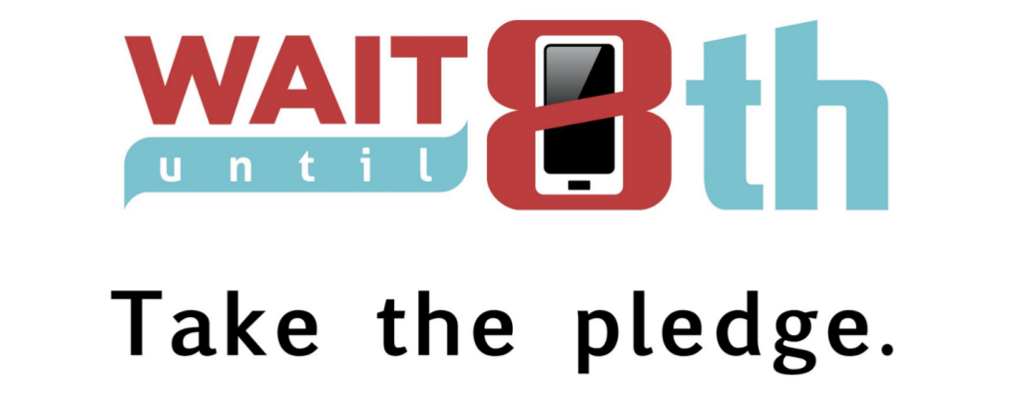
Community
Initiative
Owner
How
Why
Measure
Delay smartphone introduction
Parents
Community level pledges
“Wait until 8th”
Average child gets their first phone at 10 years old
Stopping use for 2 weeks reduces prevalence of clinical depression by ~1/3
Number of children with smartphones
Notes:
Sam
At the community level, parents can organize to delay smart phone introductions to kids. Across the country, the wait until 8th pledge is banding together parents who delay giving their children smart phones until 8th grade. This doesn’t leave any children behind, and encourages communities to promote a phone less childhood. This is shown to reduce levels of clinical depression, and success can be measured by determining how many people sign on, and how many children under a certain age still use smart phones.

Slide 20

State
Initiative
Owner
How
Why
Measure
Minimum social media age
Politician
Social Media platforms will require verified age checks before account creation and must be rechecked periodically
Must be 16+
2x likely to report poor mental health when spending 2+ hours a day on social media
Countries with restrictied social media saw up to a 50% increase in performance
Mental Health reports, attendance records
GPA averages, Standerdized test performances.
Notes:
Marissa

Slide 21



Feasibility and Risks
Risks
  Risk of unequal effort from buddies or mentors
  Increase anxiety for introverted students
  Feeling overly restricted and could lead to push back
  Difficult to enforce and easy to bypass age restrictions
Feasibility
  $0 cost
  Low-stakes
  Beneficial to both teachers and students
  Don’t depend on perfect compliance
Notes:
Happy
Of course, no solution is perfect, and we’re not here to tell you ours is, there are real risks to consider. For example, buddy systems can lead to unequal effort, and stricter policies like phone bans can feel restrictive or lead to pushback. Introverted students may feel uncomfortable in engagement based class styles. Some solutions, like age restrictions on social media, are also difficult to fully enforce.
However, we have taken these risks into account, and what makes these solutions work is that they are zero-cost, low-stakes, and beneficial across the board. Most importantly, they don’t rely on perfect compliance. Even small shifts in behavior and structure can lead to meaningful improvements in engagement
This isn’t about fixing students, the teachers, the parents, it’s about fixing the system they’re learning in

Slide 22
Call to Action
There exist proven methods towards improving student outcomes and high quality education. It will take coordinated action and strong leaders to create the change that is possible.
Notes:
Marissa

Slide 23
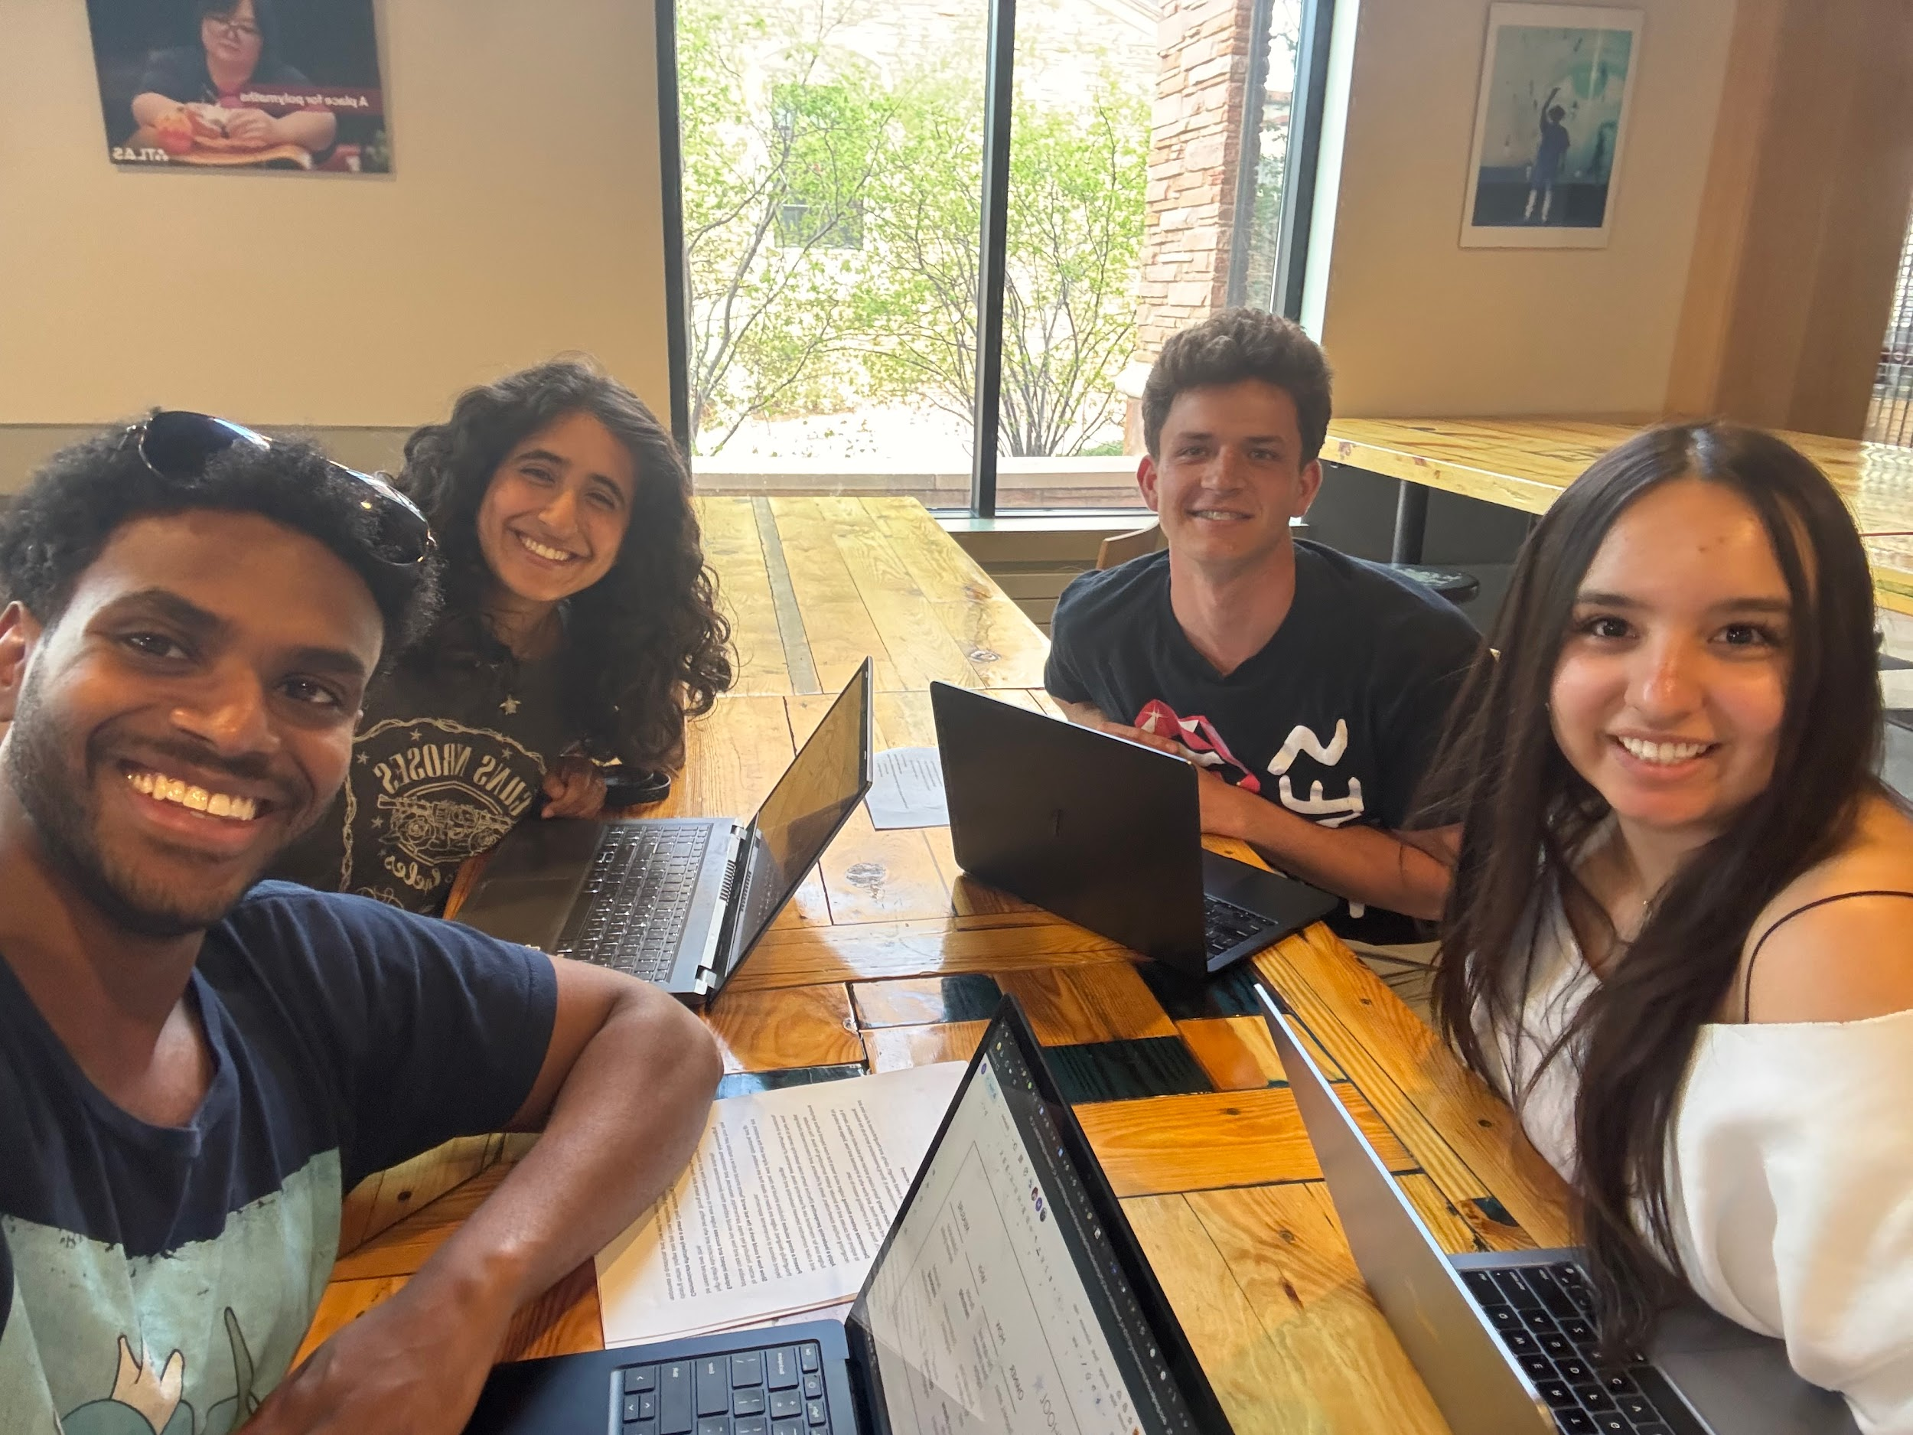
Thank You
QUESTIONS?

