Slide 1

Design For Inclusion: Syllabus Redesign
JET Action Plan Presentation
Janet Y. Tsai
Fall 2023
Notes:
Design for Inclusion Syllabus Redesign

Slide 2

Syllabus Redesign
In Week 3 and 5 of JET, we discussed equity, oppression, and power and ways to think about justice within systems and collectives, beyond our personal experiences.
Since course syllabi set the tone for entire semesters, this is a *prime* opportunity to apply our JET discussions and potentially impact my class, students, colleagues, and more…
image: Flaticon.com

Slide 3


Design For Inclusion (DFI)
Upper-division technical elective in Mechanical Engineering, open to Biomed, Aerospace, etc.
Opportunity to meaningfully disrupt pale, male, and stale* legacies of exclusion in (mechanical) engineering
4th iteration of class in Spring 2024
Syllabus can set the tone for being student-centered, welcoming of collaborative knowledge, and personal - a different kind of technical engineering course than students have been exposed to before
images: Flaticon.com
* W. A. Wulf, “Diversity in Engineering,” The Bridge, National Academy of Engineering, vol. 28, no. 4, Winter 1998. Available: https://nae.edu/19582/Bridge/CompetitiveMaterialsandSolutions/DiversityinEngineering.aspx
Notes:
By bringing students in from the start with a markedly different type of syllabus that is student-centered, welcoming of collaborative knowledge, and personal rather than impersonal and dehumanized, I hope to show students that this is a different kind of class that will set them thinking about engineering and design in a new direction.

Slide 4
Action Plan
(iterate for future semesters!)
Make changes to syllabus for S24 – keep in mind quality over quantity of changes
Review S23 DFI Syllabus, make list of what to keep and what to change
Publish in time for S24 start of classes
Compare lists and prioritize changes for maximum impact and my interest
Review Syllabus resources shared in JET – make list of what could work in DFI
Check alignment between learning objectives, assessments, assignments
(iterate as needed)

Slide 5

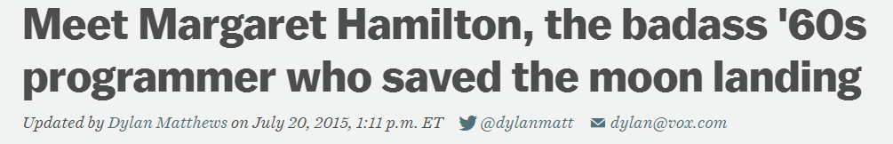
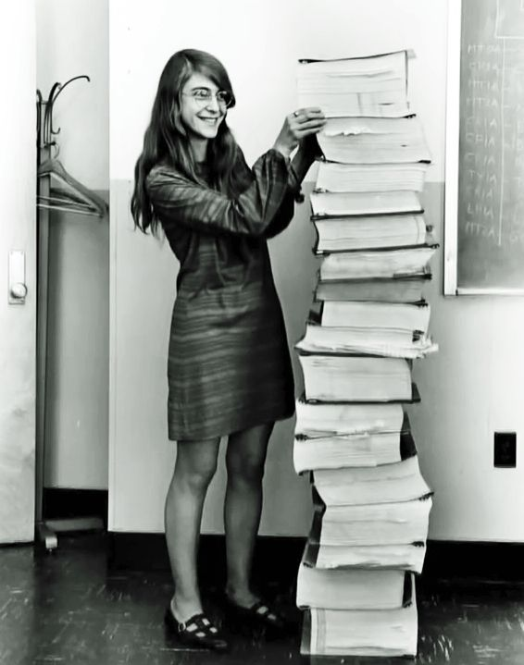

Questions? Comments? More Resources?
Janet.tsai@Colorado.edu
Thanks for a great JET experience!
From Hidden Figures
IN THEATERS JANUARY 13, 2017

