Slide 1
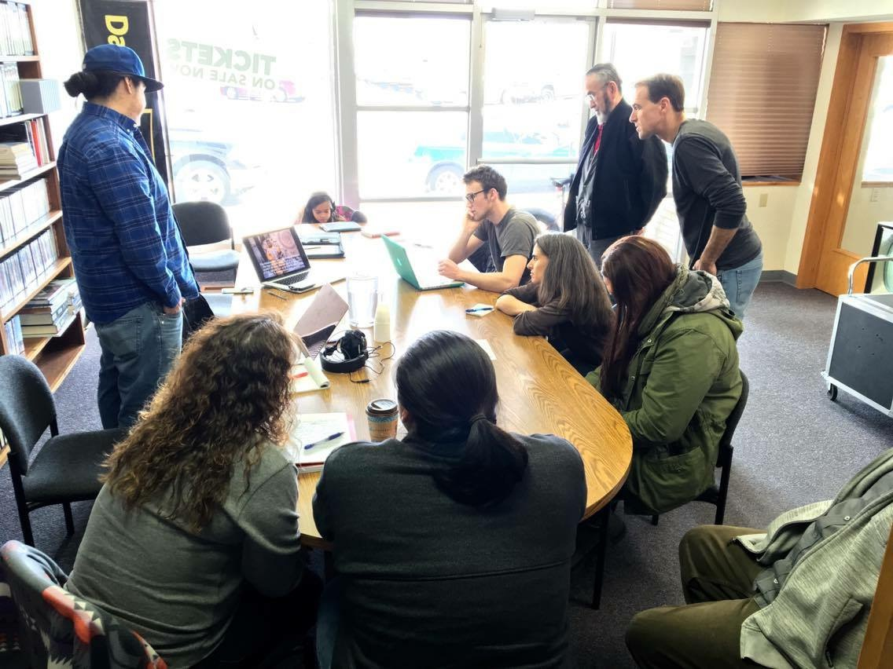
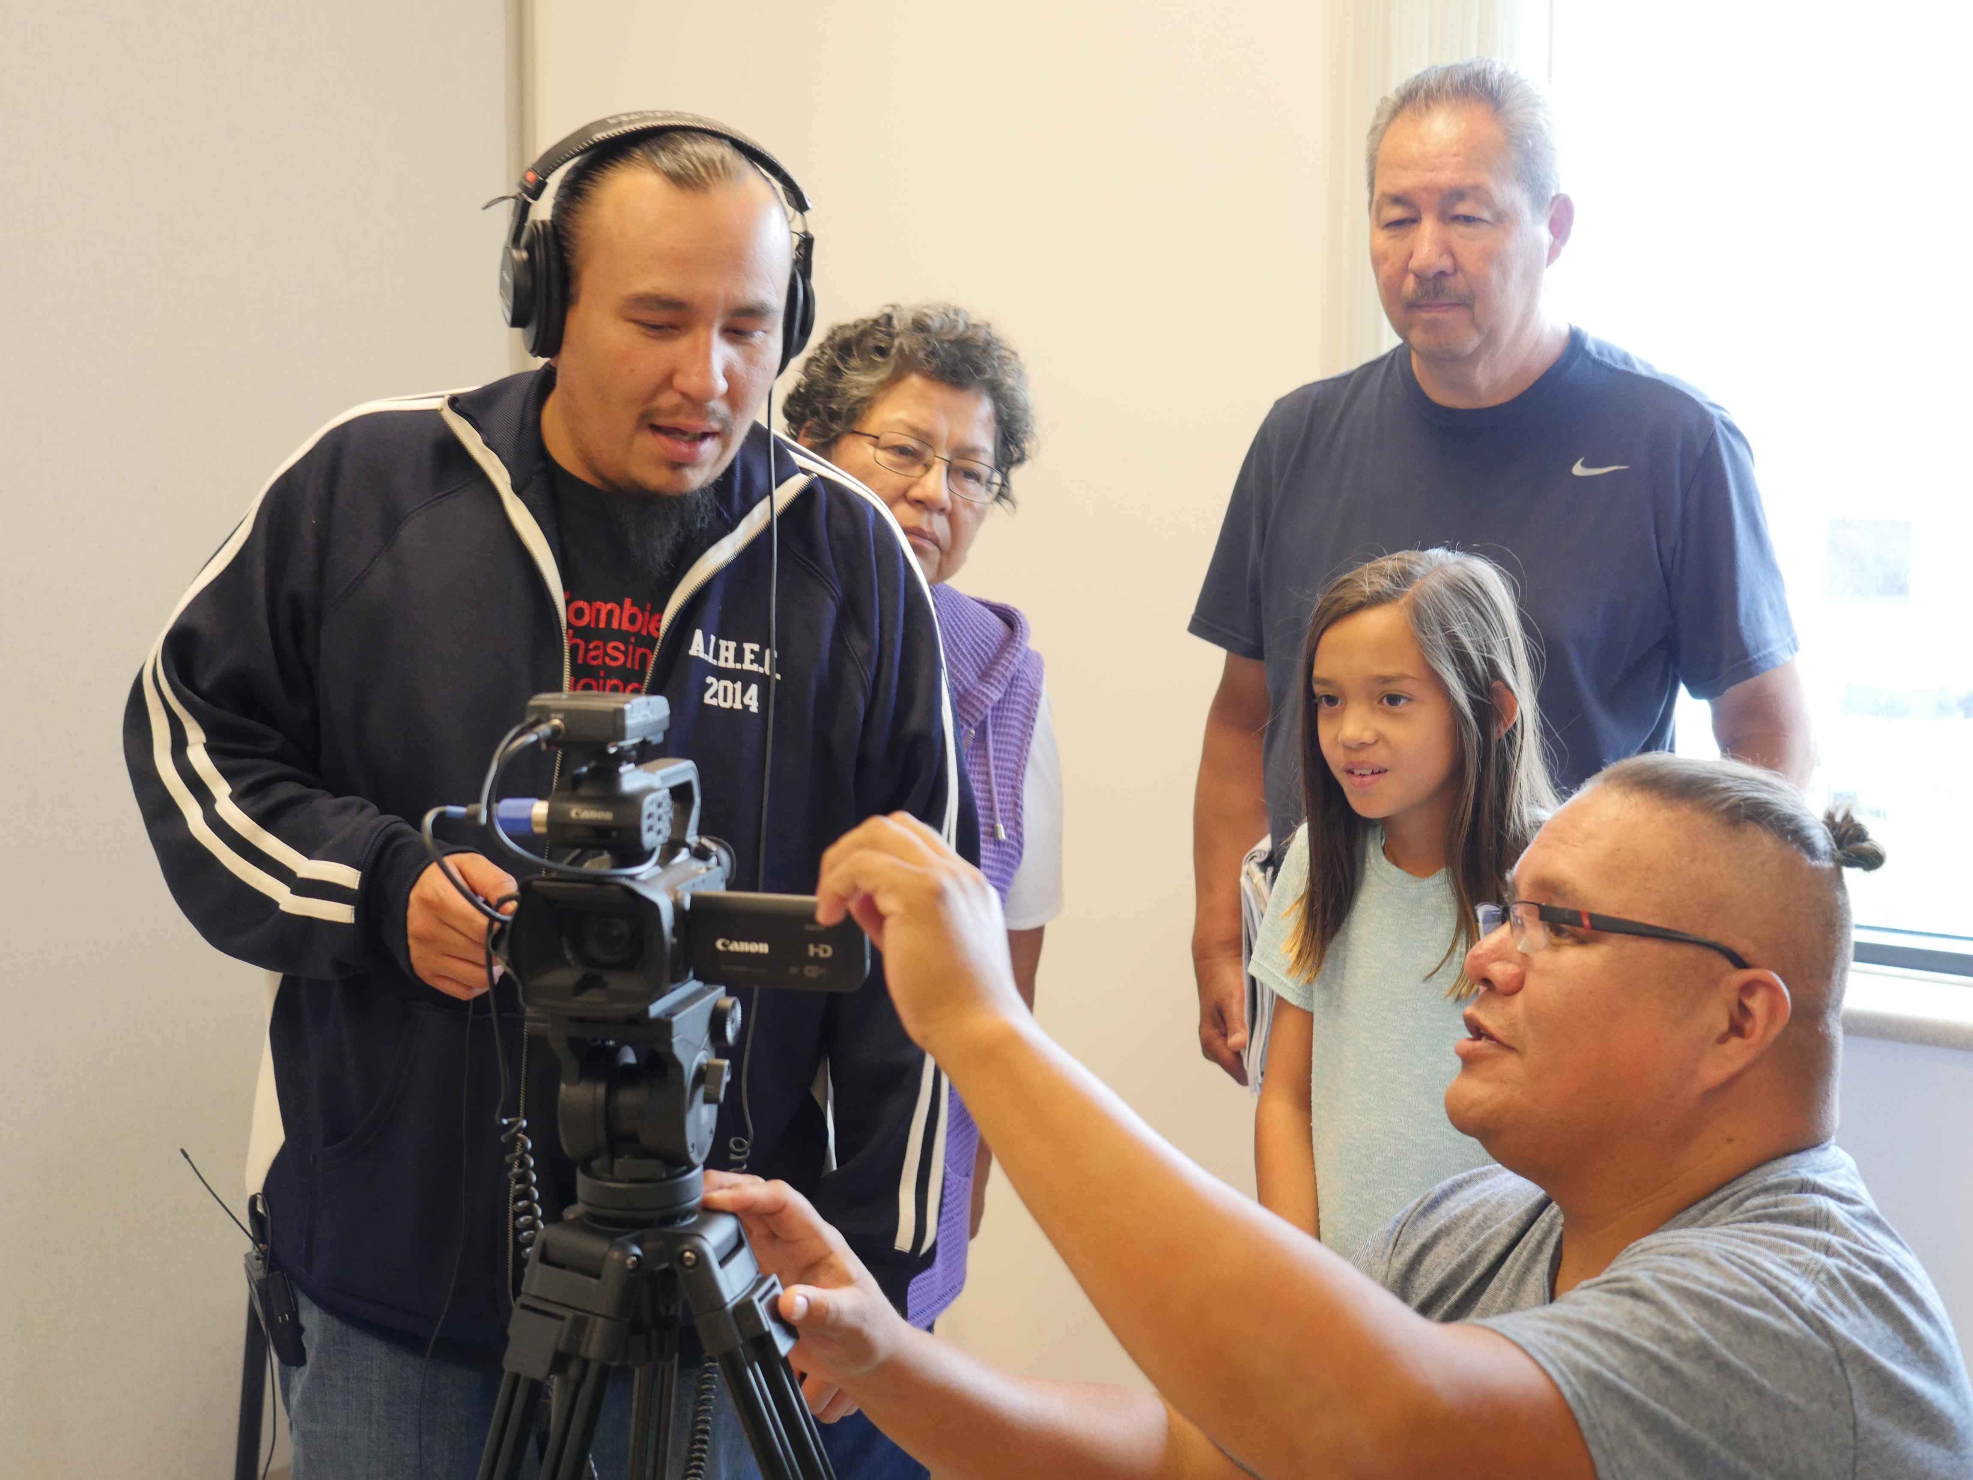
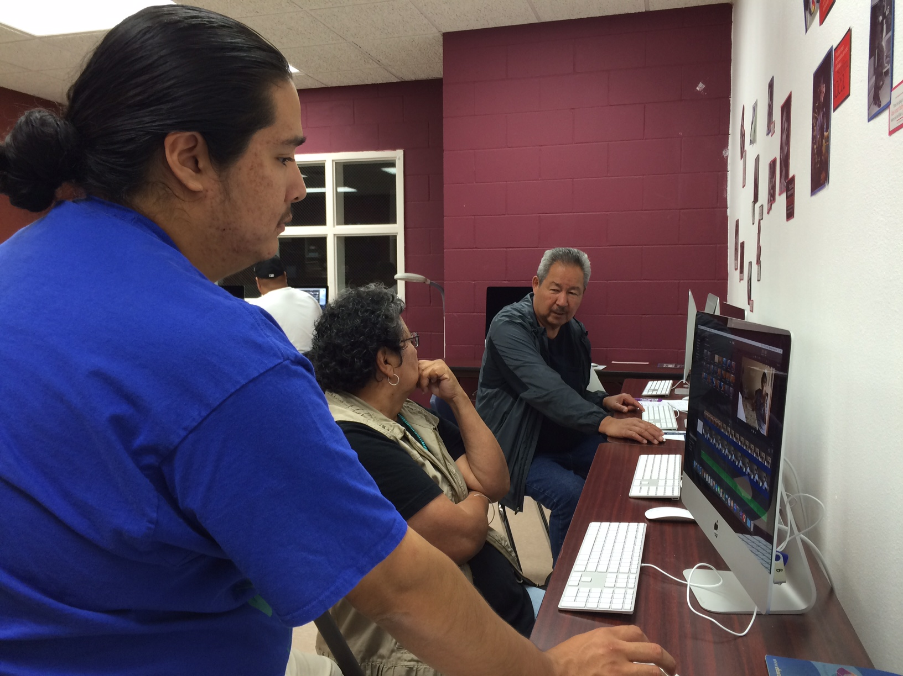
MHA.COLLAB.FILM
MHA Collaborative Film Project
GAT 199: Video Making Workshop
Nueta Hidatsa Sahnish College & University of Colorado - Boulder
Notes:
For the Workshop leader: What to know before you get started
More detailed information is in the teacher manual and at the Project website.
How it came about: This collaborative film project was suggested as a sequel to an earlier oral history project and documentary film about Rev. Harold Case and the Garrison dam (the video is online here). Film screenings and discussions with community members led to the idea of community based video workshops, where MHA community members can learn to make and edit videos themselves. MHA community members are interested in representing themselves and their perspectives in the media. This project has been developed in partnership between staff at the University of Colorado in Boulder, CO; Nueta Hidatsa Sahnish College in New Town, ND; and Dakota Media Access in Bismarck, ND. Workshop participants will be able to view and share their work online and on community access cable television.
Contacts
MHA Collaborative Film Project Website: http://mhacollaborativefilm.weebly.com
On Facebook: https://www.facebook.com/mhacollaborativefilm/
On Vimeo.com: https://vimeo.com/mhacollaborativefilm
By Email: mhacollaborativefilm@gmail.com
University of Colorado - Boulder
The funding for this workshop/film project is provided by a Seed Grant from the University of Colorado - Boulder. Jen Shannon is a Curator & Associate Professor of Cultural Anthropology. Chris Hammons is an ethnographic filmmaker and instructor in the Department of Critical Media Practices.
Jen: 303-919-5022; jshannon@colorado.edu | Chris: 626-590-0907; christian.hammons@colorado.edu
MHA Nation-based partner: Nueta Hidatsa Sahnish College
Continuing Education Units (CEU credits) are available through the NHSC. Kerry Hartman is Academic Dean of the College. The Credits are for a GAT 199 course, MHA Video Making Workshop under Shannon Fox, instructor of Graphics Arts and Technology. Kerry: khartman@nhsc.edu | Shannon: sfox@nhsc.edu
Dakota Media Access
Dakota Media Access is helping to plan the content of the workshop and will provide equipment for filming. They will also air workshop produced content on the Bismarck community access cable channel. Jim Kambeitz is the Production Manager. Jim Kambeitz: 701-258-8767; jimk@freetv.org
Local Workshop Facilitators
Justin Deegan: 701-421-3290; justin@thunderrevolution.com
Elijah Benson: 612-708-8459; elijah.benson89@gmail.com

Slide 2
Welcome to the
MHA Video Workshop!
Documentary Film – Stories from your own experience
What I see, hear, taste, smell, experience, feel, love, am frustrated by, want to change, envision in the future, what I dream...Where did I come from…Where I live now...Me, my family, my friends…
Notes:
Comment: Fiction or non-Fiction, we just hope it will speak to your experience. Truth telling comes in many forms.

Slide 3
DAY 1:
PRE-PRODUCTION
Review videos, get to know each other, come up with some ideas!

Slide 4
Welcome!
Review of what to expect this week.
Notes:
day 1: Introduction to the Workshop
Workshop Overview – let everyone know what to expect
INTRODUCE OURSELVES, ASK THEM TO INTRO THEMSELVES AND WHAT BRINGS THEM HERE THIS WEEK.
Welcome -- and let everyone know where the restrooms are and that we will have a lunch break. You are welcome to bring your own lunch if you like; we will provide snacks, fruit, and foods to make simple sandwiches.
Workshop leader and mentor introductions – let everyone know who we are and why we are here
Workshop participant introductions – let the people in the room get to know each other, ask why they’re here, etc.
Film Screening Party – on DAY and TIME; friends and family are welcome to join us!
Some Common Questions
What is a Video Workshop? These are community based workshops that will teach you how to make a short film (around 2-7 minutes). You will work in small groups with a workshop facilitator and several mentors to help guide you through the process of story development, video recording, editing, and then sharing your work with others. These workshops were developed in response to community members' interest in creating media from their own perspectives and in their own voices. With your permission, your work will be aired on Bismarck's community access cable channel, at this website, and at Vimeo.com through the project's website.
Who are the workshops for? Workshops are for any age and are intended for any skill level. We plan to conduct workshops in different areas of the MHA Nation. Bismarck, New Town, Mandaree, White Shield, Parshall, and Twin Buttes are all possible workshop locations. We are also willing to work with community groups or organizations who might want to produce a short documentary about their interests or organization.
Who is sponsoring these workshops? The workshops at MHA Nation are funded by an Innovative Seed Grant from the University of Colorado; the workshops in Bismarck-Mandan are supported by a digital storytelling grant to the Sacred Pipe Resource Center.
Is there a cost to participate? These workshops do not cost you anything. Equipment will be provided.
What will we learn? The workshop is a boot camp style course in film production. You will learn story development, framing shots, using mics and lights, and editing on basic movie editing software. Primarily we will be teaching documentary film making but are open to other suggestions from participants.
What will we be doing every day?  Refer them to the schedule-at-a-glance handout and review it with them. The schedule is subject to change, but this is a basic outline of what we will be doing together.
What happens to the videos we produce? You own the footage you collect during the workshop. Your finished film, with your permission, will be aired on the Bismarck community access channel and online. Should you wish to do anything else with your film (like share it on you tube), that's up to you -- it's your material! We will review sharing options and your preferences at the end of the course.

Slide 5
Workshop Overview
MONDAY | TUESDAY | WEDNESDAY | THURSDAY | FRIDAY
Introduction Sample Films Idea Development | Video Recording Tips Audio and Lighting Tips Interviewing Tips Scavenger Hunt Idea Development Making a Plan | Intro to Editing Editing your film/ Continue shooting | Additional editing techniques Capture additional Footage/Editing | Finish Editing Save and Upload by 3pm 5pm Screening Party!
Notes:
INTRODUCTIONS ALL AROUND!
NOTICE: we develop ideas before we go out with the cameras. Really important to begin with an idea, and then begin shooting your film.
It’s all about options – we show you many options, and your short film develops from the unique set of choices you make, based on your perspective and experience, in shooting and editing your film.

Slide 6
Introductions
Notes:
Now the participants get a chance to introduce themselves. Go around and have each person introduce themselves. Maybe their name, if they’re a kid how old/what grade, and where they live.
Ask each person,
Do you have any filmmaking background? Have you ever worked in video?
Why did you want to take this workshop?

Slide 7
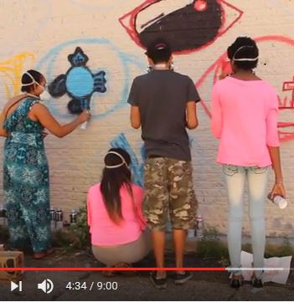
Review of Sample Short Films
(2-10min, same length as yours)
Notes:
Did you like the film? Why or why not?
What aspects caught your eye, or were particularly interesting?
These are short films around the length you’ll be making (2-10minutes). What messages are they able to convey in such a short time – and how do they accomplish that?
Let’s review some of the camera angles, editing techniques...

Slide 8
What makes a good story?
What brings you to the workshop?
Have you done any video or editing work before?
What makes a good story?
Notes:
To make a film, you need to decide the story or subject you want to focus on. What makes a good story?

Slide 9

Film Crew Positions

Producer – makes things happen, like a project manager
Director – calls the shots as they’re happening, person who has the vision and makes decisions
Camera Operator – recording the image
Sound – records the sound (may be same as camera operator)
Editor – reviews and decides which footage to use and what order it should go in to tell the story; they bring it all together at the end, with director’s guidance
One person can do all of these roles, and multiple people can do any single role. Do any of these positions appeal to you more than others? Think about which ones you might like to try.
Notes:
HANDOUT.
There are many different jobs and titles in filmmaking, these are the basic responsibilities to make a film and the roles we will be trying on in this workshop.
Introduce the various roles and responsibilities in filmmaking using the crew positions handout.
Emphasize that the group will be dividing the labor –sometimes you will work together, sometimes you will all be tasked with doing different things in order to accommodate your different interests and to complete the project in time.

Slide 10
Idea Development
First step: Brainstorm!
Second step: Develop your idea taking into account your interests, resources, and time available.
Notes:
Brainstorming Ideas – Workshop Leader, then Mentors with Groups
For Documentary Film, the best way to start is to begin with what you know.
Draw on your own experience, on your experience of the world.
Brainstorm, just throw some ideas out there.
While it is fiction, it helps us understand something real, that the filmmaker has experienced.
Dream big, think small, whatever you like.
Then we can discuss what’s feasible and how to figure that out through developing these ideas into a plan based on what resources you have available (people, transportation, equipment, places, time, etc).

Slide 11

Large Group Brainstorming
Let’s come up with some sample ideas!
Then.. Large group idea development example
We will take one idea and develop it into a plan for a project as an example.
Notes:
Large Group Demo: Let’s throw out some ideas on anything and everything that comes to mind! Workshop leader will then take one example idea, and demonstrate how to “develop” it: how to take the idea and decide whether it’s possible given the resources available, and if so how one might being to make a plan.
(WORKSHOP LEADER MAKES A LIST ON THE WHITE/CHALK BOARD AS PEOPLE SUGGEST THEM, then later circle the one or two that will be developed into a feasible project; group discussion about different possible directions a film about a subject can go)

Slide 12
Small Group Brainstorming!
First, introduce yourselves – you will be working together throughout the week.
Do you have any filmmaking background?
Why did you want to take this workshop?
Brainstorm some ideas that you might have for a short film; come to consent as a group about which ideas you’d like to develop.
Notes:
Small Group, Introductions and Brainstorming with Mentor:
First, introduce yourselves – you will be working together throughout the week. Brainstorm some ideas that you might have for a short film; come to consent as a group about which ideas you’d like to develop.

Slide 13

Small Group Idea Development

What is the goal/purpose of the video? Who is your intended audience?
What is it about?
What is the content/information you want to convey?
What is the creative approach you want to take?
    Narrative Style: Voice over with pictures explaining the story
    Documentary Style: Let others tell the story with testimonials, interviews, etc.
    Drama Style: Use actors with directed action to tell the story
What do we have to work with - what are resources, places, people do we have access to in the next few days?
What do you hope the viewer will think or feel afterwards?
Notes:
HANDOUT – no need to go over the slide, it’s just a placeholder as people write on the worksheet to develop their ideas.

Slide 14
Overview of Your Film

Goal of your Film:
Audience:
Creative Concept:
Length: 5-10 minutes
Production Schedule: Video should be ready to play in five days
Responsibilities: (roles can be shared; it’s just important that each role is filled, and that everyone knows who is responsible for each)
  Producer(s):
  Director(s):
  Camera/Sound:
  Editor(s):
Notes:
HANDOUT – again, just a placeholder as people write on their worksheets.

Slide 15
Make a Plan
Identify the next steps to your project.

Slide 16
Potential Locations and Interviewees

Discuss and write down
Subject matter of film: _______________________________________
Intended audience: __________________________________________
Potential locations/events for capturing footage:
Potential people to interview:
Notes:
Potential Locations and Interviewees – Mentors with Groups
 HANDOUT Make a list of potential locations and people to contact for the film.
Divide up group members responsibilities for scouting later in the day (some will call or visit with potential interviewees, others will scout film locations)
MAKE CALLS, SCOUT LOCATIONS.

Slide 17
DAY 2: PRODUCTION BEGINS
Learn how to use the camera, go out and start shooting some video!

Slide 18
Workshop Overview
MONDAY | TUESDAY | WEDNESDAY | THURSDAY | FRIDAY
Introduction Sample Films Idea Development | Video Recording Tips Audio and Lighting Tips Interviewing Tips Scavenger Hunt Idea Development Making a Plan | Intro to Editing Editing your film/ Continue shooting | Additional editing techniques Capture additional Footage/Editing | Finish Editing Save and Upload by 3pm 5pm Screening Party!

Slide 19
Review from Yesterday
What are the film ideas you decided to work on?
Did you contact anyone for interviews, or find any good locations?
Any questions?

Slide 20
Video Recording Tips
Framing shots and camera angles.

Slide 21


Some Vocab: Shots, Scenes, Sequences

Story:
My Dream Vacation Finally Came True!
(Traveling to Egypt to visit the Pyramids)
SHOT
(press start to press stop)
SCENE
(all at pyramids)
A SEQUENCE
(planning trip, going to pyramids, back home)
Notes:
Guardians of Eternity: one scene with multiple shots.
SHOT: single, continuous moment (from pressing start to stop recording)
SCENE: a series of shots that represent action in one time and place
SEQUENCE: series of scenes that follow a common story of theme
Shot – from the time camera is turned on to turned off
A continuous shot of Chris and Jen discussing the upcoming workshop in the classroom
Scene – all in one time and place
Scene is inside the apartment talking about the upcoming workshop
Can include shots like
the entrance to the classroom
Chris and Jen sitting at a table talking
Sequence – a series of scenes linked by common storyline or theme (theme: workshop)
Outside of the building then
Two people talking about the workshop (preparation) then
People in the workshop practicing with video cameras (learning) then
People watching a final screening (final product).

Slide 22
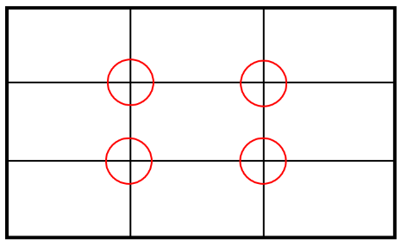
Framing Your Shots: Rule of Thirds

Notes:
You can draw the audience’s attention to something and make them feel a certain way simply through how you frame the image (no dialogue needed to communicate your idea!). “Subject” here can refer to a person, animal, object, etc. – whatever is the main character in the shot.
Framing Your Shot: How you frame your shot communicates to the audience what is important and how they should feel about the subject.
Rule of Thirds
When framing a shot, keep your subject off center – the circles represent good positions for the subject.

Slide 23

Framing Your Shot: Head Room

Ok… Much Better!
Notes:
The first has too much room above the head. If you stick to the rule of thirds, and make sure there is not too much head room, you will naturally draw your audience’s eyes to your subject.

Slide 24
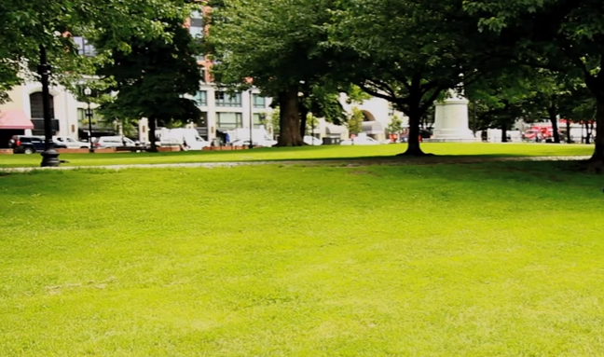
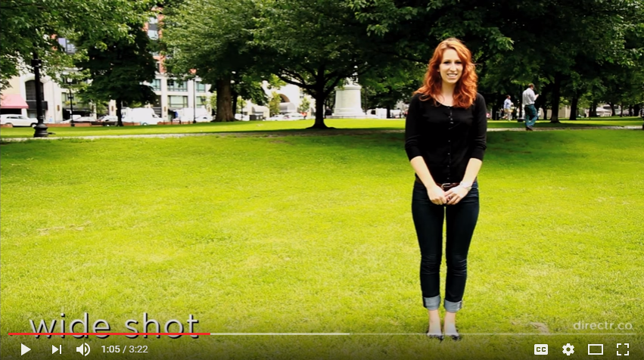
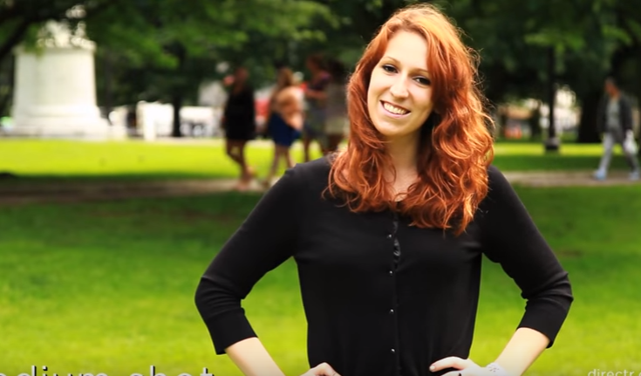
Framing Your Shot

Wide Shot / Establishing Shot
Long Shot
Medium Shot
Medium Close Up
Close Up
Extreme Close Up
Notes:
Review the 2 page handout for Video Recording Tips, with additional information below:
What is the best point of view/camera angle? How much area include in shot? How big should the person be in the shot? As you move closer to the subject, the greater the connection to the audience.
Low connection|---(WS/ES)---(LS)---(MS)---(CU)---(ECU)---| High Connection

Slide 25
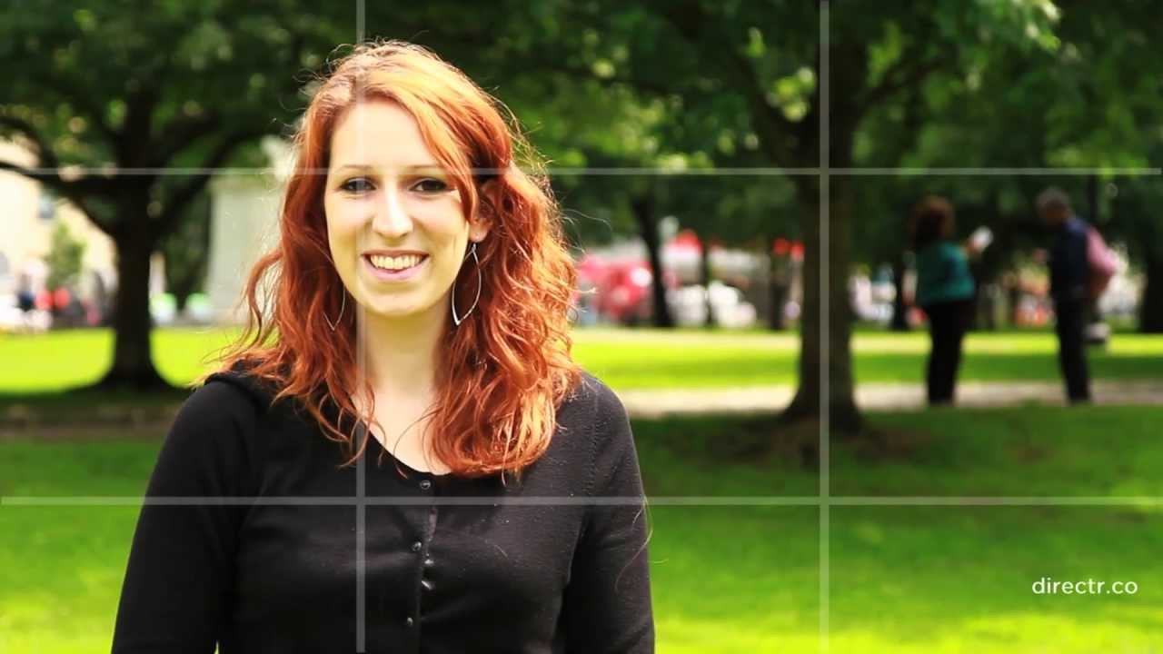
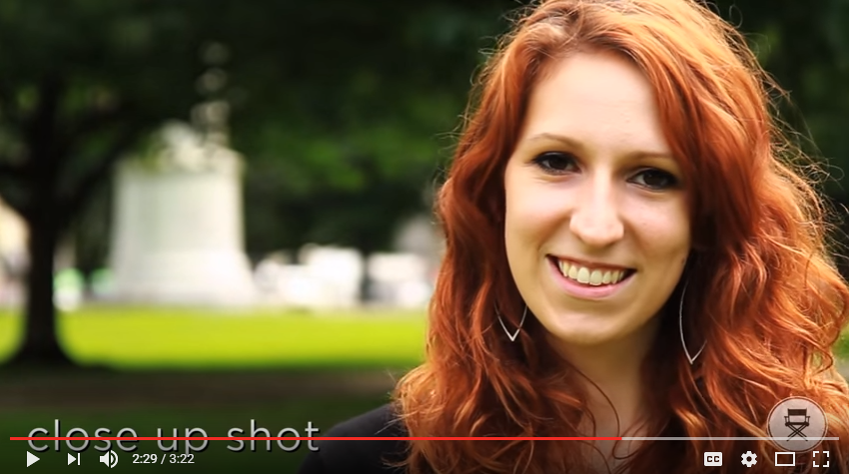
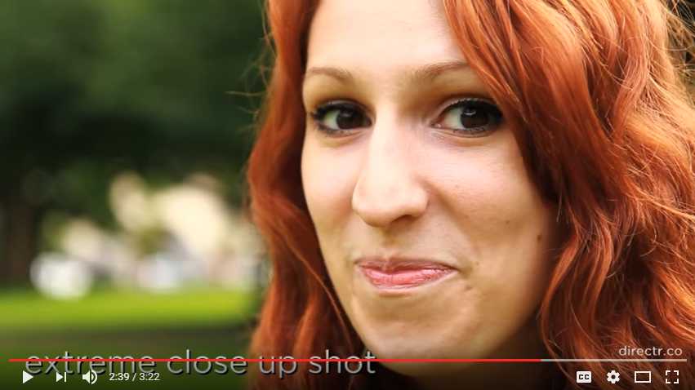
Framing Your Shot

Wide Shot / Establishing Shot
Long Shot
Medium Shot
Medium Close Up
Close Up
Extreme Close Up
Notes:
Review the 2 page handout for Video Recording Tips, with additional information below:
What is the best point of view/camera angle? How much area include in shot? How big should the person be in the shot? As you move closer to the subject, the greater the connection to the audience.
Low connection|---(WS/ES)---(LS)---(MS)---(CU)---(ECU)---| High Connection

Slide 26
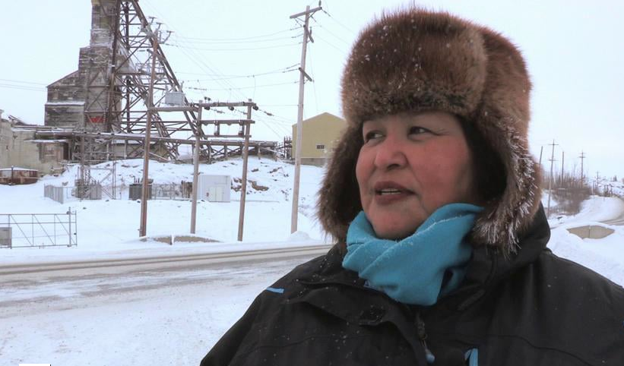
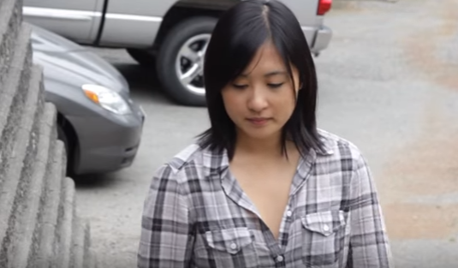
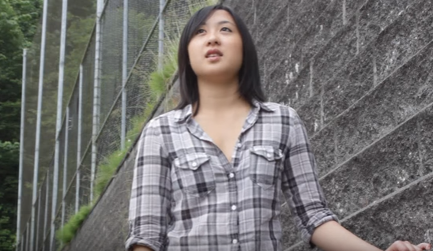
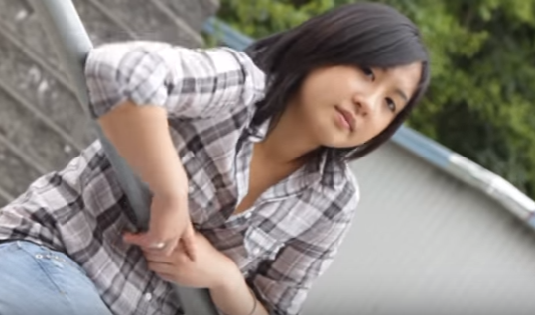
Camera Angles

Neutral/Eye Level Shot
Shot Angle is determined by where camera is placed. Angle really affects what an audience feels when viewing the film. Most shots are done at eye level→ which is a basic, neutral angle.
From Guardians of Eternity
High Angle Shot
Low Angle Shot
“Dutch” Angle Shot
Notes:
High Angle – the camera looks down on subject; appear less powerful, insignificant.
Low Angle – the camera looks up at subject; appear more powerful.
“Dutch” Angle – the camera is tilted, increases tension and uneasiness for audience.

Slide 27

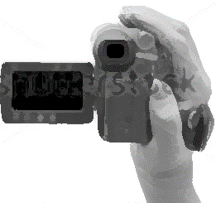
Following a Subject in Motion

How to move the camera
        Tilt
        Pan
        Handheld
        Tracking
Notes:
Keep in Mind:
Frame your shot using the rule of thirds, avoid too much head room.
Have more or less of your subject filling the frame depending on whether it is an “establishing shot” to provide context and how “intimate” you want the audience to feel with the subject.
Consider how you want to angle the camera and how you want to follow motion in any given scene – without words, you can communicate powerful, powerless, frantic, calm, etc.
Tilt: tilt camera lens upwards and downwards while fixed on tripod; tilt vertically
Pan: swivel camera left to right, or vice versa; move horizontally while on tripod
Handheld: hold it in your hand; it can dramatize, make viewers feel excited, unsettled
Tracking: follow subject as they move, often at the same pace

Slide 28
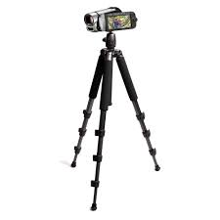
Following a Subject in Motion

How to move the camera
ZOOM
ZOOM TIPS
Best if used on a tripod
Handheld it gets really shaky
Use a zoom to change the frame of your shot, but not during the shot while the camera is rolling (unless you plant to cut it out during editing).
Notes:
Keep in Mind:
Zoom is best used when on tripod
If handheld, get closer to the subject instead of zooming in to avoid lots of shaky footage
Do not use zooms in the edited film; film keeping in mind you will cut those zooms out of the final film.
SOME LESSONS LEARNED:
Hold a still shot for longer than you think (for ex., establishing shot) – at least 10 seconds. Will feel forever while shooting, but too short while viewing if not.
Pan and tilt SLOWLY, slower than you think you should. Again, while viewing it will seem much faster.

Slide 29
Video Tips to Keep in Mind
Frame your shot using the rule of thirds, avoid too much head room.
Have more or less of your subject in the frame depending on whether it is an “establishing shot” to provide context and how “intimate” you want the audience to feel with the subject.
Consider how you want to angle the camera and how you want to follow motion in any given scene – without words, you can communicate powerful, powerless, frantic, calm, etc.

Slide 30
Audio & Lighting Tips
Good sound quality is essential; be creative to get the best lighting possible.

Slide 31

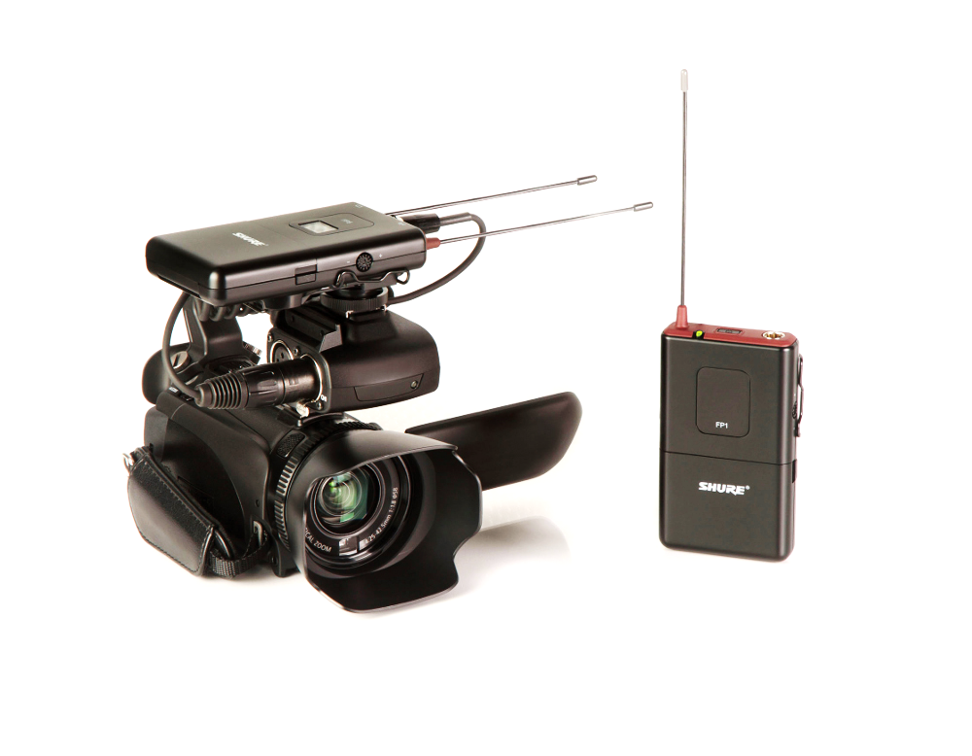
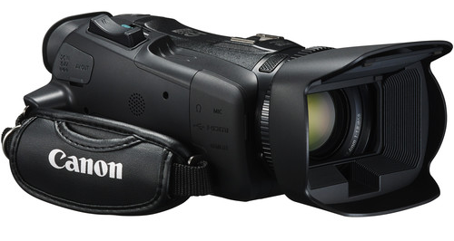
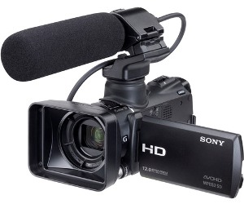

Good sound quality is essential!

Types of Microphones with our gear:
On camera
Lapel/Lavalier, wireless
Shotgun Mic
Always test the microphone! (test while recording, stop, listen to test recording, then start official recording)
Notes:
Review the handout for Audio and Lighting Tips, with additional information below. Do a mock three point light setup, and demonstrate placing a lapel microphone on someone.
When possible it’s best to use microphones and lighting that are external/in addition to the camera. This is not always possible; sometimes you just use what the camera provides and improvise on the lighting!
On camera – it is best to avoid relying on the on-camera microphone when possible.
Lapel/Lavalier, wireless – great for interviews or when you are following someone around. When placing the mic on someone, hide the cord. You may have to slip the cord down their shirt and attached it to the pack as it comes out the bottom of their shirt.
Shotgun Mic– great for on the go, following the action around you. Keep in mind – it will only pick up sound from the direction you are pointing the camera in. So if someone is talking and your camera is pointed away from them, it will not adequately capture their voice.

Slide 32

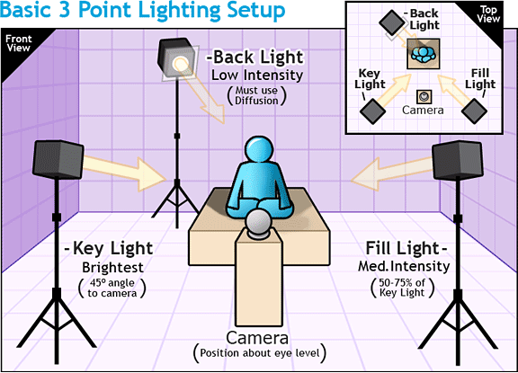
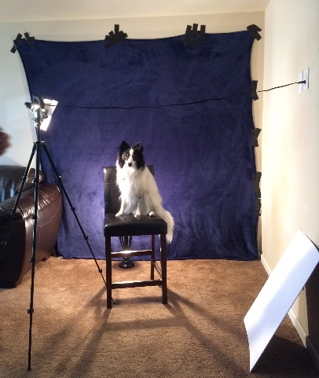
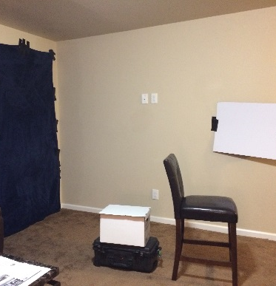
Lighting: Improvise… be creative!

Ideal lighting setup
Notes:
Ideally when you are interviewing, you want Three Point Lighting (see illustration to the left). For our purposes, it’s important that you are aware of lighting and do the best you can. Try to avoid heavy shadows on one side of a person’s face, for instance.
Often can’t get to the ideal… and often not inside! So… BE AWARE OF LIGHTING OPPORTUNITIES, inside or outside, and improvise!
Be Creative, Improvise!
Windows, sunlight, reflectors made out of white poster board, etc. See our recently improvised setup:

Slide 33
Interviewing Tips
Asking permission, asking good questions.

Slide 34

Setting up an Interview
Notes:
USE THE THREE POINT LIGHTING SETUP TO SHOW MIC PLACEMENT AND SAMPLE INTERVIEW, ASKING PERMISSION ETC.
See teacher’s manual for details-
You do not have to use interviews in your film, but here are some guidelines should you choose to.
Overview and Stories
What is oral history, why do we interview?
Class exercise (if with kids)
Lessons learned

Slide 35
Interviews: Some things to keep in mind

Asking Permission
Is the interview location quiet, and comfortable? Inform your interviewee that you will be editing out parts of the interview, so stopping for a bit, clearing their throat, getting water, restating something, is all fine.
Pauses and silence are ok (allow for some silence, let the interviewee time to think or add more)
Respectful listening (don’t worry about your next question – keep listening!)
Taking notes (up to you: some interviewers like to make a quick not for an idea for a follow up question)
What makes a good question? Avoid questions that can be answered with a yes or a no. Consider questions that ask someone to “tell me about,” or “tell me a story about.”
Notes:
Pass out and review the interview tips handout.
Emphasize asking for permission and avoiding questions that can result in “yes” or “no” answers.
Discuss what makes a good interview question, what makes a good interview.
Try to meet the interviewee where they are (language, tone, body language); be respectful, make sure they are comfortable; ask them where a good place to meet would be that is quiet if possible
Explain why you are interviewing them and what you will do with the recording; make sure they know they can stop the interview at any time for any reason.
Let them know what to expect about the subject matter of the interview. Let them know about how much time you anticipate the interview to take (they may extend it while it’s going, but be aware of their body language if they are getting tired).
Ask permission to record before turning on recording device; when you turn it on, identify who you are talking to and ask permission to record again (this is a form of documenting consent).
Have some prepared questions – allow for silences so they can think; don’t be afraid to take a path that leads away from prepared questions through thoughtful follow up questions (that means you have to be listening to them, not just going through your questions).
At the conclusion, while the recording is still going, ask if they want a copy.
Get their basic contact information – this is very important!
Be sure to leave them your contact information.

Slide 36
Interview Preparation (if in your plan)

How will you ask permission?
After you turn on the camera, ask interviewee to state their name and (again) ask if it is ok to record so it is captured on film.
Discuss and write down sample interview questions.
Be sure to ask at the end of the interview:
  Is there anything else you’d like to add?
  Would you like a copy of this recording?
  Would you like to be notified where to find the finished film online?
Remember to get their contact information (address, phone, email) and the proper spelling of their first and last name.
Notes:
Each group can brainstorm questions using the interviewer preparation worksheet.
Once each group has worked out a plan with their mentor, it’s time to go out in the world and start calling or talking to people and scouting potential sites for the film. This is a great time to continue brainstorming film ideas and scenes. This time is also important for the group to get to know each other.

Slide 37
Equipment Review
Time for hands on the camera!

Slide 38
Review the equipment you will use

Each camera set up is slightly different, but they should all have the following equipment:
Camera – review How to record, How to view what you recorded, White balance, zoom, pan
Tripod –always use a tripod when possible
Microphones
  On camera mic – try to avoid relying on this microphone
  Shotgun mic – only picks up good sound in the direction that it is pointed
  Lapel mic – good for interviews or clear sound when walking around with someone
Lights – be aware of lighting issues; improvise and be creative with light sources!
Remember to always test equipment before recording.
Notes:
Break into individual groups with mentors and get to know your group’s specific equipment.

Slide 39
Scavenger Hunt!
Go out and capture some shots!

Slide 40
Capture Basic Shots and Camera Motions

LOCATION 1: ___________________________
Remember: 10 seconds per shot
ES - Wide/Establishing Shot
LS - Long Shot
MS - Medium Shot
MCU - Medium Close Up (ask your subject to explain or describe the location)
CU - Close Up (do the close up of something they described in the location)
ECU- Extreme Close Up
LOCATION 2: ___________________________
Remember: 10 seconds per shot
Medium Shot, from High Angle
Close Up, from Low Angle
Medium Close Up, from Dutch Angle
Choose a different type of shot for each:
Tilt
Pan
Handheld
Tracking
Notes:
Provide the Scavenger Hunt Handout.
Scavenger Hunt! Basic shots and camera motions. Apply rule of thirds to each shot. Stop and start recording again for each list item. Record each for ten seconds. Use a tripod when possible. Check off each item as you complete it:

Slide 41
Review Footage

Slide 42
Idea Development
Finalize your story idea, then make a plan.

Slide 43
Make a Plan for your Project

What is your Script/Story Outline?
Make a Shot List:
IMAGE/SHOT DESCRiPTION/Video | TEXT/Audio
Wide shot of castle, zoom in slowly | Once upon a time, a long time ago...
Notes:
Review the worksheet making a plan – shots and scripts. Discuss and decide what each person’s responsibilities will be during the off site work.

Slide 44
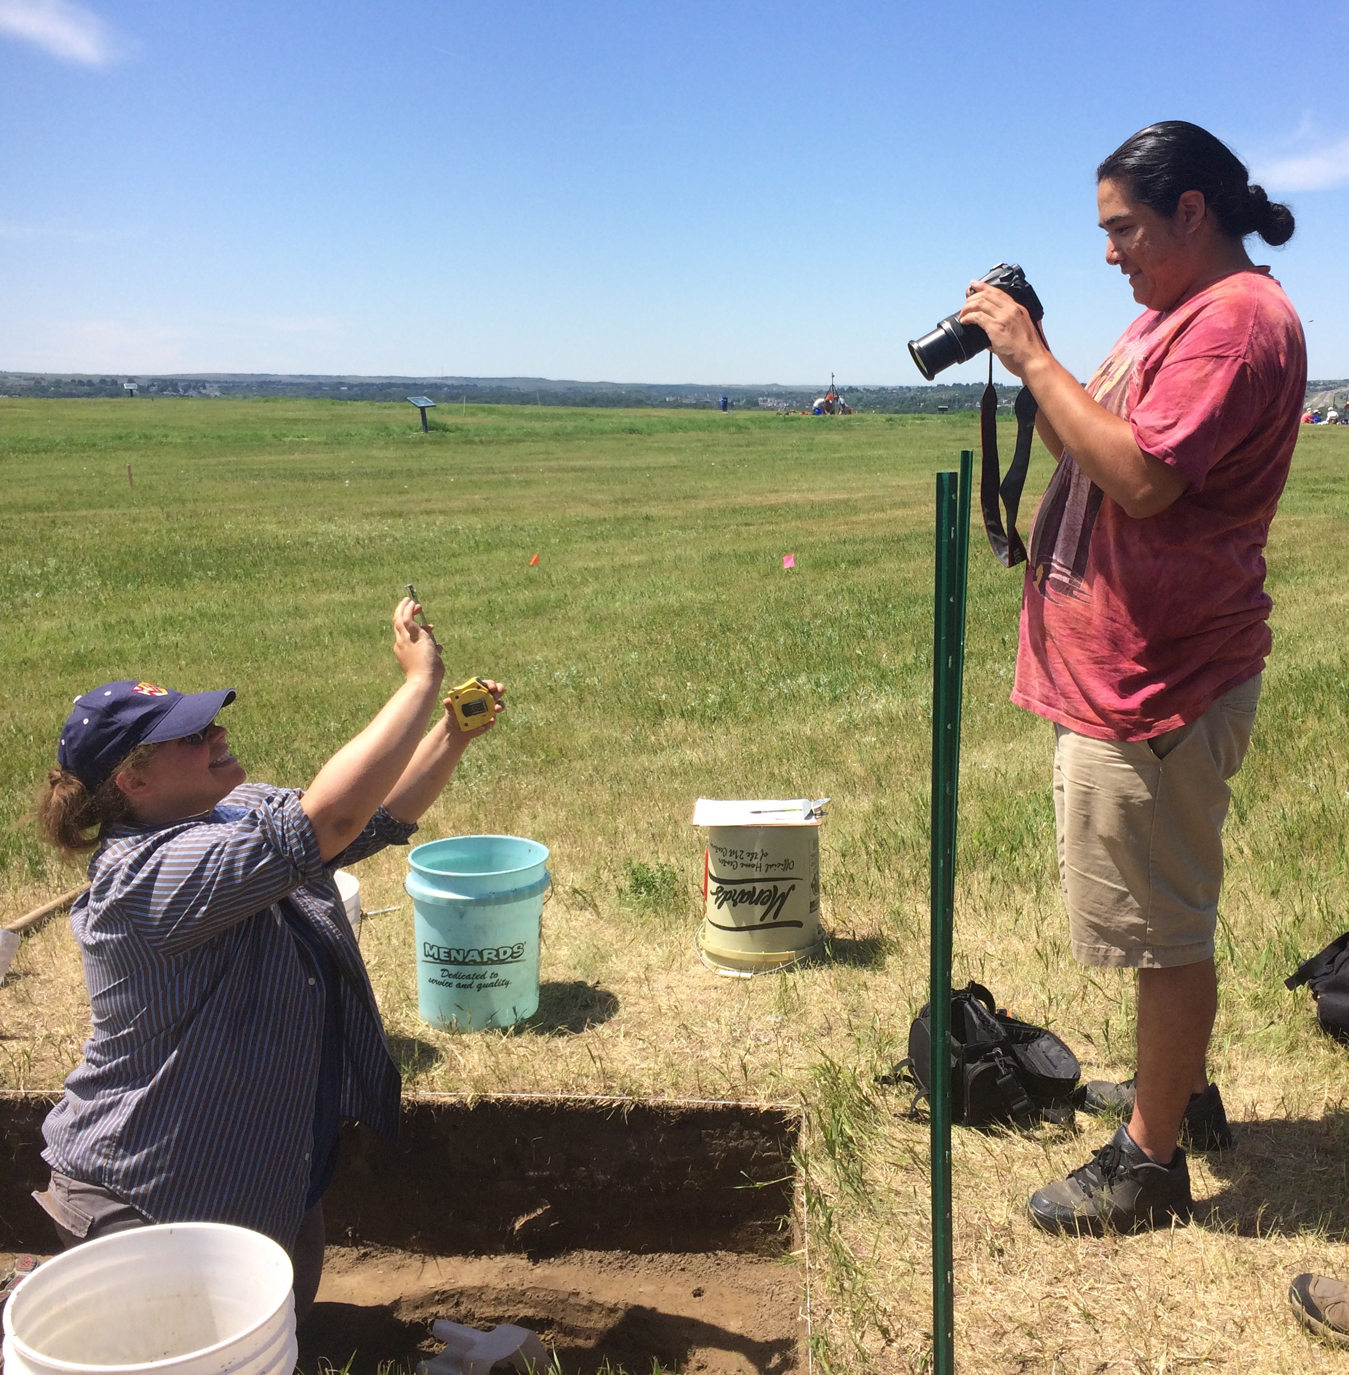
DAY 3: Production Wrap-Up and Begin Post-Production
Shoot video, learn how to edit it.

Slide 45
Review from Yesterday
What did each group decide to focus on?
How did scouting locations and contacting people go?
Any questions or concerns?

Slide 46
Intro to Editing
Learn how to edit your film using clips from your scavenger hunt.
Notes:
Together, review:

Slide 47
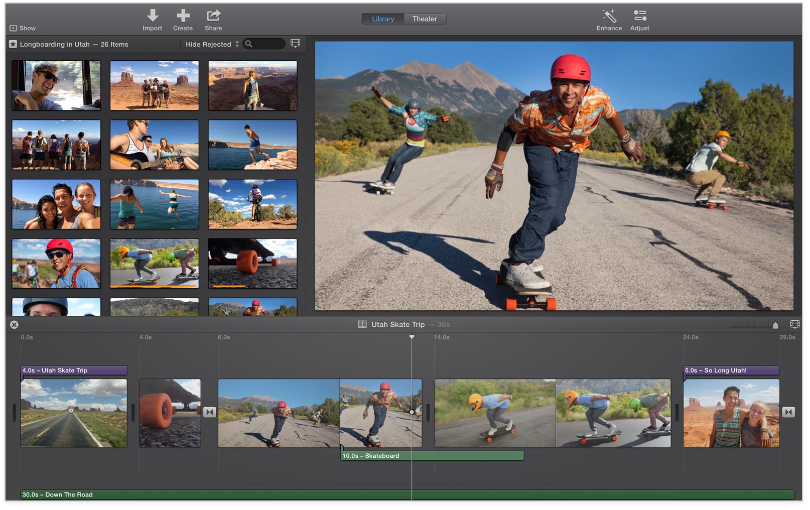
iMovie: Group tour and demonstration
Notes:
Review:
iMovie – what is it and why we are choosing it for the workshop
Files - Opening and Saving Files
Workspace - Tour around the Workspace
Project - Creating a New Project
Basic Editing – Import files; trimming, cutting and moving; titles and credits; exporting to chosen format.

Slide 48
How you will you structure your movie?
Discuss with your mentor:
Is it a story with beginning, middle and end, with characters and a plot?
Or is it something else, like a news story or an oral history, or an argument you are making? Is it experimental or artistic?

Slide 49
Make a Plan for your shots today

What is your Script/Story Outline?
Make a Shot List:
IMAGE/SHOT DESCRiPTION/Video | TEXT/Audio
Wide shot of castle, zoom in slowly | Once upon a time, a long time ago...
Notes:
Review the worksheet making a plan – shots and scripts. Discuss and decide what each person’s responsibilities will be during the off site work.

Slide 50
Go out and shoot!
The rest of the day is dedicated to video recording.

Slide 51
Review some shots
In the group, review some shots you all took before going home.
Notes:
Select one edit you want to share with the group. Make a list of what still needs to be done in order to complete your film: in filmmaking, this is called “Pickups.”

Slide 52
“Pickups”
Make a list of shots or other tasks you need to do to complete your film.

Slide 53
Pickups – a movie “to-do” list

☑ | Task | Person Responsible
Notes:
In your group make a list of things you still need to finish using the pickups worksheet.

Slide 54
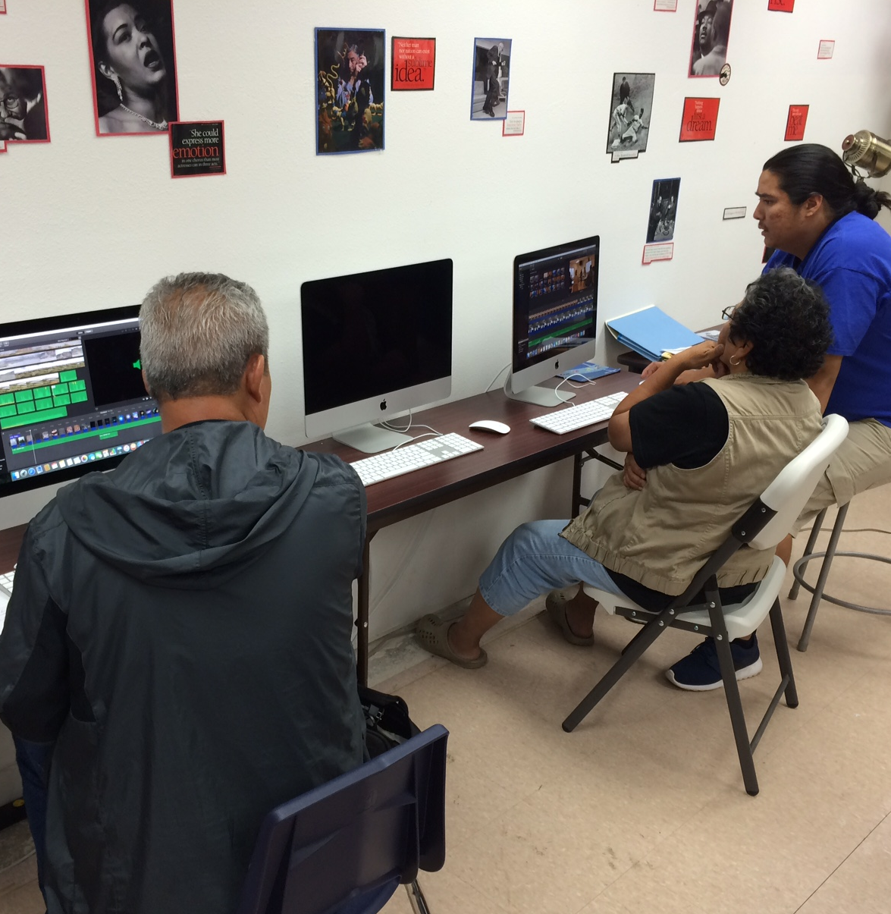
DAY 4:
Post-Production
Editing, voice over, and additional footage

Slide 55
Review from Yesterday
How did your shoots/interviews go?
Did your ideas about the content of the film change from your original plan? Why or why not?
Any questions or concerns?

Slide 56
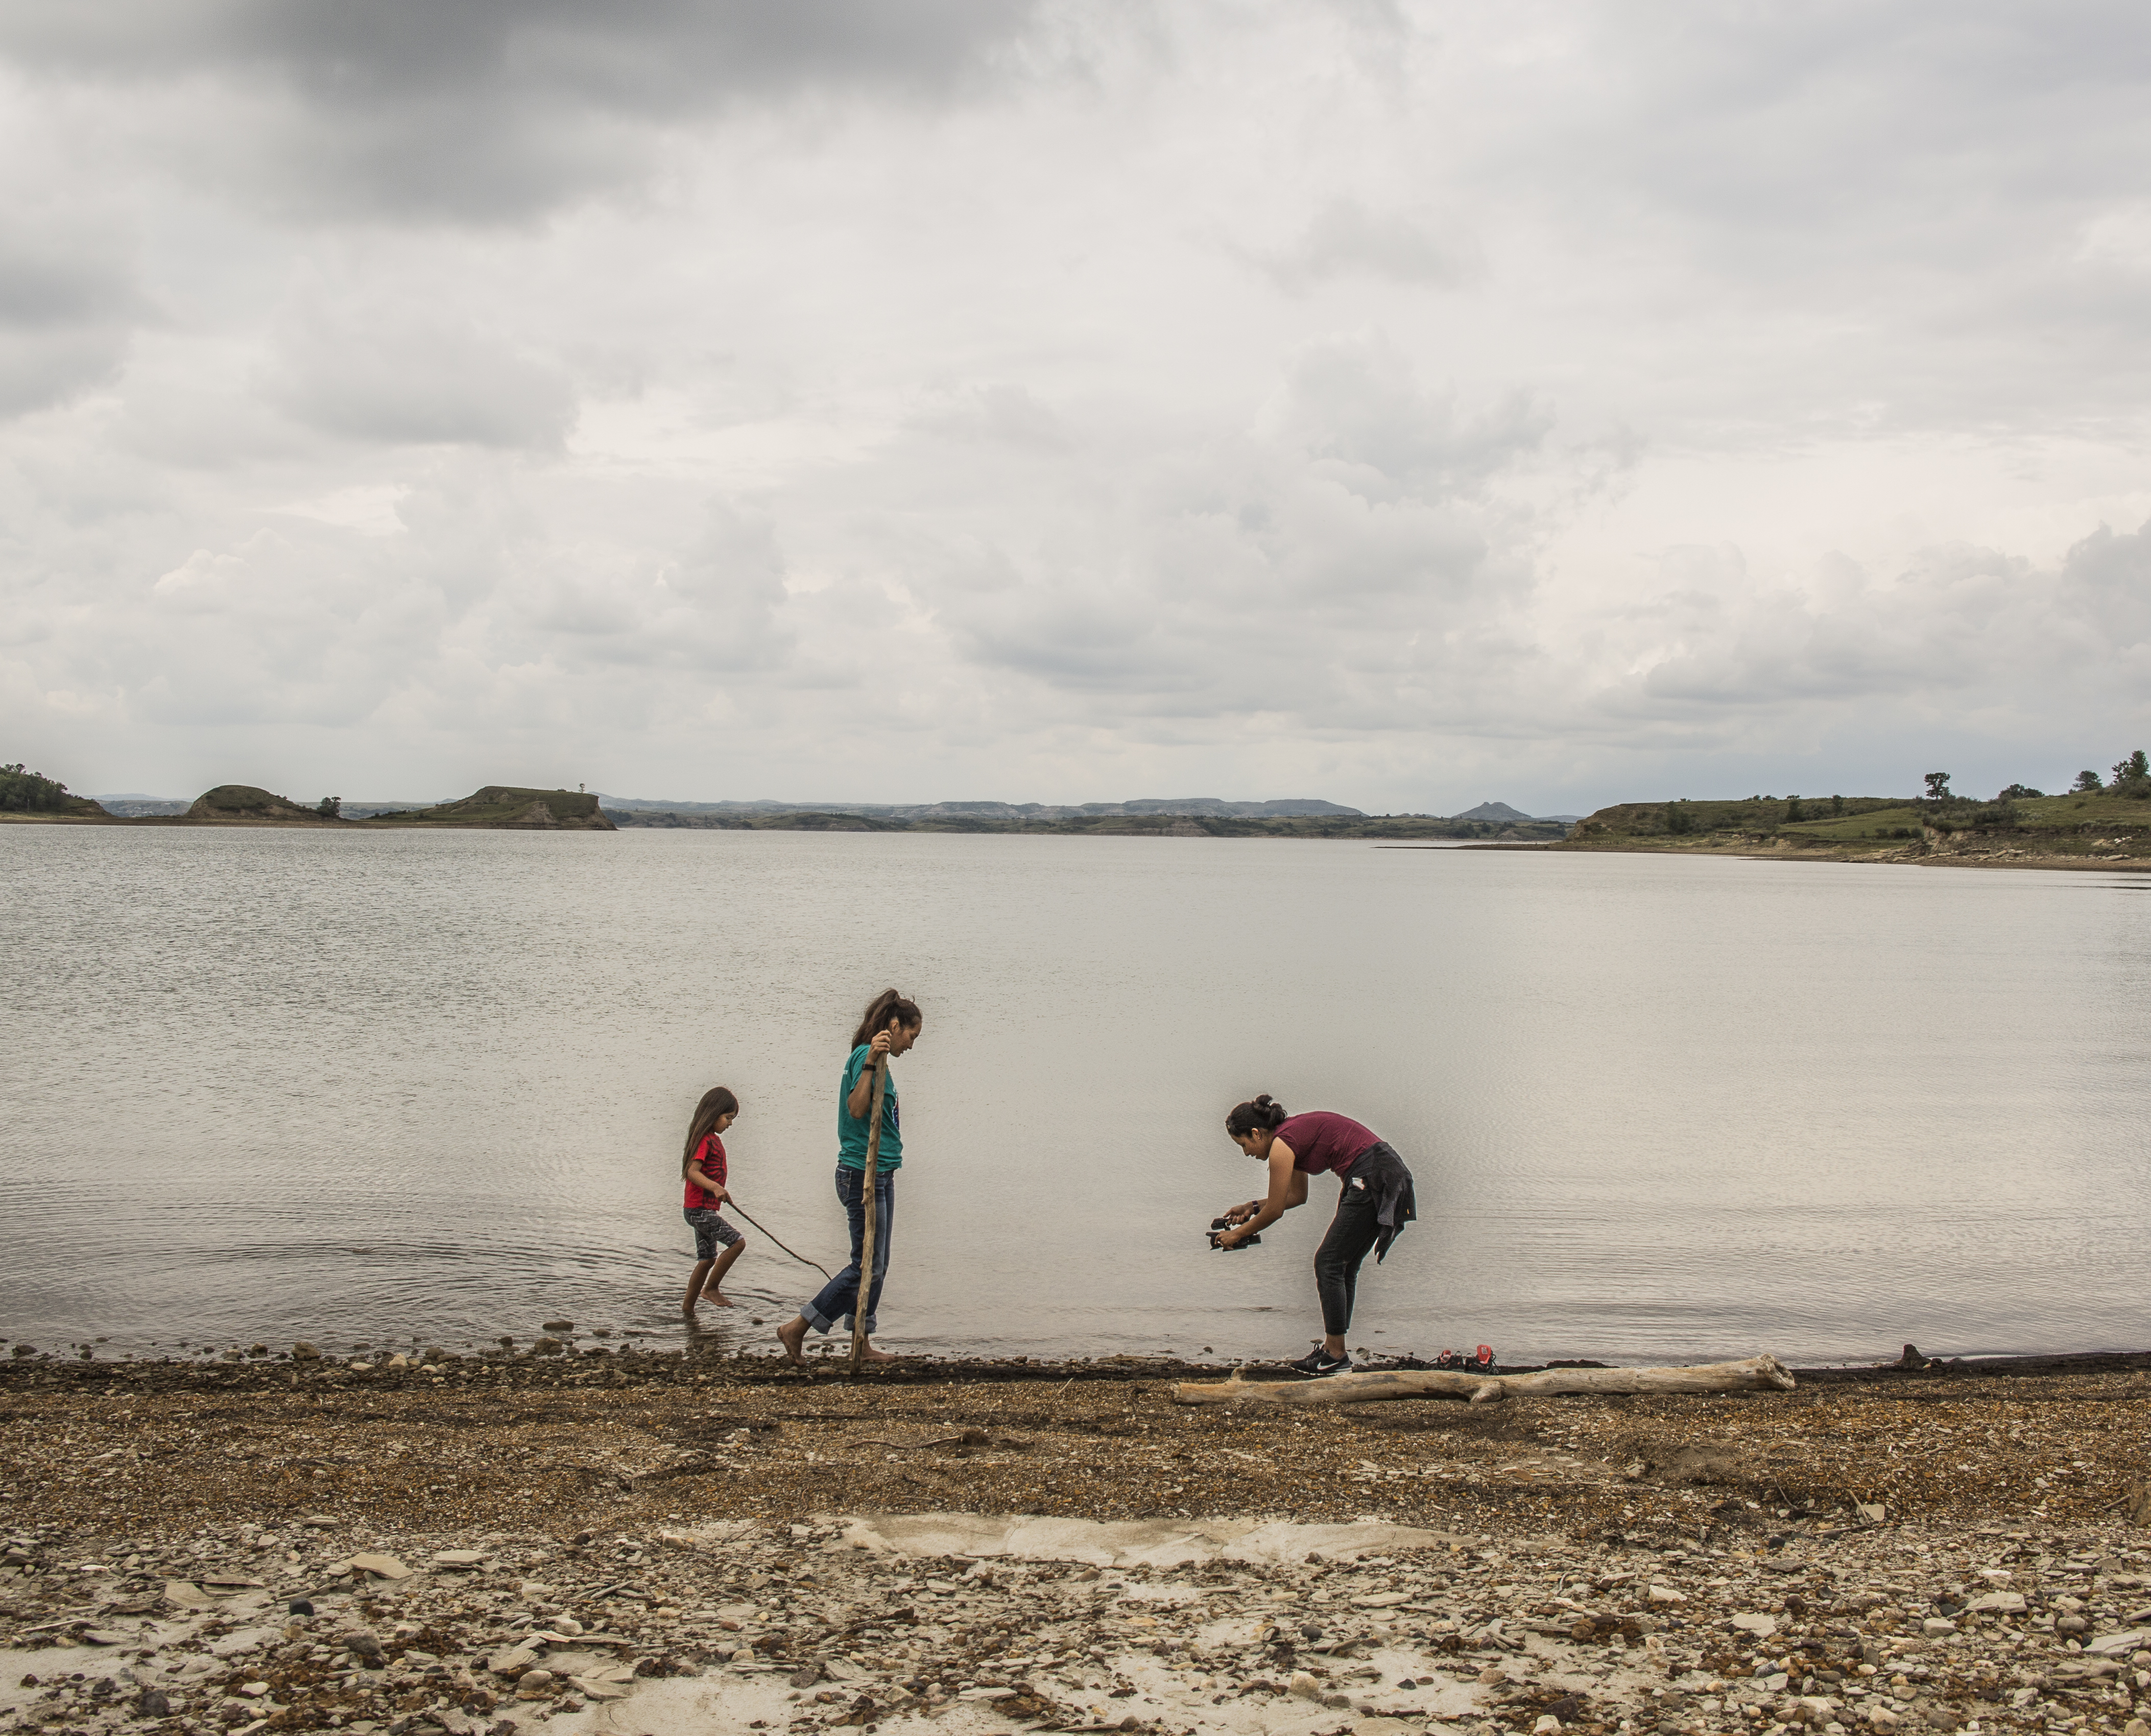
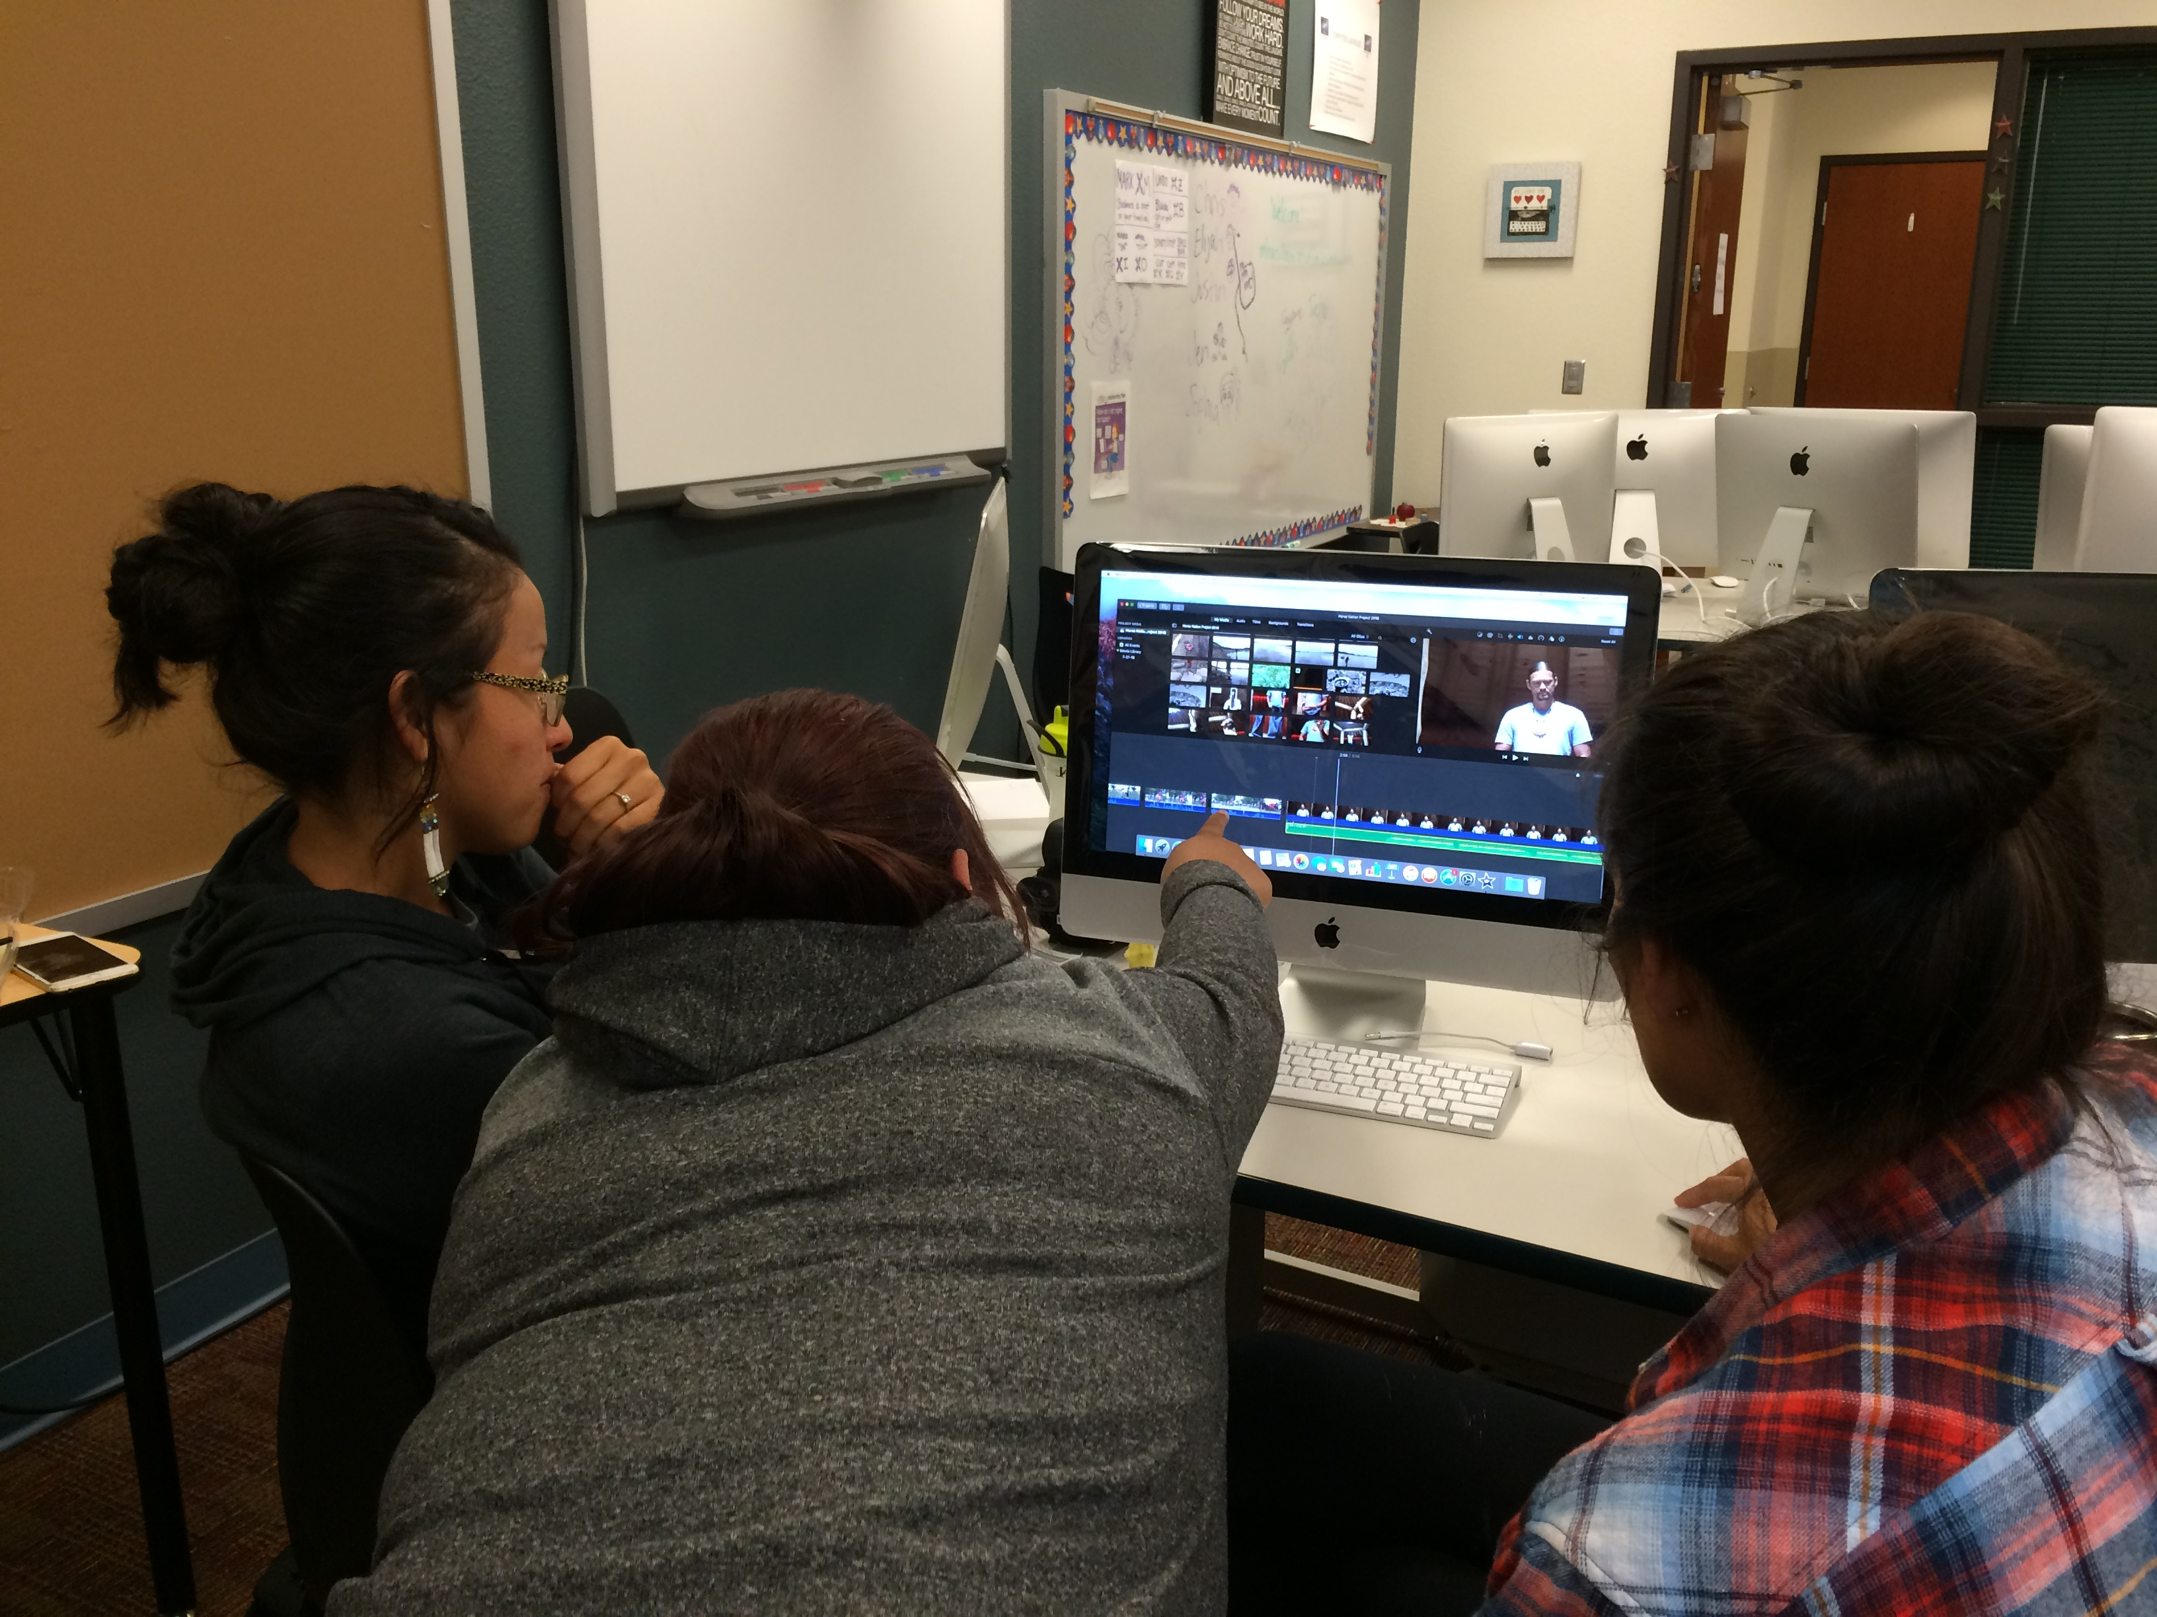
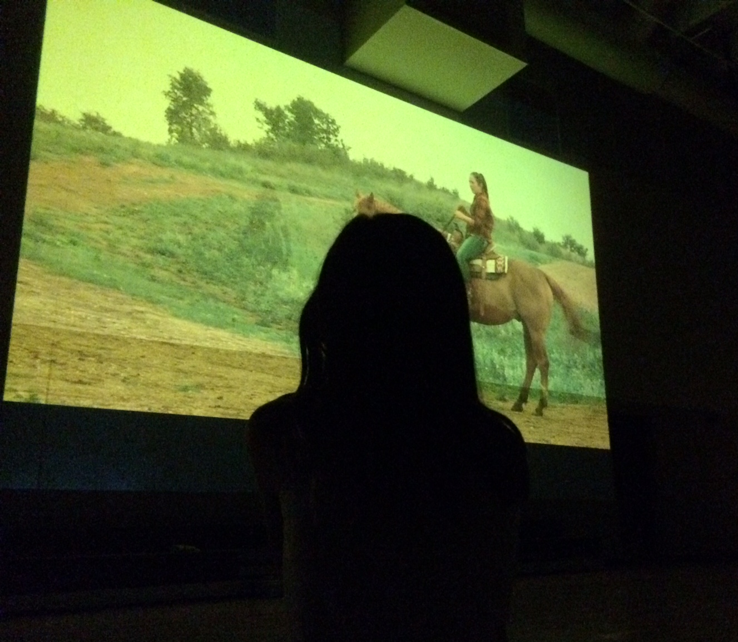
Planning a story to guide your editing:
Creating a simple outline or “treatment”
Imagine the beginning, middle and end of the final film before you start editing (it may change as you go)
Notes:
Based on what you have shot so far: go beyond the topic… what is the story you will tell? (Beginning, middle, end?)
Review again:
Discuss with your mentor:
Is it a story with beginning, middle and end, with characters and a plot?
Or is it something else, like a news story or an oral history, or an argument you are making? Is it experimental or artistic?
It is important to have a plan before you sit down to edit. You have all this footage – consider what story you want to tell using what you have collected. The first story (you can make others later) that you want to tell. It’s important to think about what will be the beginning, middle, and end to your story. Write down a quick outline, or one page “treatment” that describes the general sequence and theme of the story. Two different people editing with the same footage could come out with really different stories based on their choices.

Slide 57
Intro to Editing, Cont’d
Some additional techniques for editing your film.

Slide 58
Additional Editing Techniques
On screen text/titles
Transitions
B roll (visual of what someone is saying)
Cutaways
Voice over
Narration
Music
Still photos
Montage (sequence of images)
Notes:
Discuss with your mentor additional elements will enhance your movie.

Slide 59
Short Cuts in iMovie
CUT COPY PASTE
X C V
UNDO
START/STOP
BLADE
Z
B
SPACE BAR
SELECT PORTION OF A CLIP (upper left)
MARK A PLACE ON YOUR
TIMELINE (lower)
SELECT A CLIP
IN THE TIMELINE
I O E
IN OUT END /
M
A
send to end of
timeline
MARK
ALL

Slide 60
Shooting/Editing
Do what your project needs – start editing, continue shooting… download music, find photos… start editing, decide you need additional footage and go get it…
Notes:
Off site or online as needed. Your group members can split up responsibilities- for example, two people can continue to edit while two go out to get more footage.

Slide 61
Pickups!
☑ | Task | Person Responsible
Create another pickup list for tomorrow.

Slide 62
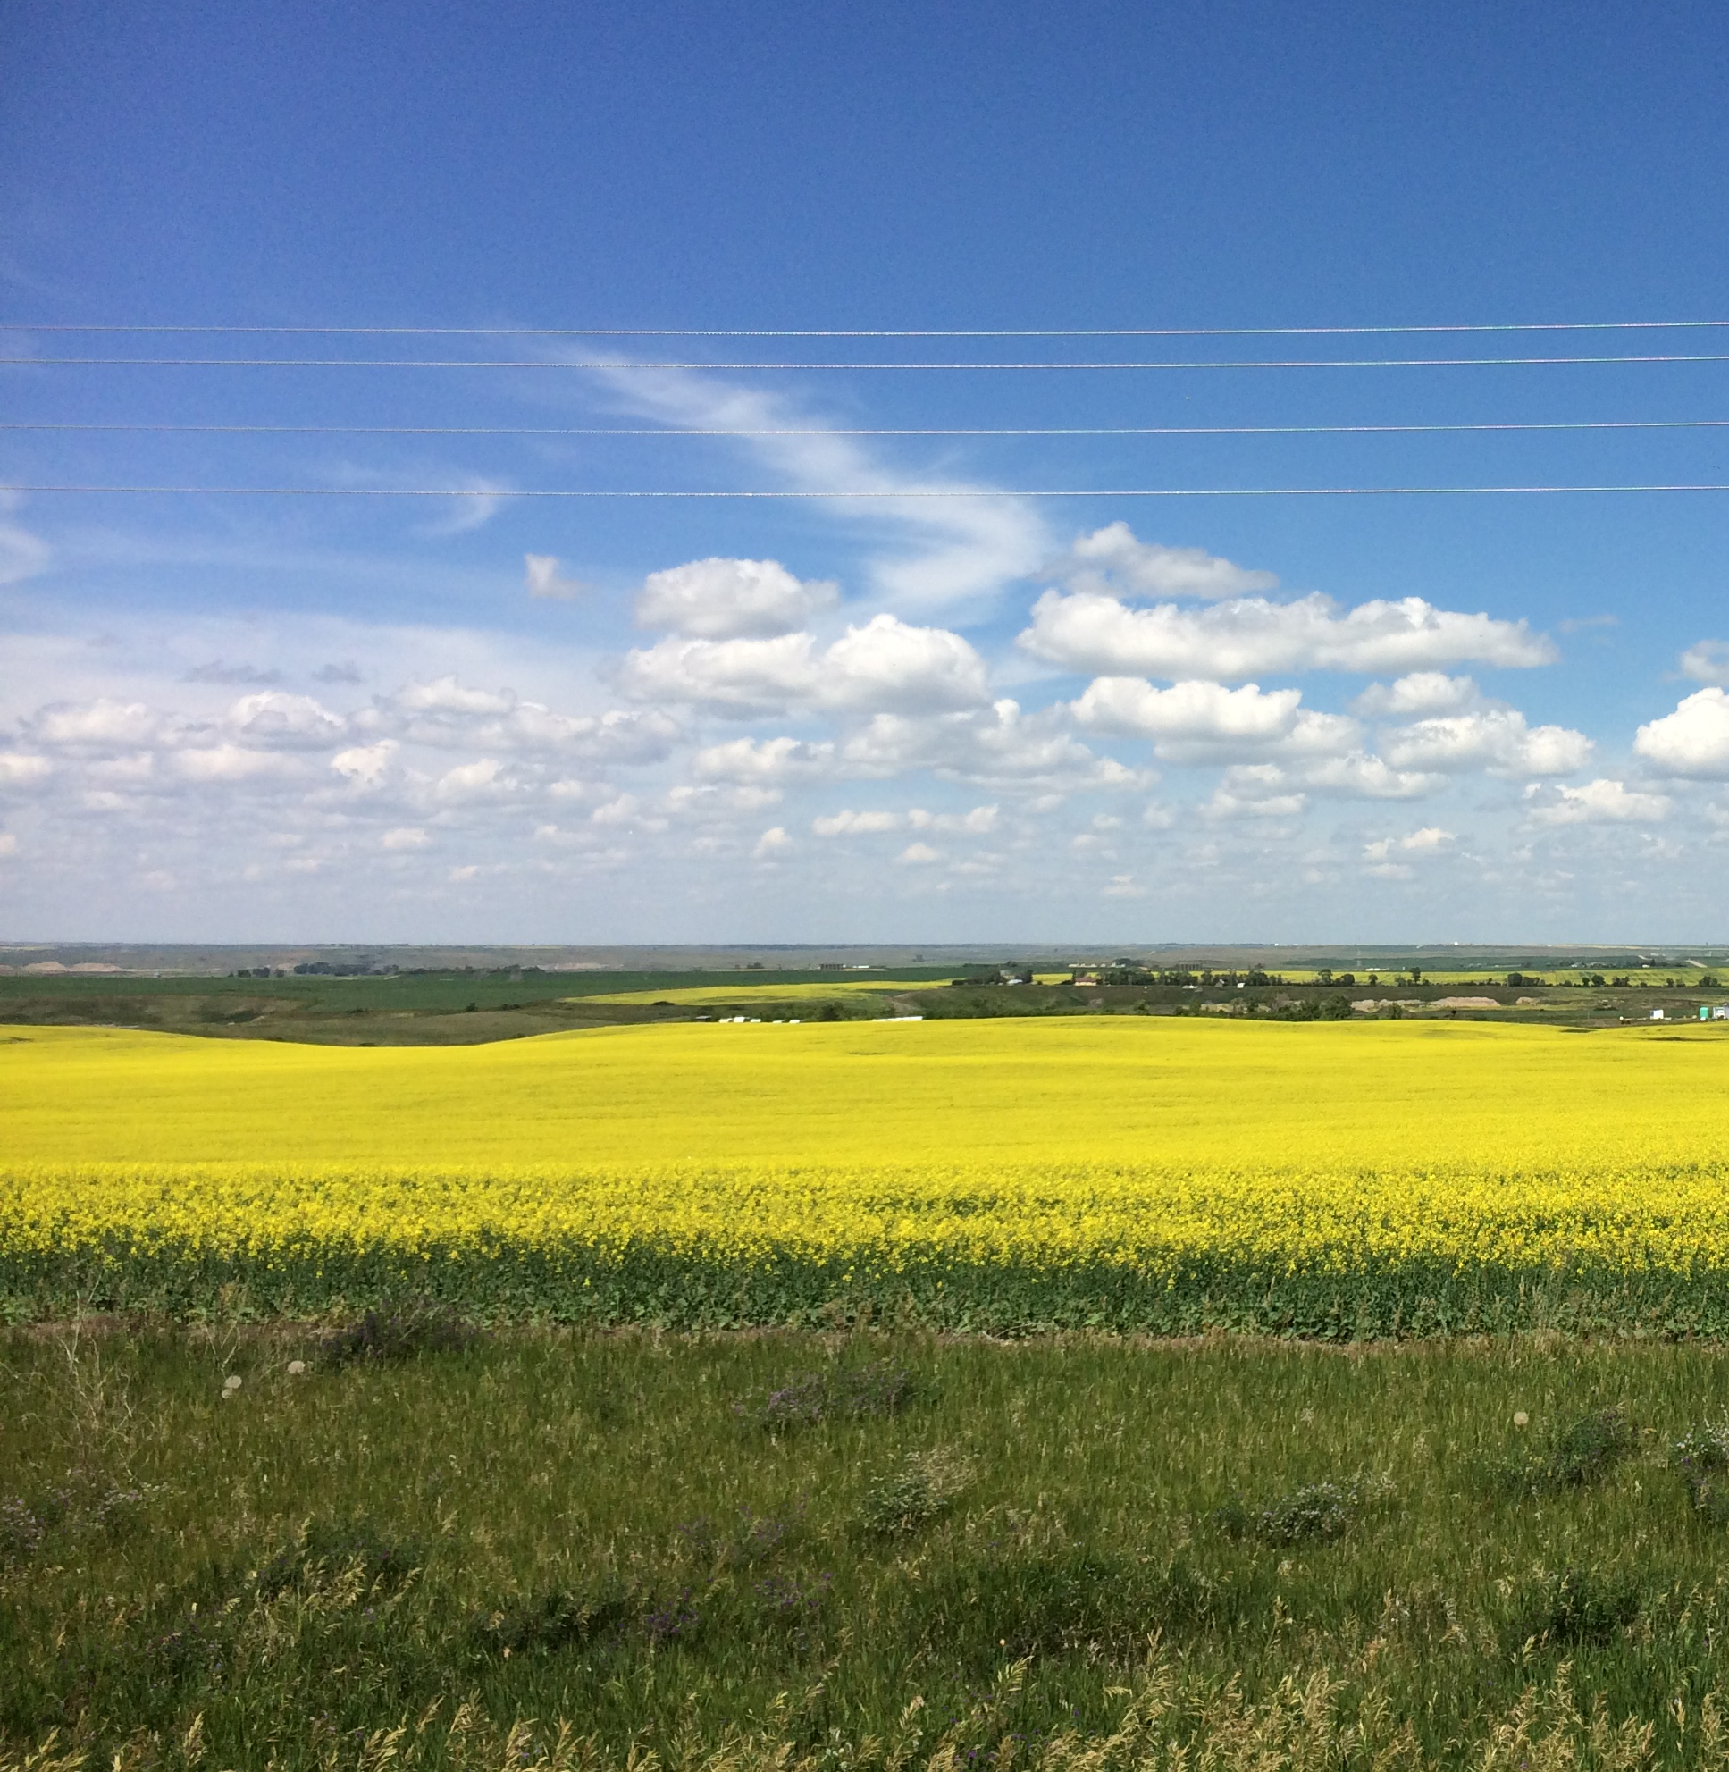

Day 5:
Post-Production and Screening Party!
Finish editing , save and export your project to a film, take a break and return for the screening party!

Slide 63
Short Cuts in iMovie
CUT COPY PASTE
X C V
UNDO
START/STOP
BLADE
Z
B
SPACE BAR
SELECT PORTION OF A CLIP (upper left)
MARK A PLACE ON YOUR
TIMELINE (lower)
SELECT A CLIP
IN THE TIMELINE
I O E
IN OUT END /
M
A
send to end of
timeline
MARK
ALL

Slide 64
Review from Yesterday
How did editing go?
What were some challenges, some surprises in the process?
Any questions or concerns?

Slide 65
Finish Editing
& Export
Complete editing your film and export it as a movie file (mp4). Review sharing options with your mentor.
Notes:
Your mentor will walk you through this export process.
During the break (3-5pm), you USB drive will be organized and everything saved by a mentor.

Slide 66
Complete Some Worksheets

Film Title and Summary Worksheet
Brain storm and decide your film’s title.
As you complete the editing process, be sure to add the title to the start of your film.
In a few sentences, describe what your film is about and turn in the worksheet.
Credits Worksheet
Name your: Director, Editor, Camera, Sound
Name people you interviewed, and cite any music or materials you used
List any thank yous
*Sharing Workshop – IMPORTANT *
Indicate the ways in which you want your film to be shared.
Notes:
Don’t forget to add credits at the end of your film.
Fill out the credits worksheet and the title worksheet and add them to your film. Please turn in these worksheets to your mentor.
Fill out the form about where and how you want to share your film. THIS IS VERY IMPORTANT, it includes your contact information and your wishes as to how your work is used and shared.
Be sure to give the students the contact information, permissions form, and the filmmaking with smart phones handout... and offer to follow up with them if they want to continue doing filmmaking!

Slide 67
Want to make more movies?
How can you continue making films? Check out the two handouts that include our contact information and ideas for shooting and editing
videos to make films with a smart phone!
Notes:
Give the contacts and smart phones handouts.

Slide 68
Film Screening Party!
Introduce yourself and your film and enjoy!

Slide 69

THANK YOU!!
Website: mhacollaborativefilm.weebly.com
Facebook: mhacollaborativefilm
Vimeo: vimeo.com/mhacollaborativefilm/
Email: mhacollaborativefilm@gmail.com
Snapchat: mhacollabfilm
Instagram: mhacollaborativefilm

Slide 70
References for teaching materials
Information in this document was compiled from a number of sources and people, including:
Dakota Media Access Production Manager Jim Kambeitz
Workshop mentors Jen Shannon and Chris Hammons
Stills and Content for Framing Your Shots came from:
"Directr's Notes: Framing your Shot," https://www.youtube.com/watch?v=NuhWNJr89u8
"6 Minute Film School - Basic Composition,” https://www.youtube.com/watch?v=Sl6iZBDS3gc
"Directr's Notes - Camera Movement," https://www.youtube.com/watch?v=JmylOrUV56U
Some information was inspired by or adapted from video production guidelines and resources:
Lights-Camera-Action: The Power of Media, by Community Access Television freetv.org
http://web.mit.edu/techtv/videoprodguide/videoprodguide.pdf
http://kidsvid.4teachers.org/
http://www.steilacoom.k12.wa.us/Page/1867

