Slide 1
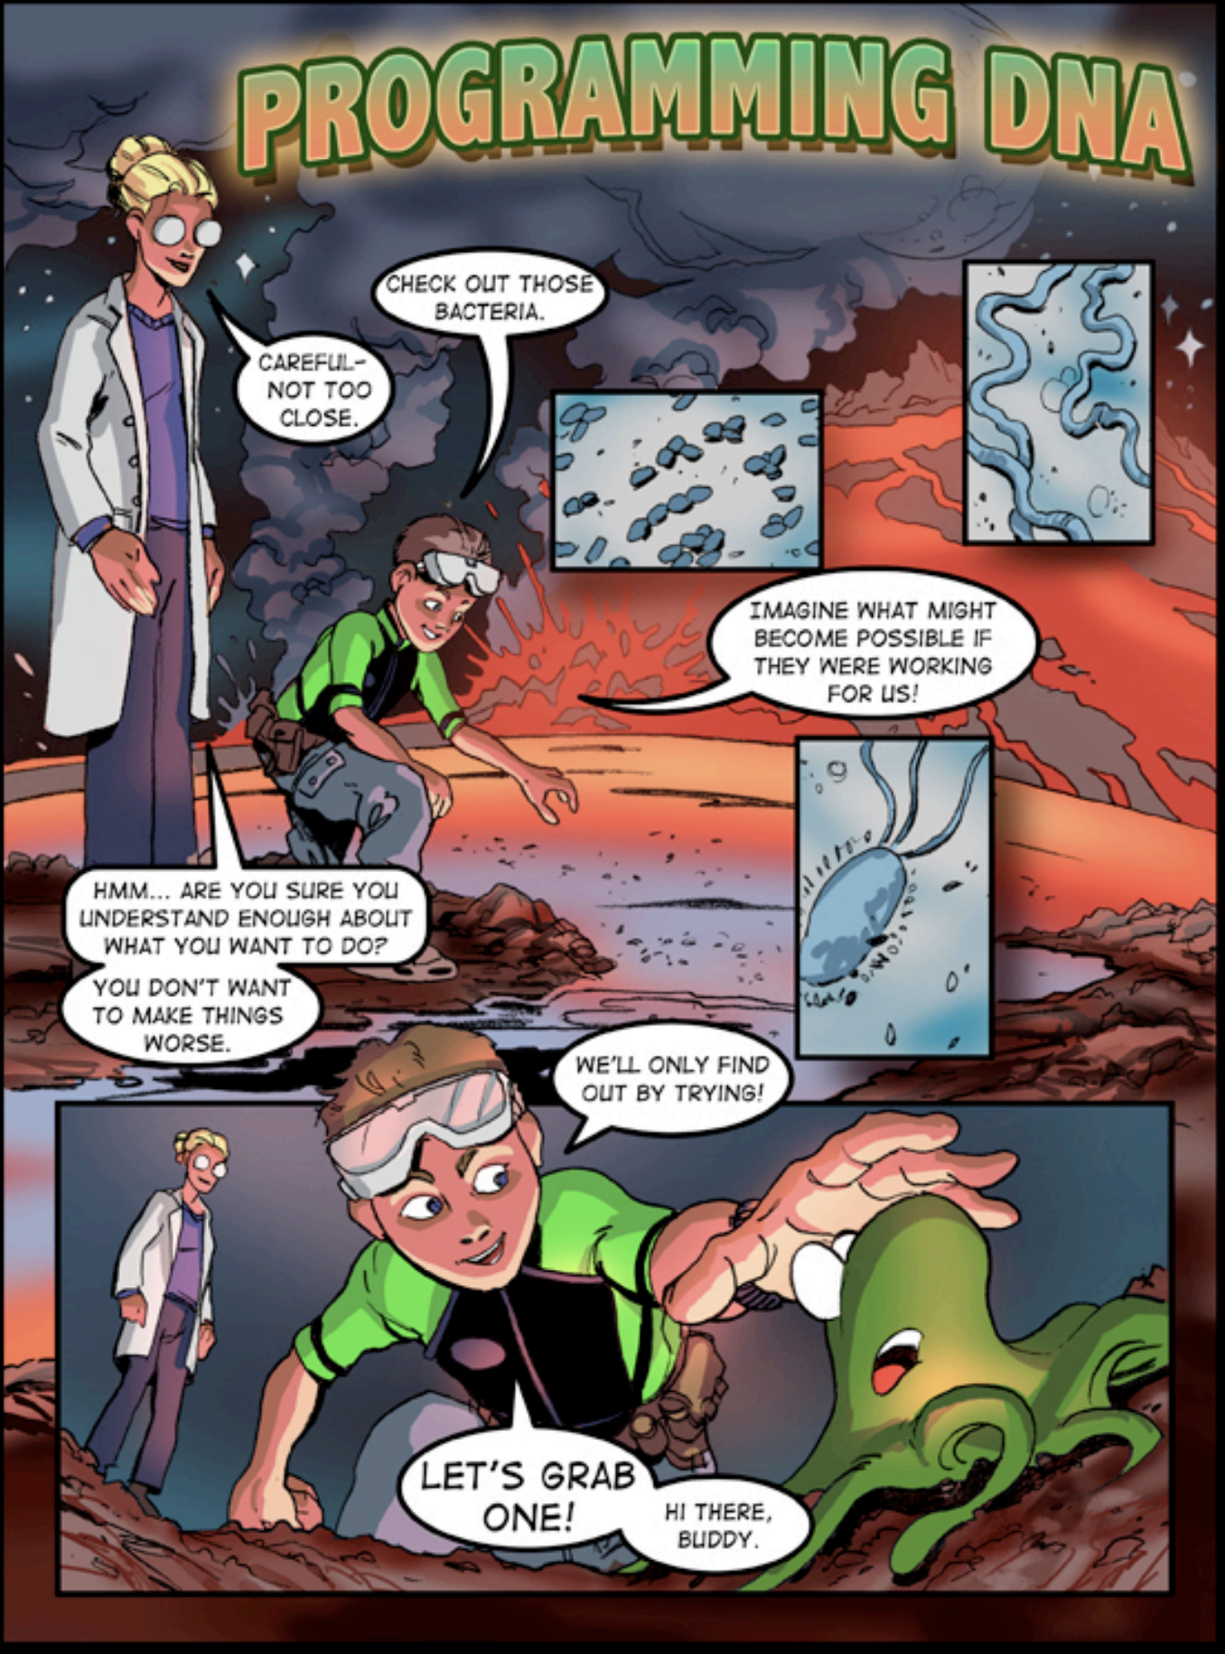
Promoting Critical Thinking in Synthetic Biology through DEI-Informed Dialogic Practices
Hatem Abdelrahman, Biomedical Engineering PhD Student
Key Strategies:
1- Create an Inclusive Classroom Climate:
Acknowledge diverse identities as assets.
Set norms for respectful dialogue.
Reduce power imbalances to amplify marginalized voices.
2- Encourage Dialogic Engagement:
Facilitate open-ended discussions:
e.g. Should we engineer organisms to combat climate change?
What are the ethical implications of synthetic biology/genetic engineering?
Encourage storytelling to connect concepts to lived realities:
e.g. societal needs for synbio: accessible medical solutions to
underrepresented communities.
3- Incorporate Equity-Centered Content:
Solve equity-related problems, such as designing low-cost diagnostic tools
for underserved regions, through project-based learning.
Critically analyze biases in synthetic biology research, e.g. unequal access to biotech advancements.
4- Practice Active Listening:
Maintain Eye contact to show engagement.
Paraphrase and summarize students’ contributions to discussions.
Ask clarifying questions to deepen the discussion.
Avoid interrupting students and acknowledge your biases.
Reference: Adventures in synthetic biology by Drew Endy

