Slide 1
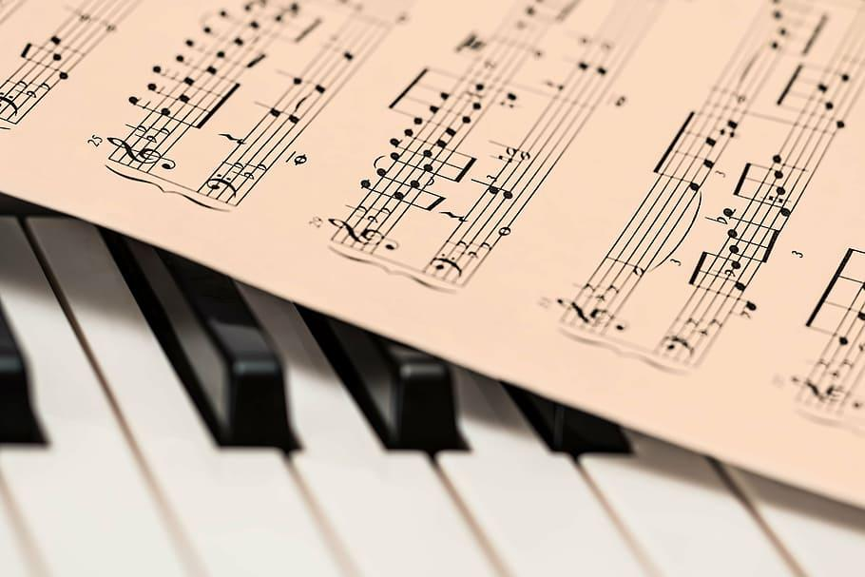
DEI Informed Dialogic Practices in Pre-service Music Education
Practice:
-engage students in practicing dialogue:
-debate vs. discussion vs. dialogue
-sustained dialogue in examining own identity, power and positionality as educators
-intentional questioning in promoting intergroup dialogue and sustained dialogue
-examining ways of teaching and learning music
-how to approach choosing repertoire
-intentionality behind planning culturally sustaining lessons
Pedagogy:
-constant reflection
-being aware of bias, power and positionality in everyday interactions with students (internalized dominance and internalized oppression)
-creating a classroom of belonging
-ally vs. co-conspirator
-highlighting students’ unique values
-social justice pedagogy: critical analysis of historically oppressive structures and uplifting historically marginalized narratives
-music as a vehicle for social change
Christy Go, PhD student in Music Education

