Slide 1


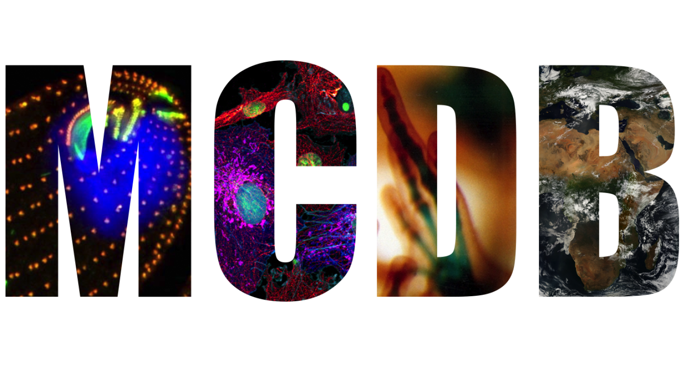
Revising Student Assessments and Grading for Equitable Learning
Lottie R. Steward (she/her/hers)
November 20th 2024

Slide 2
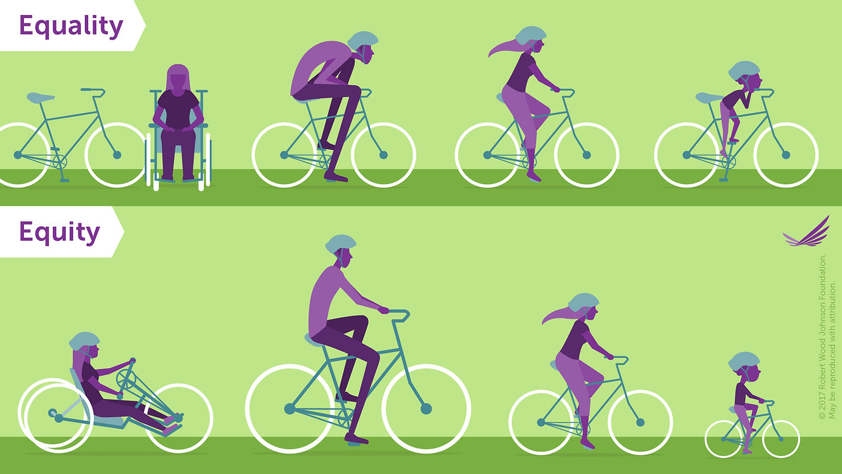
Equity vs. Equality

Slide 3
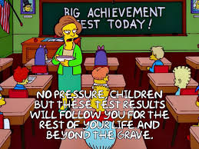
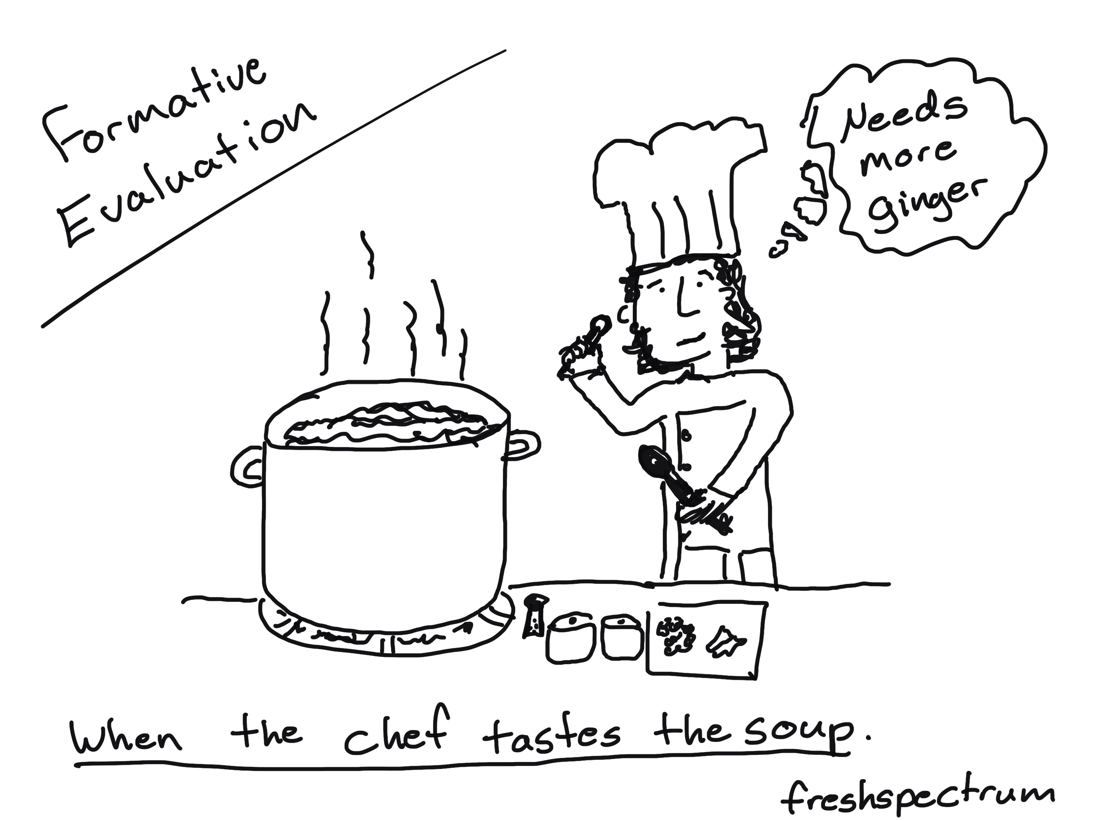
Vocabulary
Summative assessment:
  Focus on generating a measure or score, usually after a period of instruction.
    High stakes assessment
Formative assessment:
  Usually entails evaluating learning over time and having a different core purpose: improvement.
    Low stakes assessment
The Norton Guide to Equity-Minded Teaching
Notes:
Contemporary research has established that assessments are most effective when they provide students (and faculty) with feedback on their learning in relation to the course learning objectives.^ Formative assessments align with the fact that learning is an iterative process and a "work in progress." It's also true that the line between formative and summative assessments is often blurred: an activity, project, or quiz can both result in a grade and provide students with feedback on their progress.
Formative assessments also go hand in hand with low-stakes assessments, that is, assessments that carry relatively little weight in the course grading system. These take the pressure off students so they do not become overwhelmed by the consequences of any one score. Lowering the stakes of any individual assessment is another important practice in inclusive teaching. Historically, faculty with a "testing" approach to assessment, particularly those with large class sizes, may have relied on high-stakes assessments. Under this approach, by using only a handful of assessments, each one ends up carrying a lot of weight in students' grades. In a class with highest-stakes assessments, a student's final grade might be calculated based mostly on midterm and final exam grades. Even if a course grade is determined by students' score on four exams, a student who fails just one exam cannot mathematically earn an A in the class-regardless of their grade on the other three.

Slide 4
Vocabulary
Methods of Molecular Biophysics
Participation and Team Projects (40%)
  4 presentations (10% each)
Homework (10%)
  2 assignments (5% each)
Final exam (50%)
Summative assessment:
  Focus on generating a measure or score, usually after a period of instruction.
    High stakes assessment
Formative assessment:
  Usually entails evaluating learning over time and having a different core purpose: improvement.
    Low stakes assessment
BCHM 4761 Biochemistry Laboratory
Exams 300
  2 Exams (150 each)
Pre-labs 200
  10 Pre-Lab (20 each)
Attendance/participation 100
  Start with 100, deduct 10 for every absence
Lab reports 400
  10 lab reports (20 points each)
  1 final report (200)
Total 1000
The Norton Guide to Equity-Minded Teaching

Slide 5
Vocabulary
Summative assessment:
  Focus on generating a measure or score, usually after a period of instruction.
    High stakes
Formative assessment:
  Usually entails evaluating learning over time and having a different core purpose: improvement.
    Low stakes assessment
Authentic assessment:
  Students demonstrate their learning in ways that are meaningful and purposeful
Deficit thinking:
  The belief that some students are intellectually limited
POGIL
  Process Oriented Guided Inquiry Learning
The Norton Guide to Equity-Minded Teaching
Notes:
Authentic assessments are those in which students demonstrate their learning in ways that are meaningful and purposeful. A traditional exam may rely on multiple-choice questions that ask students to recall information, such that students' performance does not accurately gauge or represent their knowledge and skills. The results are also limited in what we as faculty glean regarding student learning and may more accurately assess whether students are effective test-takers or whether they experience performance-reducing test

Slide 6
So what?
Learning is not about the speed with which you learn the material. It’s about mastering it.
Not just memorization but understanding the material
  Wiggins example: We memorized a²+b²=c², but can you tell me if each side needs to be square? Can this be generalized to a rhombus?
  Mitochondria are the powerhouse of the cell. Why? What is the significance of this thing?
Minoritized groups and first-generation students are affected disproportionately.
The Norton Guide to Equity-Minded Teaching, Brookings
Notes:
Weed-out classes disproportionately impact students from first-generation families. This leads to students giving up before reaching their true potential

Slide 7
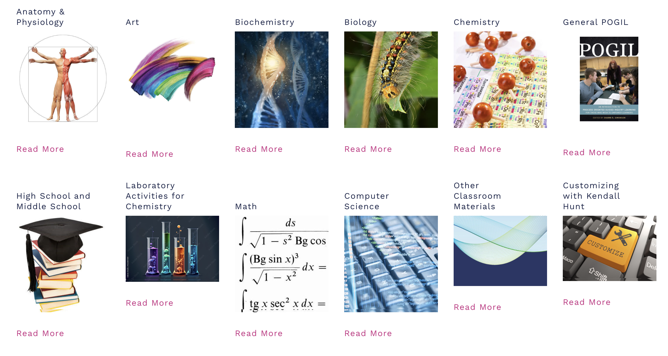
POGIL
POGIL
Notes:
The effectiveness of POGIL has been assessed at a range of institutions and for a variety of courses. Not only is POGIL based on educational research, but The POGIL Project strongly encourages instructors to reflect on and assess their teaching. Over the years, The Project has collected a great deal of data related to the effectiveness of POGIL in the classroom to both teach students content knowledge and to develop process skills.

Slide 8
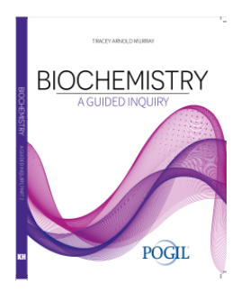
POGIL
The teacher's role in a POGIL classroom is to facilitate and coach, observing and periodically addressing individual and classroom-wide needs.
POGIL
Notes:
Biochemistry: A Guided Inquiry uses the philosophy of Process Oriented Guided Inquiry Learning (POGIL) to teach the fundamental concepts of biochemistry. In these activities, students will work in teams to explore models of biochemical information and develop essential ideas so they can more fully understand the discipline. In addition, they will intentionally practice process skills including teamwork, information processing, critical thinking, and communication. The topics in this book cover the major themes of biomolecules, metabolism, and the replication, transcription, and translation of genetic information.

Slide 9
POGIL
1−Thermodynamics of Water
2−Buffers and pH in Biological Systems
3−Amino Acids and Protein Primary Structure
4−Protein Secondary Structure
5−Protein Tertiary and Quaternary Structure
6−Oxygen Binding Proteins
7−Structural Changes in Hemoglobin
8−Enzyme Catalysis
9−Enzyme Kinetics
10−Enzyme Inhibition
11−Lipid Structure and Function
12−Membrane Transport Article
13−Carbohydrate Structure
14−Introduction to Metabolism
15−Glycolysis and Gluconeogenesis
16−Regulation of Glycolysis and Gluconeogenesis
17−Glycogen Metabolism
18−Citric Acid Cycle
19−Electron Transport Chain
20−ATP Synthase
21−Fatty Acid Catabolism
POGIL
Notes:
The effectiveness of POGIL has been assessed at a range of institutions and for a variety of courses. Not only is POGIL based on educational research, but The POGIL Project strongly encourages instructors to reflect on and assess their teaching. Over the years, The Project has collected a great deal of data related to the effectiveness of POGIL in the classroom to both teach students content knowledge and to develop process skills.

Slide 10
Action Plan for FA 2025
Principles of Biochemistry
Spring 2025
Meet with the BCHM department to work on a different curricula set up for Principles of Biochemistry
Summer 2025
Prepare course curriculum and inclusivity by collaborating with Center for Teaching and Learning and Digital Accessibility Office
Summer 2025 POGIL:
Request workshop for Principles of Biochemistry
FA 2025: Assessments
FA 2025: Lectures
Clicker questions
Fall 2025: Recitations
Color cards
Misconception check
Post lecture - muddiest point
POGIL
Teacher Assessment
Two-stage exam questions
Drop the lowest quiz score
Final assessment choice
Reflection during Winter Break
Survey students about how they felt about this method of instruction.
See if there are metrics to measure improvement.
Student Generated Test Questions
Notes:
Biochemistry Dept: Dr. Jim Goodrich (Chair of BCHM, james.goodrich@colorado.edu), Dr. Amy Palmer (Associate Chair of Undergrads in BCHM, amy.palmer@colorado.edu). Natalia Johnston (Undergraduate Program Coordinator, Natalia.Johnston@Colorado.EDU)

Slide 11
Citations
The Norton Guide to Equity-Minded Teaching [Internet]. [cited 2024 Nov 20]. Available from: https://nerd.wwnorton.com/nerd/228003/r/goto/cfi/32!/4?control=control-toc&demo=true
POGIL | What is POGIL? [Internet]. [cited 2024 Nov 20]. Available from: https://pogil.org/what-is-pogil
Who’s getting pulled in weed-out courses for STEM majors? [Internet]. Brookings. [cited 2024 Nov 20]. Available from: https://www.brookings.edu/articles/whos-getting-pulled-in-weed-out-courses-for-stem-majors/
Equality vs. Equity: “At what point is equity enabling mediocrity?” [Internet]. Adriele Parker. 2021 [cited 2024 Nov 20]. Available from: https://www.adrieleparker.com/post/equality-vs-equity-at-what-point-is-equity-enabling-mediocrity
Bhave R. Reframing Learning Goals through Assessment. Teach Grad. Routledge; 2021.

