Slide 1







What Is Chemistry and Who Uses It?
Virginia Johnson (she/her),
Physical Chemistry PhD Candidate
Department of Chemistry and Biochemistry

Slide 2
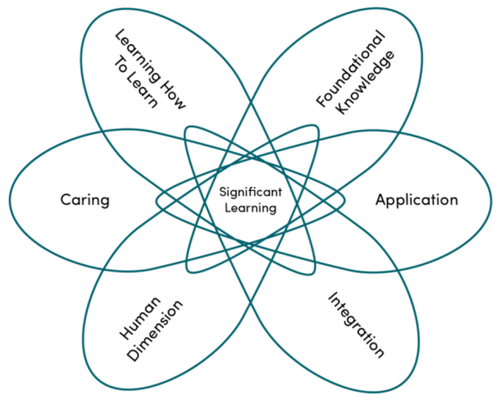
Fink’s Taxonomy of Significant Learning
Students develop learning skills, in this course and in life in general.
Students gain essential understandings.
Students care more deeply and invest values or interests.
Students apply knowledge or perform skills.
Students will better understand themselves, their identities, and others.
Students make connections between ideas within and outside of the course.
Fink, L. D. (2013). Creating significant learning experiences: an integrated approach to designing college courses (Revised and updated edition). San Francisco: Jossey-Bass.

Slide 3
Fink’s Taxonomy of Significant Learning
Formal Coursework in general chemistry emphasizes and enforces Foundational Knowledge and Application
Fink, L. D. (2013). Creating significant learning experiences: an integrated approach to designing college courses (Revised and updated edition). San Francisco: Jossey-Bass.

Slide 4
Fink’s Taxonomy of Significant Learning
With some added effort on the part of the instructor and students, traditional coursework can extend even further into this taxonomy!
Fink, L. D. (2013). Creating significant learning experiences: an integrated approach to designing college courses (Revised and updated edition). San Francisco: Jossey-Bass.

Slide 5
Fink’s Taxonomy of Significant Learning
In this action plan I outline an assignment to emphasize the rest of Fink’s Taxonomy for general chemistry students at the community college level
Fink, L. D. (2013). Creating significant learning experiences: an integrated approach to designing college courses (Revised and updated edition). San Francisco: Jossey-Bass.

Slide 6

Many community college students leave a full year of formal general chemistry coursework without achieving a sense of academic/scientific identity.
Why is this an issue?
Chemistry has a reputation for being “too hard” for certain people to do
  Limitation-based view of capacity for learning
  The social expectation of a scientist/chemist has been narrowly established as very male, white, and pretentious.
  The implication of these overlapping factors is that people who do not identify in this way will be incapable of succeeding in science/chemistry.
There is little to no formal coverage of what modern chemistry looks like in a typical general chemistry course.
  The reality of modern science is much more diverse than the black-and-white photos in a general chemistry textbook
  There is much room for improvement for inclusivity in STEM
  Opportunity to highlight the people doing that work

Slide 7
The Action Plan
First week of Semester:
  Anonymous student entrance survey
  Have you taken chemistry before
  I see myself as a “STEM person”*
  Describe a chemist**
Five weeks before semester end:
  First deadline, submit 1-3 topic ideas
  Optional: feedback on assignment clarity
Four weeks before semester end:
  Students receive feedback or guidance
Two weeks before semester end:
  Soft deadline, submit one page for print
Last week of classes:
  During scheduled lab time students participate in gallery walk
  Sticky notes for comments
  Anonymous student exit survey
* Inspired by Partnerships in Science Education (PISEC) survey
** Inspired by Scientist Spotlight Homework survey

Slide 8
The Action Plan
First week of Semester:
  Anonymous student entrance survey
  Have you taken chemistry before
  I see myself as a “STEM person”
  Describe a chemist
Five weeks before semester end:
  First deadline, submit 1-3 topic ideas
  Optional: feedback on assignment clarity
Four weeks before semester end:
  Students receive feedback or guidance
Two weeks before semester end:
  Soft deadline, submit one page for print
Analysis of results & revisions
Last week of classes:
  During scheduled lab time students participate in gallery walk
  Sticky notes for comments
  Anonymous student exit survey

Slide 9
Anticipated Areas for Growth
Will students be overwhelmed by open-endedness of prompts or feel limited to reproduce examples?
How effective is this at addressing the specific issue posed?
How “fair” are the two options relative to each other? Am I asking more work of one project than the other?
Exit survey only garners feedback from students who complete the course. Students who drop out mid-semester have valuable insight.
Using resources wisely: Advising offices, librarians, and other campus departments

Slide 10
Thank you for your questions!
Virginia Johnson (she/her),
Physical Chemistry PhD Candidate
Department of Chemistry and Biochemistry

Slide 11
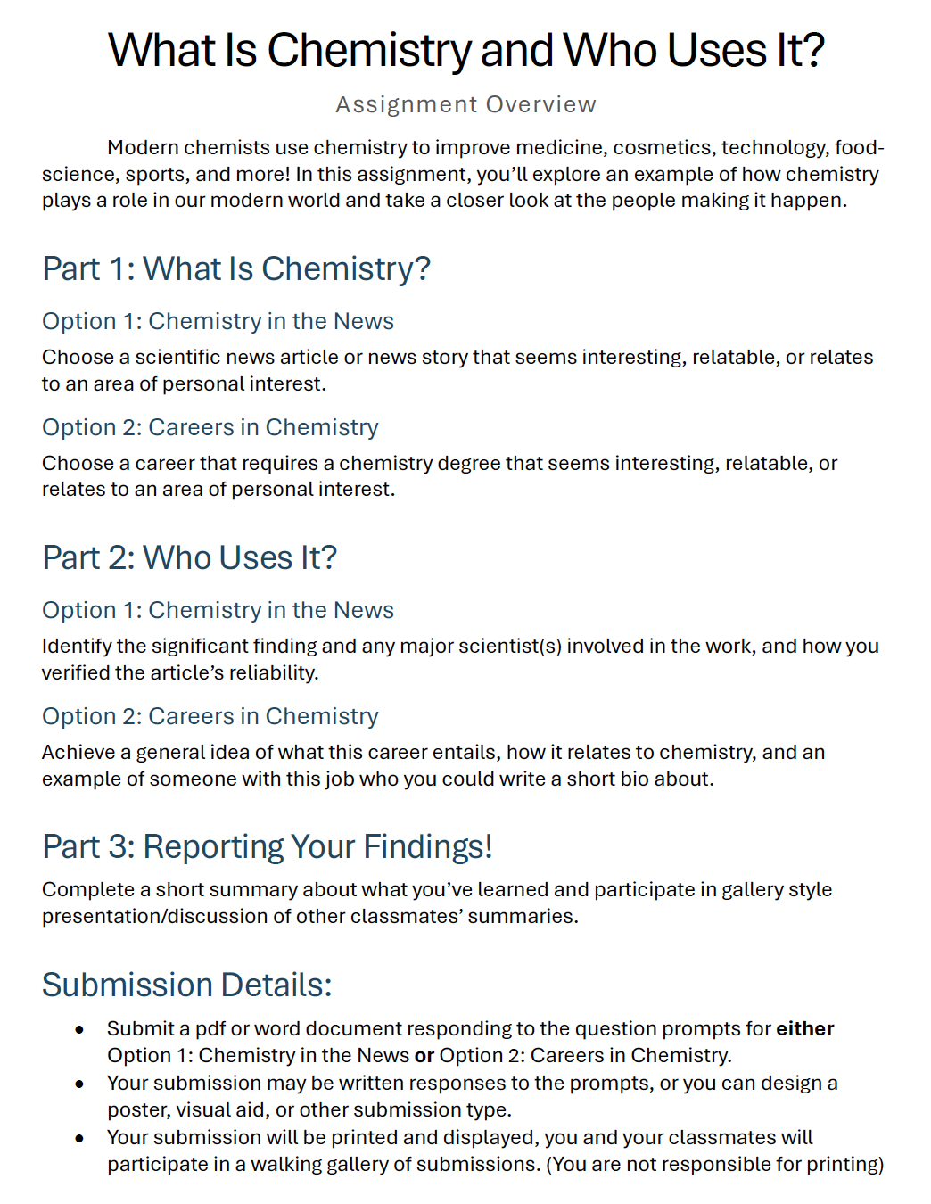

Slide 12
