Slide 1
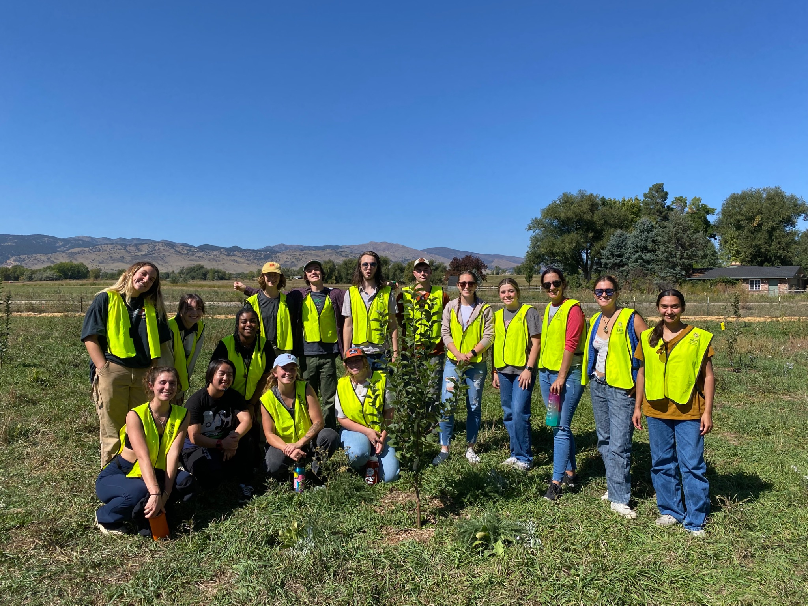

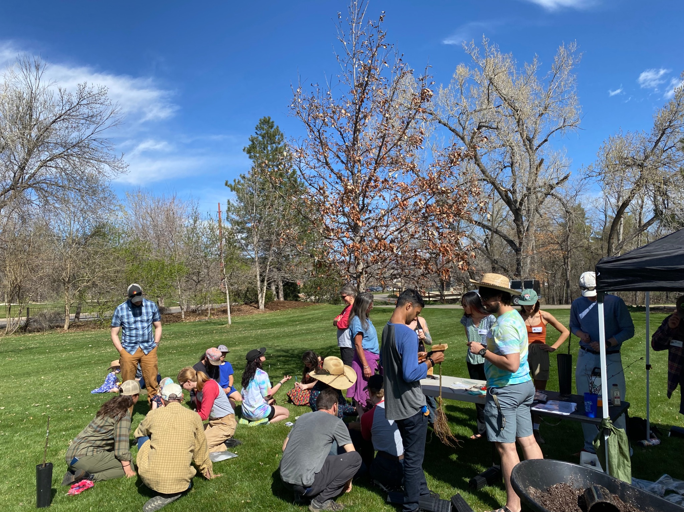

DEI Informed Dialogic Practices in Field Ecology Courses (EBIO 1250)
Amy Dunbar-Wallis, PhD Candidate
Student field safety and rightful presence in the ecological research space is an important component of EBIO 1250. When students feel a sense of belonging they can deepen their science identity and self-efficacy.
Introduce the framework
Co-create course agreements
Small group work and whip-around share-outs
Re-visit agreements, is there anything we want to change/add after small group work?

