Slide 1
Bilingual
Citation Management
ゾテロ
日・中・韓・英
Multi-Lingual Zotero / MLZ
Adam H. Lisbon
Japanese Studies Librarian
A Full Introduction to Multilingual Zotero by Adam H. Lisbon is licensed under a Creative Commons Attribution-ShareAlike 3.0 Unported License.
Based on a work at http://gsl-nagoya-u.net/http/pub/zotero-multilingual-overview.html.
Created for the North American Coordinating Council on Japanese Library Resources (NCC) - 2013 Summer Workshop

Slide 2
Outline - (get this presentationa at bit.ly/mlzotero)
The Basics (Download MLZ)
MLZ 101
Getting citations into your MLZ Library
Activate PDF Indexing
Saving PDFs
Bilingual Citations
Setting up
Language Profiles
Citing in Action
Limitations
MS Word Plugin
Backing up your Library
Time saving tricks

Slide 3
MLZ 101
unfinished BETA (though very stable now)
Created by Professor Frank Bennett
A legal scholar at Nagoya University
Zotero and MLZ are technically not the same program.
MLZ uses nearly all of Zotero’s source code
MLZ is well supported by Bennett and the Zotero community.
The Zotero forums are a wealth of information

Slide 4
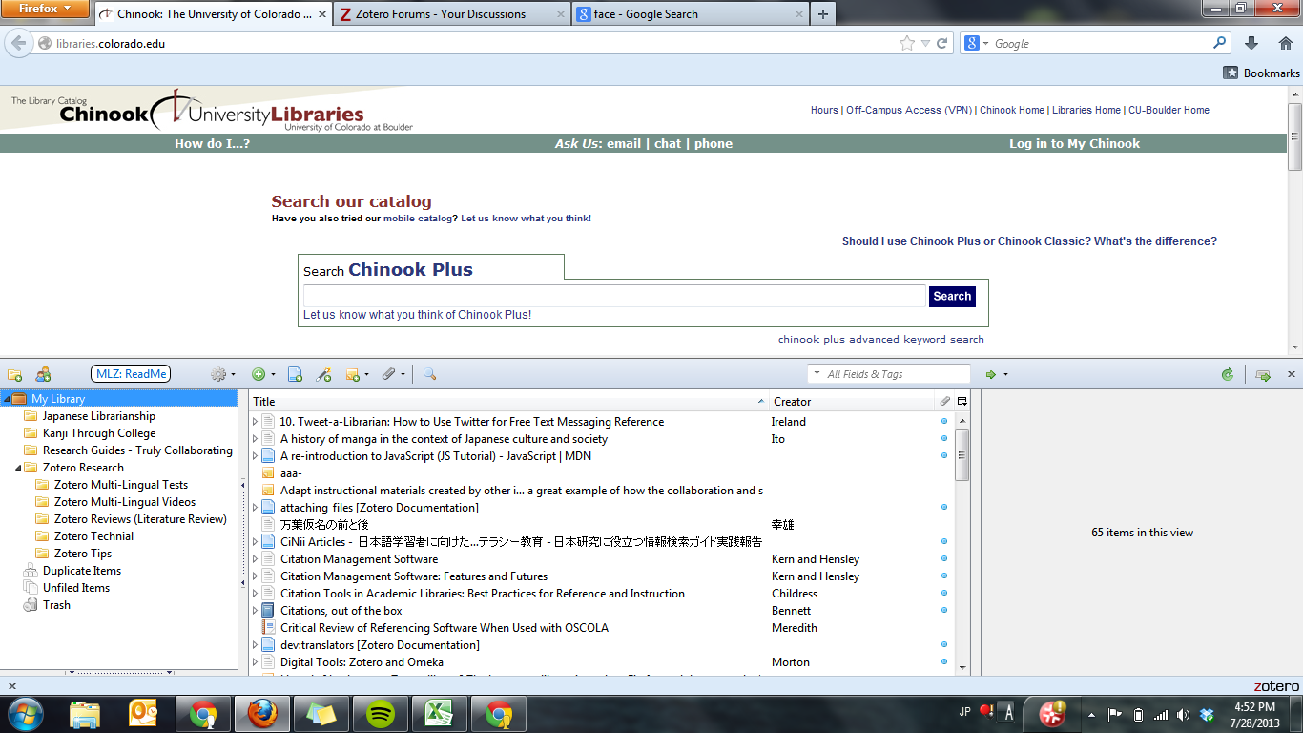
Basics (Official Quick Start Guide)
You MUST use FireFox to use MLZ
Generate citation with an identifier: ISBN, ISSN, DOI, etc.
Attach a link, webpage, document on your local drive, etc.
Attach notes to your citations, PDFs, etc.
Add ‘new item’ in 38 possible formats
Create a snapshot of a webpage
Sync with Zotero servers
Preferences (*more later*)
My Library: all your citations, regardless of what 'Collection' you put them in.
Blue dot indicates you have a attached a local file on your hard drive
Create a new collection
Advanced Search
Your collections / projects
Toggle MLZ pane
Notes:
It’s always best practice to manually sync your MLZ library when you are done with your session.

Slide 5
Populating Your Fields
Citations are generated by clicking the ‘capture’ icon in the toolbar.
The capture icon changes based on the type of resources:
Cite multiple objects at once
Zotero has identified a video
Zotero has identified a book
Zotero has identified an article
These icons appear because the Zotero community creates ‘translators’ that parse the information from a source. E.G. the catalog at your library, major database vendors, amazon.com, CiNii, etc. In some cases no translator exists, like for the NDL catalog, so no capture icon appears.
When Zotero cannot translate an online resource’s data, you can manually enter the information.

Slide 6
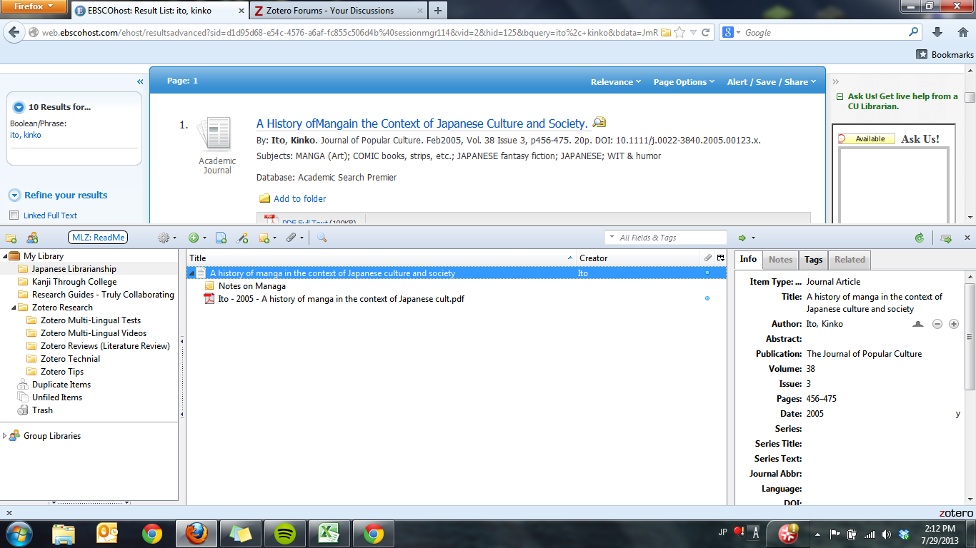
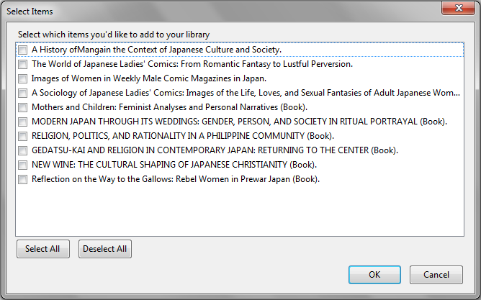
A Populated Citation
To be VERY CLEAR:
ALWAYS double check your citations
NEVER assume your data is 100 % correct
Databases often have typos
Databases may have bad metadata
Name order can get jumbled
Here’s how to generate a record from a database into your Zotero library, automatically populating all the metadata fields you will need to create a citation.
Click the capture icon
Then choose the items you want to generate citations for (only one in this example)
I’m currently in my “Japanese Librarianship” Collection. So any citations I generate will appear in this folder.
Ta-da! Your citation is now complete. You can see, review, and edit your metadata on the right (more on that later). At this point it’s advisable to download and attach the actual PDF file from the database via Zotero. You can also add a note and do note taking inside Zotero while you read the PDF.
Notes:
Currently in “Japanese Librarianship” Collection
Click Capture Icton
Select Items window pop-up
Ta-da!

Slide 7
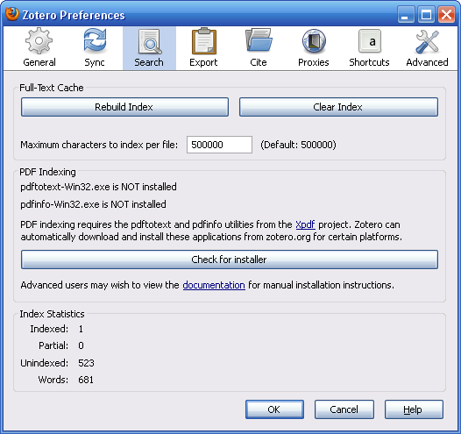
Activate PDF indexing*
A feature you should always activate because:
Zotero will be able to search through any PDF’s you’ve downloaded
You can use a one-click solution to rename your PDFs.
Choose Search
Finally, rebuild your index
Install PDF Indexing
Where do the PDFs go? We will review that when we learn to back-up our Zotero Library
* for now, you can’t index PDFs in Japanese.

Slide 8
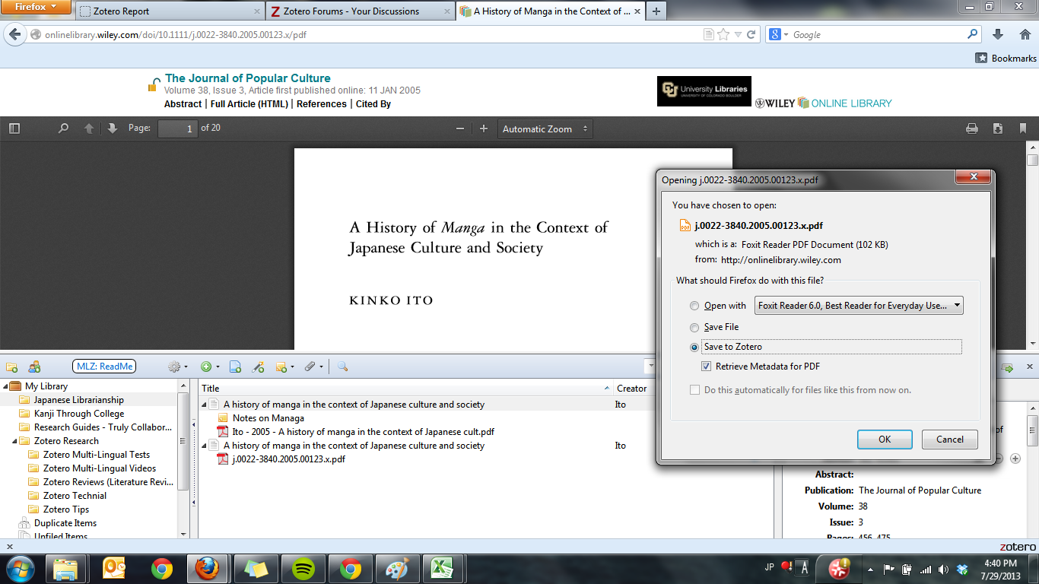
Saving PDFs to your MLZ Library
Everyone’s screen will look slightly different, but you want to get to your download prompt window. With Zotero installed, you should see a new option when downloading PDFs.
Now that you have MLZ installed, you should have this new option for downloading PDFs.
You will get this much easier to read format.
Notice the title actually cuts off after so many characters. You have to edit and correct it.
This is the result, but the file name is not convenient.
Right-click the PDF file, and select:
“Rename File from Parent Metadata”
Although partially blocked, you can see the metadata for citing the source has also been populated. Two-birds with one stone!

Slide 9
Bilingual Citations 日英
Until now, MLZs features have been identical to the standard Zotero client.
MLZ still needs more development for a true ‘one-click’ citation experience. But you can now generate a citation in English or Japanese, and fill in the language gap.
You can add as many language fields as you need. For example:
English
Japanese
Romaji - as defined by the ALA and LoC
Kana
There are capabilities for Chinese and Korean as well.
The setup for these capabilities is a little confusing, and will be reviewed.
***it is important to remember that YOU still need to take the time to add this extra language data. Many websites do not yet provide the convenient bilingual metadata that MLZ translators can parse and import into your citation library.

Slide 10
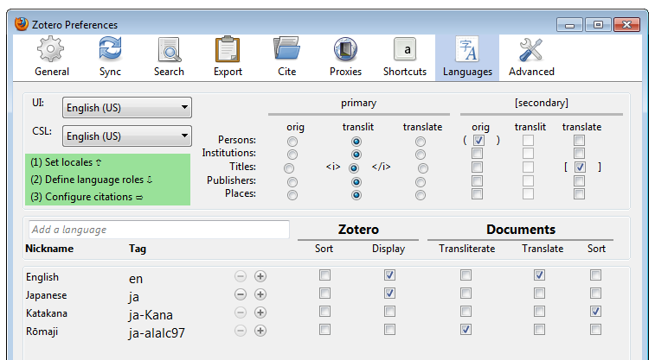
Activating other Langauages
Looking below at this complicated matrix; this is roughly what you want your language settings to look like. These setting are oriented toward researchers publishing on Japan in English Language journals. However, you will probably want to change them in the future.
This language tab is only available in MLZ
These are the‘universal defaults.’ For now mimic what is here. This menu will reappear in a more logical context later.
Essentially this menu is telling MLZ how to format multilingual citations. These will be the defaults when using the Word Processor Plugin (we’ll do that later). These can be changed on a per document basis. So don’t stress about the current choices.
Choose your languages here. Click the + and choose your languages. The nicknames you can choose for yourself
The main purpose of the Katakana script field is so that you can sort Japanese by gojūon
order.
Type ‘Japanese’ in the ‘Add a language’ box above.
+ >> Scripts >> Katakana
+ >> Variant >> ALA-LC Romanization, 1997 edition

Slide 11
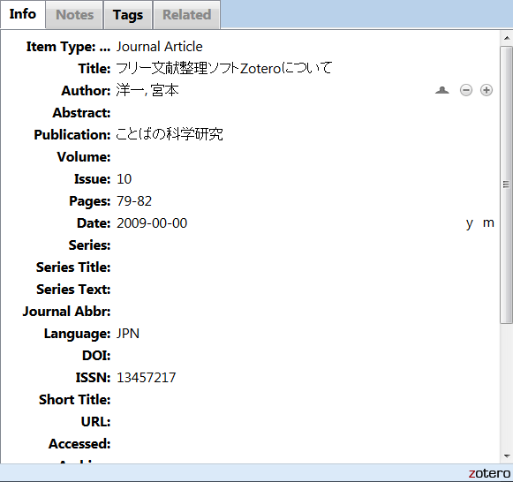
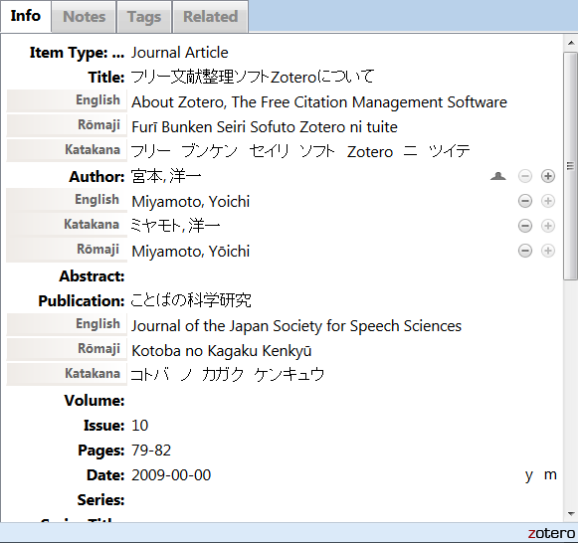
Filling out a Bilingual Citation
Your languages and scripts are selected, let’s start making a citation. But before that, look at these ‘before’ and ‘after’ screen captures.
Raw Import
After adding multilingual Data
*Important*
You won’t be able to see this field in the next slide, but you need to enter either ‘jp’ or ‘en’ exactly in the language field. This metadata is essential. If you don’t this will create problems later on.
This ‘jpn’ should not be used, nor should ‘eng’ be used for English.

Slide 12
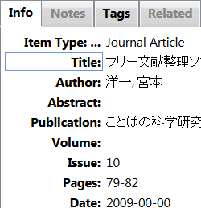
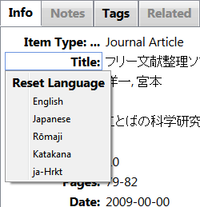
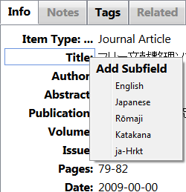
Filling out a Bilingual Citation
Basics about filling out multilingual data.
English
This is the English translation of the Japanese Title / Author / Publisher /etc.
Rōmaji
This is the transliteration of the Japanese into Latin letters. Add macrons for long vowels and follow the style conventions of the ALA-LC Romanization guide.
Katakana
Libraries and other information agencies usually use katakana to clarify pronunciation. This is especially important when you need to keep track of complex readings (like people and place names). Additionally, because kanji cannot be ‘alphabetized’ you need the phonetic katakana field to sort Japanese citations in gojūon order.
LEFT-CLICK for the ‘Reset Language’ menu so you can set the language of the master field.
RIGHT-CLICK to add a subfield in one of the language options previously set up.
When your mouse hovers over a field that is ‘multilingual enabled’ a blue border will appear. These are the ‘master fields’

Slide 13
MLZ and Word Processor Plugins
Available for MS Word, OpenOffice, and Libre Office
Not included by default, click the link above to get one
Instantly insert a citation in the preferred style while typing.
Only useful if you have been maintaining clean metadata in MLZ:
Always fill out your multilingual fields
Always add the ‘jp’ or ‘en’ language tag
The plugin will also automatically generate a bibliography for you based on the citations in your document.
Your thorough metadata will allow you to swap the citations between Japanese, English translations, or romaji transliterations with ease.
You can still manually edit any citation or bibliographic source when you need to.

Slide 14
MLZ and MS Word
After installing the plugin, there will be a new tab in Word’s Ribbon.
This is the Zotero group.
Edit the bibliography you generated
Insert a citation from your MLZ Library
Edit one of the citations you imported
Set document preferences - pick your citation style and language display preferences here.
Refresh and sync the sources in your document with any changes you’ve made inyour MLZ library
Remove the hidden Zotero coding. Do this when you need to submit your document for publication or need to collaborate with someone who doesn’t use Zotero.
Insert a bibliography - based off the citations in your document.
If you remove the Zotero coding, make sure you save a back up copy first! You CAN’T undo this action once you excecute it!

Slide 15
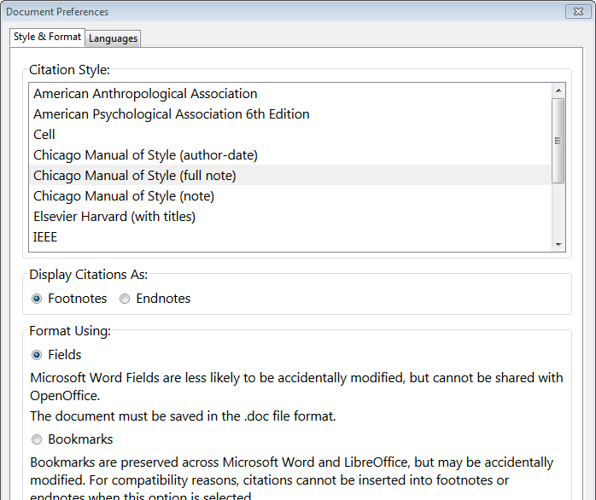
MLZ and MS Word
Here’s the main context menu set the citation/bibliographic format for the document (which you can change with a simple click at ANY TIME while editing your work!)
** Two Glitches **
When you decide to switch from one style to the Chicago author-date style - the contents of the MS Word window will ‘disappear.’ Don’t worry, your content is fine. Just save your document and restart Word.
The glitch is likely because of moving so much data out of the footnotes and into the main body of the text.
The presentation is geared toward researchers in the humanities, so Chicago style will be the example citation style.
In the Chicago full note style - Your first citation from a work will be a full citation, while any subsequent ones will be abbreviated. MLZ uses the ‘Short Title’ field for abbreviated titles. However, the plugin will only ever use the ‘master field’ for the short title. Meaning, regardless of whatever style is applied to the documents citations, the Short Title will never change. This also affects the Chicago note style.
A workaround is when your document is finished, do a find & replace command on that exact footnote and replace it with the short title in English / Japanese / Rōmaji.
Remember, MLZ is an opec source BETA product. It’s development relies on a participatory user community. Report issues on the Zotero Forums after you have thoroughly investigated the issue.

Slide 16
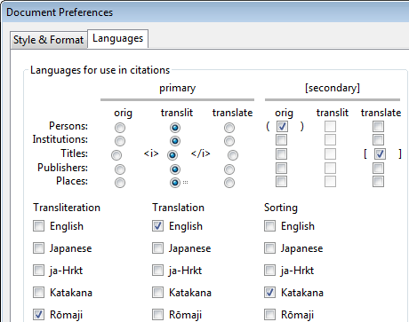
MLZ and MS Word
After setting ‘Style & Format’ go to ‘Languages’ - Remember this menu? It’s almost identical to the MLZ language preferences window.
On your computer, go ahead and tinker with these settings and see how it changes the way your citations are displayed.
It’s much easier to play with these settings and see what they do in a test document.
Download this Word doc
You need to have Japanese Language support :
(PC)(MAC)
and input on your system:
(PC)(MAC)
And of course, you need to have installed MLZ and the Word Processor Plugin if you haven’t already.

Slide 17
MLZ and MS Word Breakdown
Here’s an explanation of what is happening in case you can’t tinker with the Word document provided in the previous slide.
Primary Settings:
Here, we are saying, transliterate all people’s (authors, editors, translators) names in Romaji. MLZ knows you want Romaji because you specified below that you want to use the Romaji field for transliterating.
Secondary Settings:
Here, we are saying AFTER the author’s name has been written in rōmaji, to write it again in the same language as the master-field in MLZ (You should have been setting your master-fields in Japanese for Japanese documents, and English for English documents). The indicate that () shoulbe enclose that secondary name.
Remember the language field in MLZ where you need to write ‘jp’ or ‘en’ ? If you haven’t been writing either of these exact codes in, your citations will not process correctly.

Slide 18
MLZ and MS Word Breakdown
Look at this comparison to see how the Language settings generate a citation and a bibliography entry:
Citation / Footnote:
Miyamoto Yōichi (宮本洋一), “Furī Bunken Seiri Sofuto Zotero ni tsuite” [About Zotero, The Free Citation Management Software], Kotoba no Kagaku Kenkyū [Journal of the Japan Society for Speech Sciences] no. 10 (January 2009): 76.
Bibliography Entry:
Miyamoto Yōichi (宮本洋一). “Furī Bunken
Seiri Sofuto Zotero ni tsuite” [About Zotero, The Free Citation Management Software]. Kotoba no Kagaku Kenkyū [Journal of the Japan Society for Speech Sciences] no. 10 (January 2009): 79–82

Slide 19
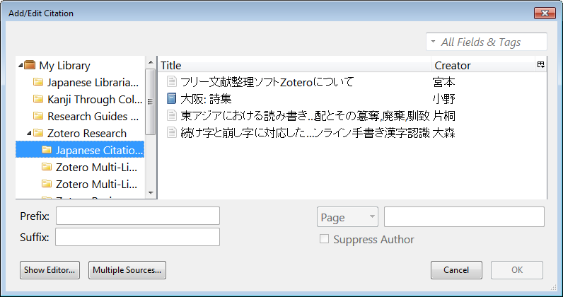
MLZ and MS Word: Enter a Citation
After all that setup, actually inserting a citation is quite straightforward.
And now you have your context menu that displays your MLZ Library.
And your end result will be something like this:
Click the ‘insert citation”button
Choose the citation you want from one of your collections.
Note that the styles here are changed from the previous slide, just to reaffirm that you can change the language settings at any time.
Add the relevant page number or other reference you need.

Slide 20
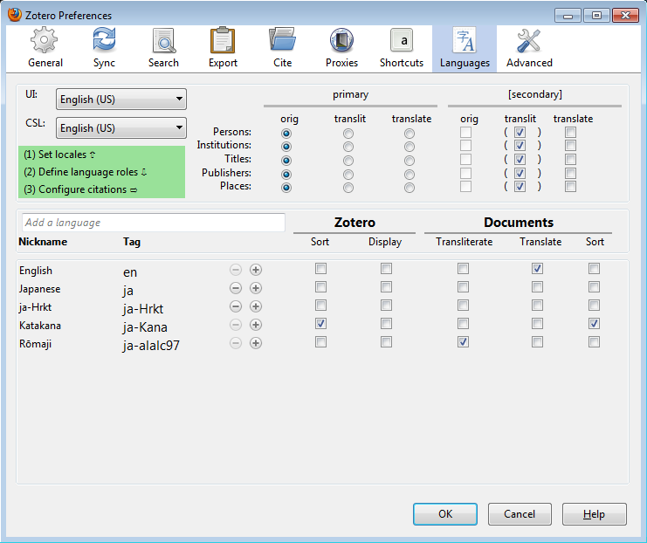
Jumping back to MLZ
You’ve seen how to automatically insert citations and Bibliographies into your document - let’s jump back to the MLZ language settings.
This is for your settings inside Zotero. Want your citations to display in English instead of Japanese? (maybe you need to work with colleagues or teach students who have low or zero Japanese skills
Last time on this screen, you added the languages and variants you wanted to write your citations in.
Play with these settings to see how it changes the way your Japanese language citations are displayed.
This part you saw before in MS Word. Here you can set your universal langauge settings so that all documents you write default to these language preferences.

Slide 21
Syncing Your MLZ Library
MLZ / Zotero has fully embraced the world of cloud computing,
There are two types of syncing:
Data Syncing
Data syncing merges library items, notes, links, tags, etc.—everything except attachment files—between your local computer and the Zotero servers
This is FREE, and space is unlimited
File Syncing
Data syncing syncs library items, but doesn't sync attached files (PDFs, audio and video files, images, etc.). To sync these files, you can set up file syncing to accompany data syncing, using either Zotero File Storage or WebDAV
This is a service you pay for, pricing is reasonable, click the link for the details.
Zotero Discourages using the sync feature as your ultimate backup. So...

Slide 22
Backing up your MLZ Library
Where is my library being stored?
The easiest and most reliable way to find your Zotero data directory is by clicking the “Show Data Directory” button in the Advanced tab of your Zotero Preferences window.
Windows 7 / Vista:
C:\Users\<User Name>\AppData\Roaming\Mozilla\Firefox\Profiles\<randomstring>\zotero
Windows XP / 2000
C:\Documents and Settings\<username>\Application Data\Mozilla\Firefox\Profiles\<randomstring>\zotero
Mac OSX
/Users/<username>/Library/Application Support/Firefox/Profiles/<randomstring>/zotero
Linux (most distributions)
~/.mozilla/firefox/Profiles/<randomstring>/zotero
Make a copy of the folder labeled ‘Zotero’ and save it somewhere off of your computer: a thumb-drive, or a cloud service like Dropbox, SkyDrive, or GoogleDrive.

Slide 23
Tips and Tricks
These are directly from the link above:
When you have selected an item in the middle column, you can highlight all collections that contain this item by holding down the “Option” key on Mac OS X, the “Control” key on Windows, or the “Alt” key on Linux.
Press ”+” (plus) on the keyboard within the collections list or items list to expand all nodes and ”-” (minus) to collapse them.
To see the number of items in the selected library or collection, click an item in the middle column and use the Select All shortcut (Command-A on Mac OS X or Control-A on Windows and Linux). A count will appear in the right column (attachments are included in the count when visible, i.e. when the parent item is expanded).
Are you unable to adjust the size of the Zotero pane downwards beyond a certain point? Close the tag selector (e.g. by dragging the splitter above the tag selector down), as it has a minimum height.
You can convert the contents of the title and publisher fields to either lower or title case by right-clicking the field and using the Transform Text menu.
The date fields will automatically convert “yesterday”, “today”, and “tomorrow” into the respective dates
When using Quick Copy, holding the “Shift” key while dragging and dropping items into a text document will insert citations instead of full references.
You can click the DOI and URL field labels to open the field link. To prevent the link to load in the active tab, you can use the standard Firefox shortcut keys for tab/window opening: Ctrl/Cmd-click for a new background tab, Ctrl/Cmd-Shift-click for a new foreground tab, and Shift-click for a new window.
Manually adding authors to a Zotero item? You can use Shift+Enter after typing each name as a faster alternative to clicking the ”+” button.
Need more than one Zotero library? Use multiple Firefox profiles to keep your libraries separated.

Slide 24
Frank Bennett’s Book
Consider picking up Frank Bennett’s Book: Citations Out of the Box.
It deals with a lot of the inner workings of Zotero and MLZ and may be of interest to the technically inclined.
focuses heavily on the legal citations aspect of MLZ
There is also a creative commons open license PDF here.

Slide 25
Thanks!
Congratulations on making it to the end of a rather long introduction to MLZ
Questions? Email me:
adam.lisbon@colorado.edu
OR
Register at the Zotero Forums and check out all of the great advice there:
https://forums.zotero.org/categories/
ゾテロ
Adam H. Lisbon
Japanese Studies Librarian
A Full Introduction to Multilingual Zotero by Adam H. Lisbon is licensed under a Creative Commons Attribution-ShareAlike 3.0 Unported License.
Based on a work at http://gsl-nagoya-u.net/http/pub/zotero-multilingual-overview.html.
Created for the North American Coordinating Council on Japanese Library Resources (NCC) - 2013 Summer Workshop

