Slide 1
The Importance of
Quality Educators
Yasmin Mohamud, Tyler Kivelson, Michel Jarjour

Slide 2
Agenda
High quality education and why it matters
Our threat and its importance
Our scope
Our solution
Closing

Slide 3
What is High Quality Education?

Slide 4
"High-quality education is an inclusive, learner-focused experience done in a safe environment that is led by a qualified educator to equip students with transferable skills (e.g, social, critical thinking, etc.) that will help them to support their communities and societies."

Slide 5
Why it Matters
Potential to lift over 100 million people out of poverty
Education can help empower underserved communities
Education drives people toward peace
Current increase in enrollement but the the number of qualified teachers hasn't followed

Slide 6
The Threat: Lack of Quality Educators

Slide 7
Why it Matters
Students aren't Learning: Children are not picking up basic skills after years in school
Economic Link: Content learned has been directly tied to the longterm economic performance of developing nations.
SGD 4 Relation: Directly address some of SGD 4s goals

Slide 8

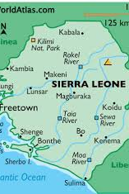

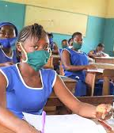
Our Scope – Sierra Leone
Post-conflict system with weak educational infrastructure
High number of undertrained and unqualified teachers
Limited access to teacher training and development
Strong rural–urban education inequality

Slide 9
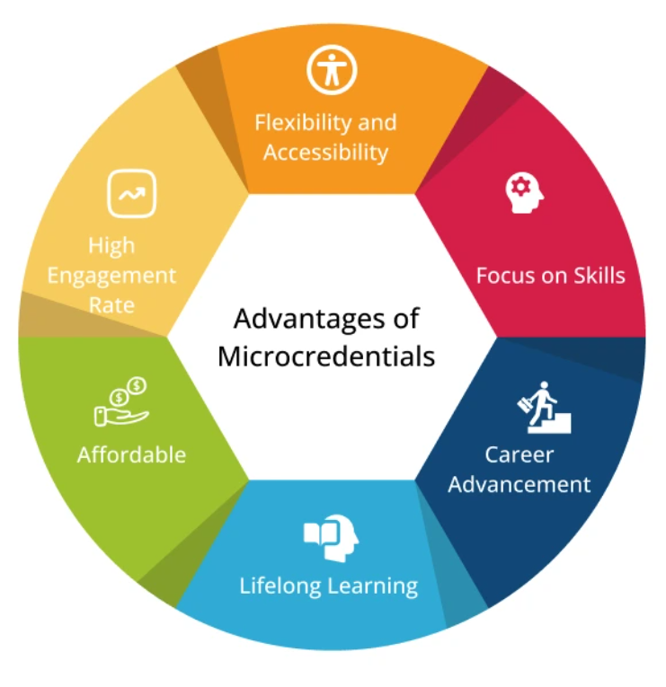
Our Solution
Focused on developing community volunteer teachers
Criteria:
  Needs to be affordable
  Needs to be accessible
  Needs to be relatively quick
Stackable micro credentials
  Benefits:
    Significantly less expensive than a bachelor's
    Accessible material both online and in-person
    Significantly quicker than a bachelor's
    Focused and specialized

Slide 10
Our Solution - Diagram (1/2)
Return to teaching: fundamental classes
Micro credential #1
(Synchronous-online)
3 months (approx. 12.5 hrs per week)
  60 min: pedagogy I
  60 min: basic literacy
  30 min: homework
Community Volunteer Teacher
Micro credential #2
(Synchronous-online)
3 months (approx. 12.5 hrs per week)
  60 min: pedagogy II
  60 min: numerical skills
  30 min: homework

Slide 11
Our Solution - Diagram (2/2)
Micro credential - Specialization
Literacy
  English
  Language
Micro credential #3, 4, 5
Literacy I
Literacy II
Literacy III
Micro credential #2
(Synchronous-online)
3 months (approx. 12.5 hrs per week)
  60 min: pedagogy II
  60 min: numerical skills
  30 min: homework
Micro credential - Specialization
Sciences
  Geology
  Biology
Micro credential #3, 4, 5
Mathematics I
Mathematics II
Mathematics III
Micro credential - Specialization
Mathematics
  Algebra
  Calculus

Slide 12

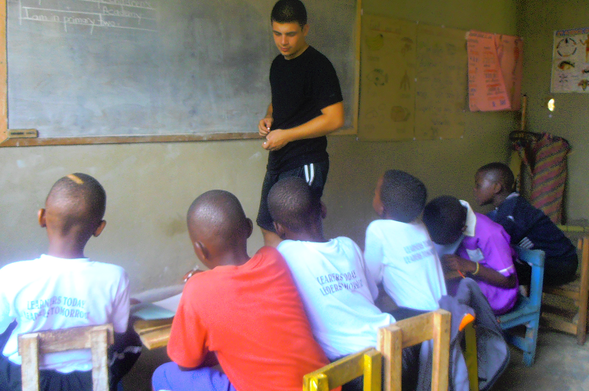
Innovation
Reliance on bachelor degrees; not always feasible
Micro credentials are a relatively new creation (2011-2014)
  Stackable micro credentials (2016)
Not trying to recreate an existing program (e.g., Teach for America, Peace Corps); focus on those already "teaching" without formal training
Cross-industry inspiration:
  Academia (those currently in a Bachelor's program)
  Computer Science & Technology
  Business/Marketings
Notes:
What Are Micro-Credentials And Why Are So Many Universities Talking About Them?
Pioneering New Ground: Creating One of the World’s First Modular, Stackable Microcredentials

Slide 13


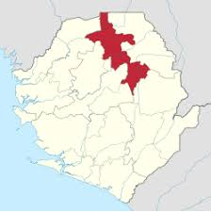
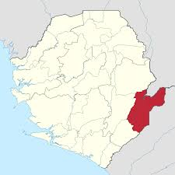
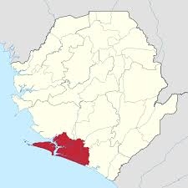

Implementation Plan
We will be using a pilot to scale model to test for feasibility and evaluation.
By choosing three specific regions, we allow for geographical diversity, comparison across different conditions, and a scalable model for national expansion.
University Partners: Fourah Bay College, Njala University, and Ernest Bai Koroma University.
Rural Implementation Regions: Kailahun District, Bonthe District, Koinadugu District

Slide 14
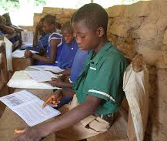

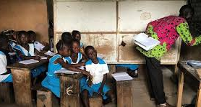
Impact
Short-term impact (0-6 months):
Rapid upskilling of community educators and immediate classroom improvements.
Medium-term impact (6-18 months):
Measurable gains in literacy and numeracy and a consistent teaching quality across regions.
Long-term impact (2+ years):
Sustainable pipeline of locally trained educators and a stronger, self-sustaining education system.

Slide 15
Feasibility and Risks
The funding plan has precedent but there is no way to guarantee that it works
We are not certain of how much engagement there will be from community teachers
There would still be a lot of work to do with the universities, but there are already frameworks to work off of

Slide 16
Metrics of Success
We would measure the success of this program across three categories.
Teacher Development
Classroom Quality
Student Learning Outcomes
Within the first year, we would expect measurable improvements in teaching practices and early gains in student engagement and foundational skills.

Slide 17
Closing- SOCO (Strategic Optimal Communication Objective)
We want more qualified teachers because the data suggests quality educators are invaluable to the development of students. Therefore, our solution is to develop training processes (i.e., stackable microcredentials) to grow the number of qualified, trained teachers to support the growing population, aid with teacher burnout/workload, and develop the betterment of the community.

Slide 18
Citations
$1 invested in youth skills can pay back fifteen-fold in economic growth | Global Education Monitoring Report. (n.d.). Retrieved April 12, 2026, from https://www.unesco.org/gem-report/en/articles/1-invested-youth-skills-can-pay-back-fifteen-fold-economic-growth
Agarwal, A. (2022, August 22). Pioneering new ground: Creating one of the world’s first modular, stackable Microcredentials. edX. https://press.edx.org/pioneering-new-ground-creating-one-of-the-worlds-first-modular-stackable-microcredentials#:~:text=Back%20in%202016%2C%20that’s%20exactly,50%25%20of%20a%20master’s%20degree.
Hendron, J. (2026, January 30). Teacher shortage by the numbers. Educators Rising. https://educatorsrising.org/teacher-shortage-by-the-numbers/
Reading: A way out of poverty | blog | global partnership for education. (2017, March 23). https://www.globalpartnership.org/blog/reading-way-out-poverty
Tackling learning poverty in sierra leone’s education system through the lens of the pdia – building state capability. (n.d.). Retrieved April 12, 2026, from https://bsc.hks.harvard.edu/2026/03/27/tackling-learning-poverty-in-sierra-leones-education-system-through-the-lens-of-the-pdia/
Teacher education report reveals declining standards, minister wurie calls for action. (2026, March 17). Sierraloaded. https://sierraloaded.sl/education/teacher-report-declining-standards/
Teachers and learning: Addressing the global educator shortage. (n.d.). Theirworld. Retrieved April 12, 2026, from https://theirworld.org/resources/teachers-and-learning/
The importance of quality education worldwide—Action Education. (2021, August 10). https://action-education.org/en/why/the-impacts-of-a-quality-education/
What are micro-credentials and why are so many universities talking about them?. Suitable. (n.d.). https://www.suitable.co/knowledge-center/blog/what-are-micro-credentials#:~:text=With%20micro%2Dcredentialing%2C%20students%20can,their%20lectures%20free%20of%20charge.
World Bank. (2021). Teachers and teaching in Sierra Leone: Teacher quality and management study. World Bank Group.https://teachertaskforce.org/sites/default/files/2023-06/2021_WB_Teachers-and-Teaching-in-Sierra-Leone-Teacher-Quality-and-Management-Study_EN.pdf

Slide 19
Questions?

