Slide 1
Building a just and equitable classroom through a well-planned syllabus
Meghan Hayden (she/her)
PhD student
Ecology & Evolutionary Biology

Slide 2
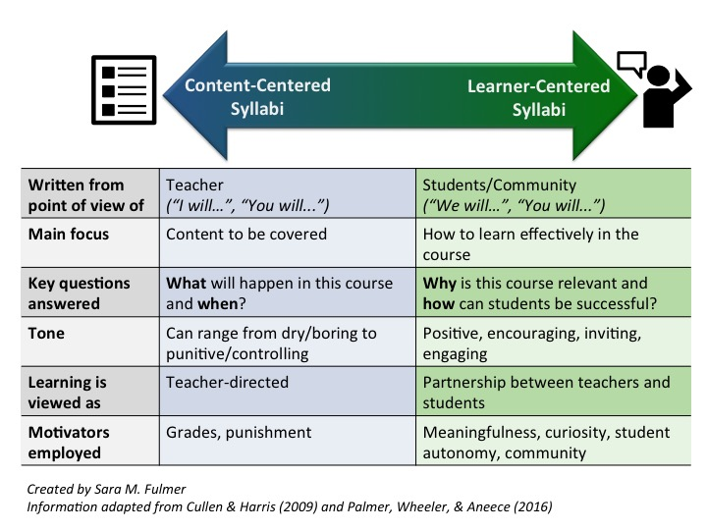
The research
The syllabus contains core pedagogical features and can be used to advance equity
Learning-focused syllabi (as opposed to content-focused) might better achieve equity-focused goals
Syllabi matter for students’ perception of the course & its instructor (accessibility, belonging) and for making clear the “hidden curriculum” that some students don’t come into college knowing

Slide 3
Setting the tone for learning
A good syllabus can:
Showcase the course’s relevance,
Humanize the instructor, and
Emphasize student success,
which builds trust, demonstrates a commitment to equity and conveys to all students that their success is important.

Slide 4
Action plan
I am updating my syllabus to meet these goals by:
Making adjustments to language
Reframing requirements to be learning-focused
Adding a preface to learning objectives
Including a clear statement surrounding help and accessibility
Updating the grading policy
AND highlighting text/materials that emphasizes work by underrepresented scientists (plus a welcome week activity to showcase diversity in STEM)

Slide 5
Examples of updates
EBIO 2040: PRINCIPLES OF ECOLOGY LAB
Syllabus
Lab Instructor (TA): Meghan Hayden
Email: meghan.hayden@colorado.edu
Office Hours: Wednesday from 2 -3 PM in Ketchum B16 and Thursday from 11 AM – 12 PM on Zoom
Lab Day/Time: Wednesday, 3:35 – 6:25 PM
Room: Ketchum 1B14
Course Description:
The lecture portion of EBIO 2040 introduces major ecological principles, concepts, and classical hypotheses. The lab portion of the course focuses on how ecologists conduct research, particularly emphasizing the scientific process via critical thinking, data analysis, and communication.
The lab is designed to provide first-hand experience in conducting and designing ecological research. The first half of the semester will focus on demonstrating ecological research through field labs; and the second half of the course will focus on independent projects, where you will test an ecological question of your choice. With a partner, you will design, conduct, analyze, and present the results from your research project. A final poster presentation will be held to present the results of your projects to your peers.

Slide 6
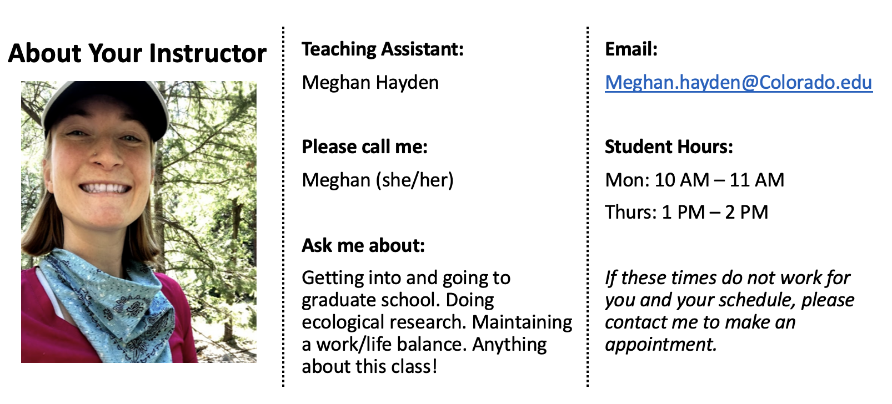
Examples of updates
Why take this course?
Ecology is all around us, shaping the natural world and influencing our daily lives. From the behavior of animals to the dynamics of ecosystems, understanding ecology is essential for making informed decisions about environmental issues and conservation efforts. In this course, we will explore the intricate connections between organisms and their environment.
How will this course help you succeed?
Whether you're curious about the behavior of a particular species or the functioning of an entire ecosystem, this course will empower you to investigate and answer ecological questions. In the first half of the semester, you will participate in field labs that demonstrate ecological research techniques and principles. These hands-on experiences will prepare you for the second half of the course, where you will embark on independent projects to test ecological hypotheses of your own choosing. By the end of the course, you will be able to…

Slide 7
Other proposed updates
Grading updates:
Provide extra credit for early turn in of assignments
Enact a consequence free late pass for one assignment
Explain rationale for deadlines (necessary to get feedback before final project) and policies
Ensure that policies reflect what is done in the course
“It is a privilege in itself to ask for an exception to the rule” (Arend)
Some ideas for welcome week activities:
To increase relevance:
In the first week of class, I will ask each student to bring a news article with an ecology story that interests them.
To increase representation:
In the first week of class, I will ask each student to highlight an underrepresented ecologist and what they have contributed to the field.
To build trust:
In the first week of class, I will ask students to bring pictures of a natural place they enjoy to share with others.

Slide 8
Referenced works
The Norton Guide for Equity Minded Teaching by Isis Artze-Vega, Flower Darby, Bryan Dewsbury and Mays Imad
Transforming Your Syllabus with an Equity Mindset by Bridget Arend
A Learner Centered Syllabus Helps Set the Tone for Learning by Mary Bart

