Slide 1
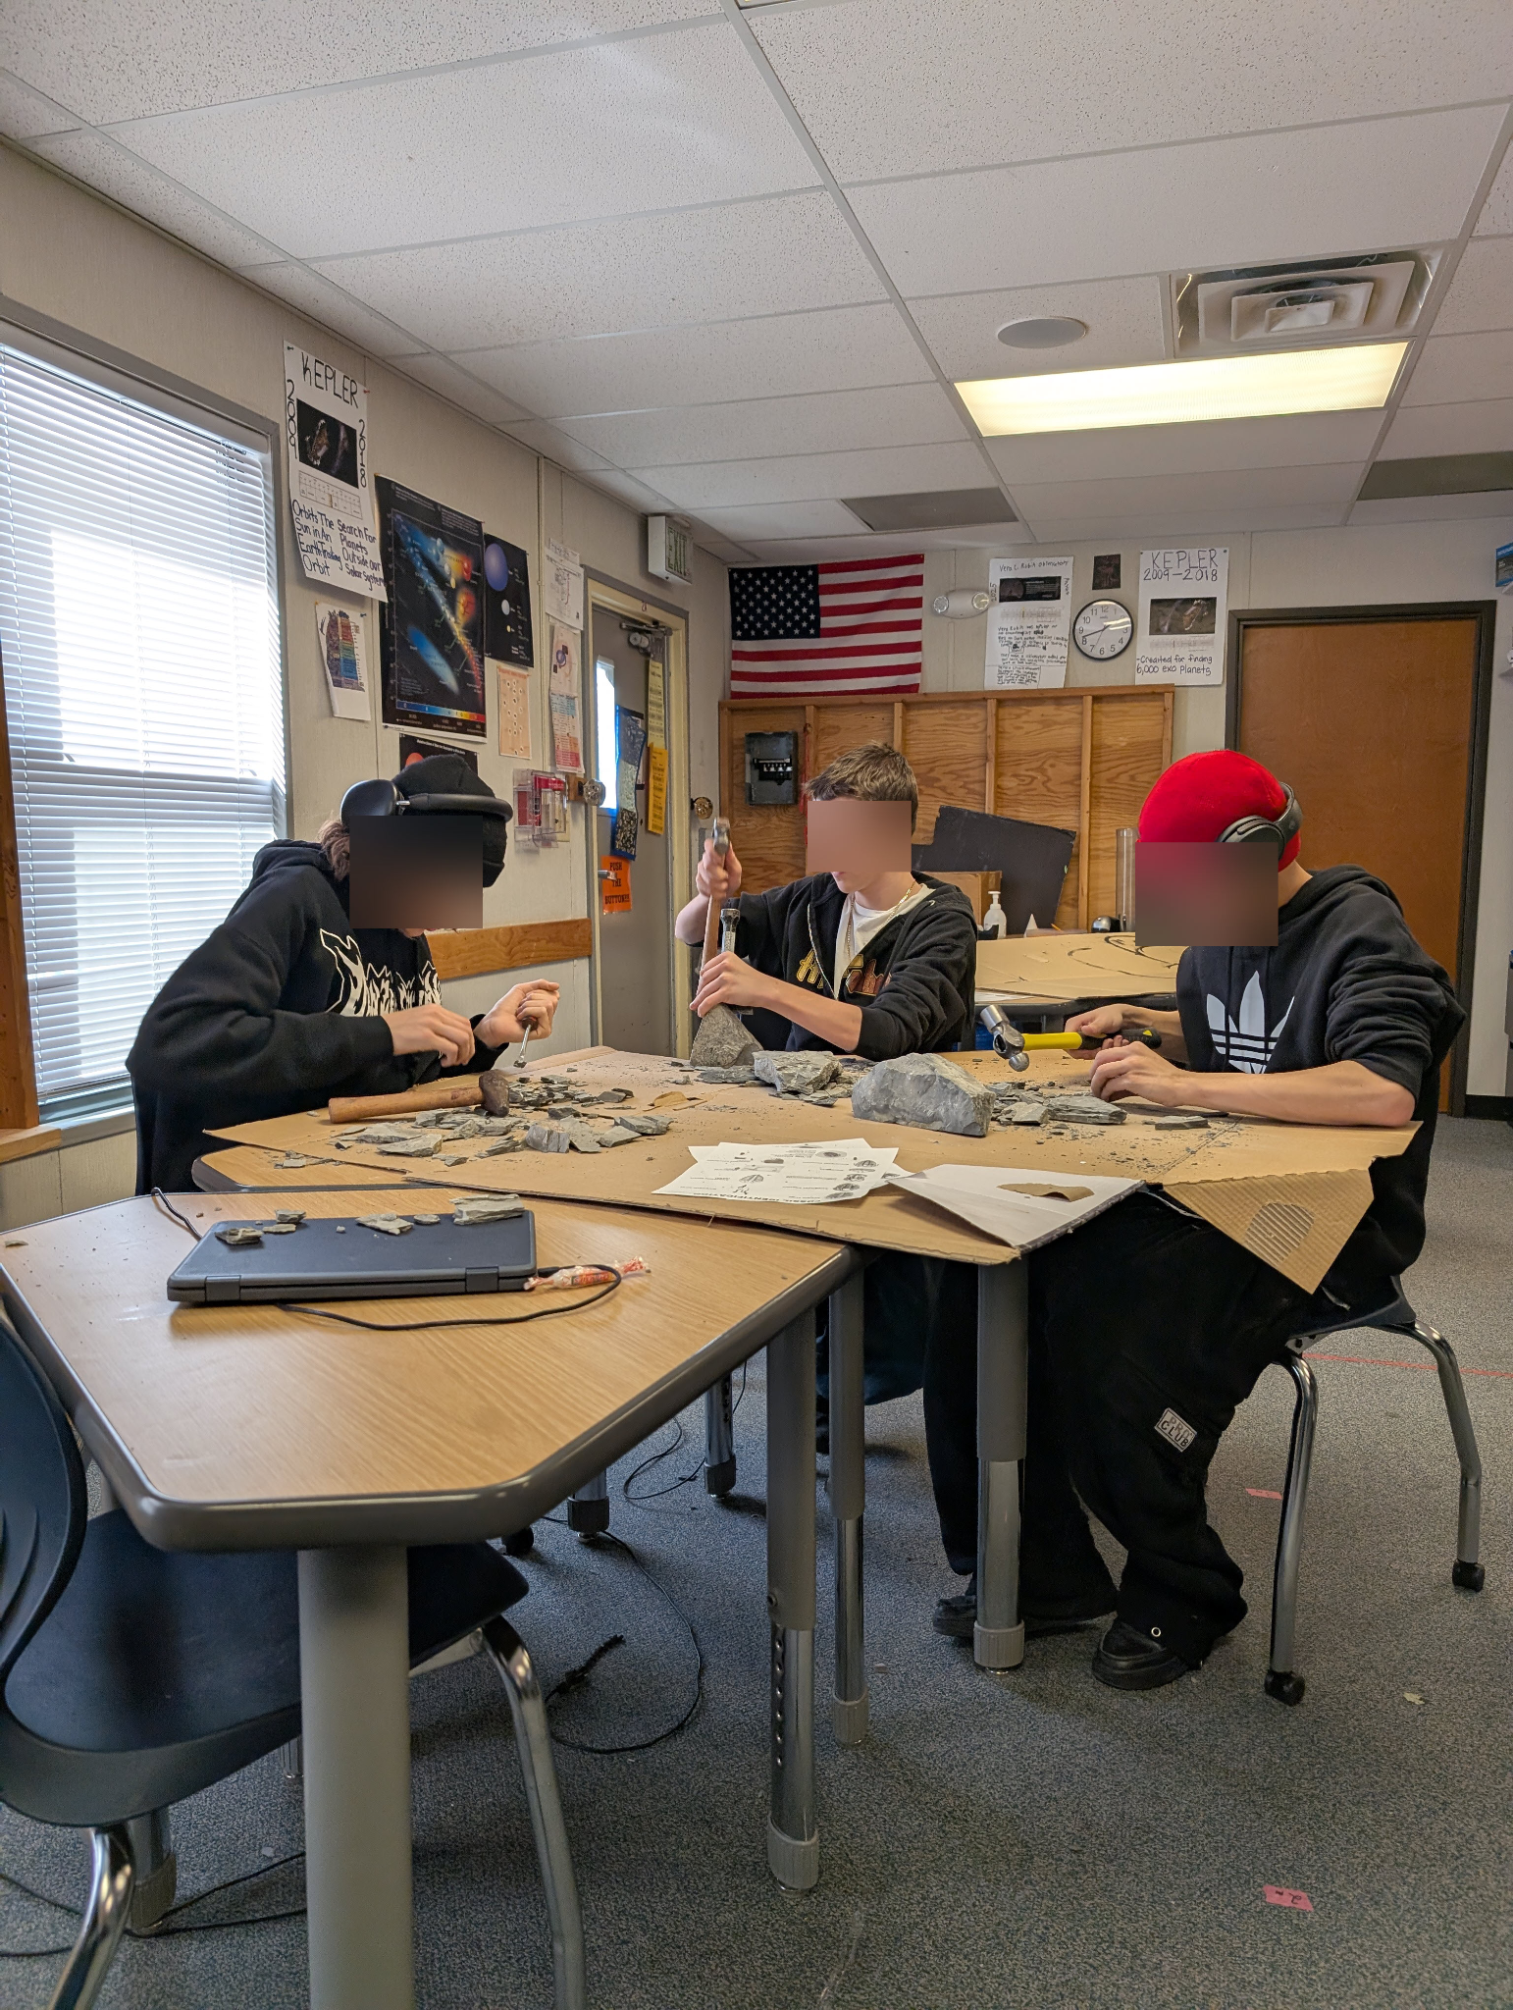
NEWTON FELLOWSHIP
Rethinking Student Engagement
Calvin Hawks, Ben Braun, Aspen Rawson, Esther Amato
The lockdown during Covid accelerated the issues that public schools face in regards to student engagement, development, and learning.
Based on primary research · Boulder, CO · 2026
Notes:
Aspen

Slide 2
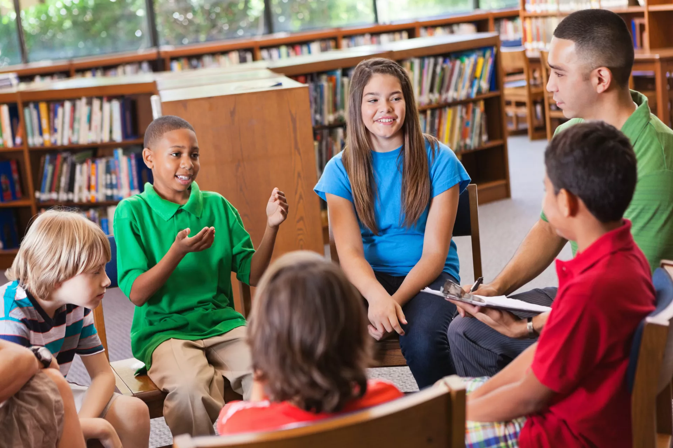
2 / HIGH QUALITY EDUCATION
What Does High-Quality Education Look Like?
SOCIAL ENGAGEMENT
Results in long-term student learning.
HANDS-ON & PROJECT-BASED LEARNING
Active doing over passive listening.
INTENTIONAL TECHNOLOGY USE
Technology as a tool, not a crutch. Used with purpose.
Notes:
Esther
High-quality education is not just about content,it’s about how students learn and engage.”
Social Engagement)
“First, it includes social engagement. When students interact, discuss, and participate, it leads to deeper and long-term learning.”
Hands-on learning
“Second, it’s hands-on and active. Students learn more by doing and participating, rather than just listening.”
Technology)
“And finally, technology should be used intentionally, as a tool, not something students depend on. It should support learning, not replace interaction.”

Slide 3
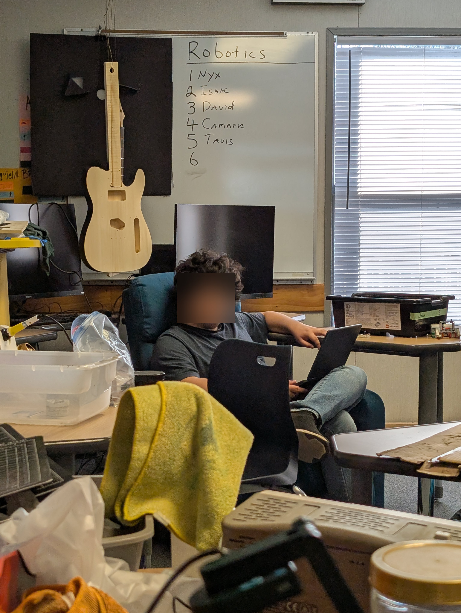
3 / PROBLEM
Reduced Social Engagement
SOCIAL SKILLS
ACADEMIC SKILLS
Stopped talking in class
Lack of skills in the “Three R’s” Reading, Riting, and Rithmetic
Students got used to phones as a method of communication during lockdown and have deficient social skills.
“We’ve had to teach them how to have conversations”
"In a lot of cases, we’re graduating functional illiterates"
Youngest students affected more
8th–10th graders (in 3rd–5th grade during COVID) show the deepest regression.
Engagement must come before content
Notes:
Calvin

Slide 4
4 / EVIDENCE
Evidence
01
02
03
04
15-Year Educator
Public Survey via Social Media
Interviews with Younger Students
Peer-Reviewed Studies
Kirk Hawks taught at-risk high schoolers through COVID and after. His classroom observations on social regression and academic gaps are our primary source of evidence.
Distributed to social media followers. Captures how parents, students, and teachers perceive shifts in student behavior, engagement, and learning since COVID.
Direct conversations with younger kids in school now. Provided perspective on technology dependence and social discomfort.
Active learning beats passive lectures. Engagement drives outcomes. Peer teaching raises scores. Collaboration boosts confidence and social skills.
This evidence has shown us that this problem was accelerated by Covid beyond the schools abilities to address it in time.
Notes:
Calvin
03
we spoke directly with younger students to understand their experience in the classroom today.
They told us that they get easily distracted, especially by other students and their environment.
Many said they struggle to stay focused and don’t always feel motivated to participate.
They also shared that learning is more difficult when it’s not engaging, and they prefer more interactive and hands-on activities.

Slide 5
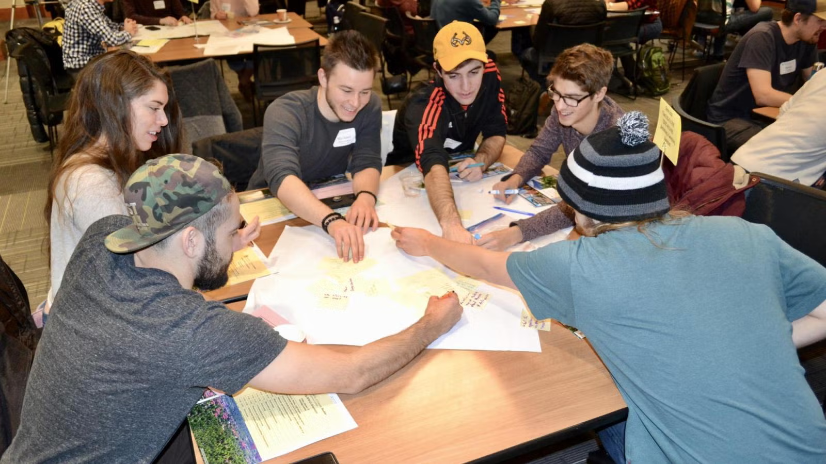
5 / THE SOLUTION
Students Teaching Students
A structured in-school program where older students facilitate small groups of younger students working through current classroom material.
Increasing Social Engagement
01
Limited Tech
We want students to be engaged, talking to each other, and building relationships
Learning content is paired with social engagement to strengthen education and peer bonding.
02
Paper & pencil first
03
Student-facilitated
Notes:
Ben

Slide 6
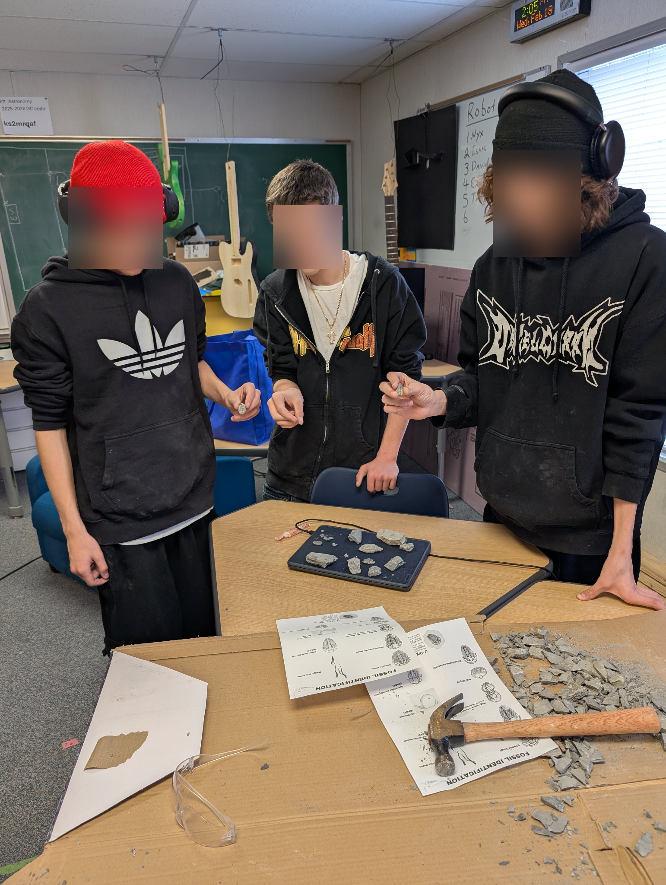
6 / IMPLEMENTATION
How This Program
Will Be Implemented
STRUCTURE
Study halls, recitations, or advisory periods · Peer groups of 4-5 students · Students separated by 2-3 years
MODEL
Students teach core concepts which builds mastery for the teacher, active learning for the learner. This interaction builds student social skills, increasing their interest in the learning environment.
WEEKLY SCHEDULE
1 hr: Lesson development in peer groups · 1 hr: Small group + one-on-one teaching sessions
"I like being able to get into small groups and talk about a subject we really care about." - Student (Survey)
Notes:
Ben

Slide 7
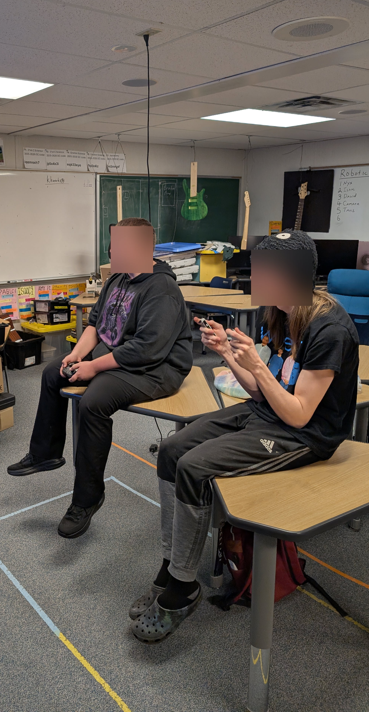
7 / WHY IT WORKS
Why We Know it Will Work
ENGAGEMENT ALONGSIDE CONTENT
OLDER STUDENTS MODEL THE SKILLS NEEDED
PEER TEACHING STUDY · QUASI-EXPERIMENTAL
ACTIVE LEARNING · UMN CENTER FOR ED. INNOVATION
Without engagement, nothing else works
11th–12th graders have recovered
Improved academic performance
Active engagement deepens learning
"Getting to a curriculum unit is secondary to engagement. If I have something they're engaged with, I'm going to run with it."
Seniors and juniors are "generally better at communicative skills, working independently, and being responsible for themselves."
200 high schoolers. Peer teaching group outperformed the control on standardized tests. Engagement scores also rose significantly. Social-emotional outcomes improved.
https://www.researchgate.net/publication/381540425
Actively engaging with material strengthens memory encoding and retrieval. Shown to improve performance, decrease failure rates, and narrow achievement gaps.
https://cei.umn.edu/teaching-resources/leveraging-learning-sciences/active-engagement-material-improves-learning
Notes:
Esther
We know this works because research consistently shows that engagement has to come before content.
Without engagement, students don’t learn effectively.
We also see that older students already have the communication and independence skills needed to lead and support others.
Peer teaching has been shown to improve academic performance. Students who teach and explain concepts actually understand them better.
And active learning deepens understanding. When students are participating instead of just listening, they retain more and perform better.

Slide 8
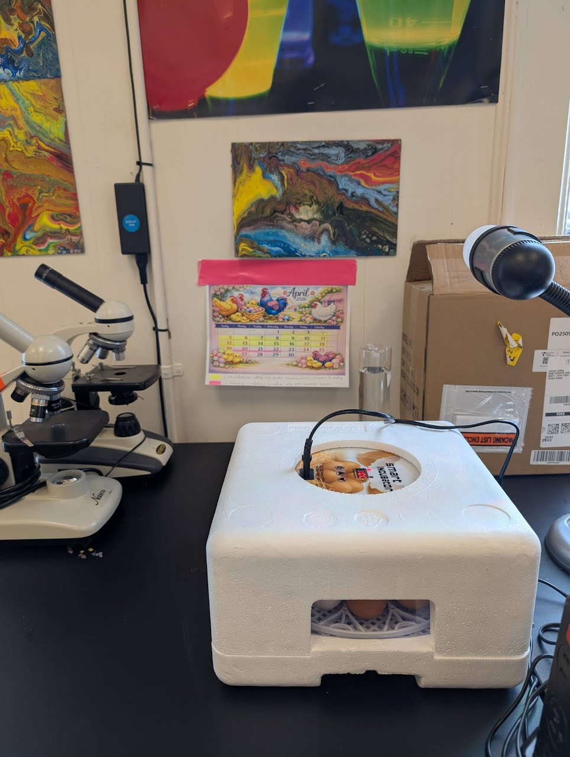
8 / OUTCOMES
Learning Outcomes
COMMUNICATION & PUBLIC SPEAKING
LEADERSHIP & RESPONSIBILITY
Explain complex ideas clearly · Speak confidently in groups · Adapt messaging for different audiences
Own teaching and mentoring roles · Build accountability to peers · Gain experience guiding group learning
SOCIAL ENGAGEMENT & COLLABORATION
CRITICAL THINKING & MASTERY
Strengthen peer-to-peer connection · Active listening and discussion · Engage with diverse perspectives
Deepen understanding by teaching · Break down and structure information · Problem-solving through discussion
CONFIDENCE & BELONGING
Increased purpose in school · Stronger student identity · More meaningful connection to the learning environment
Notes:
Aspen

Slide 9
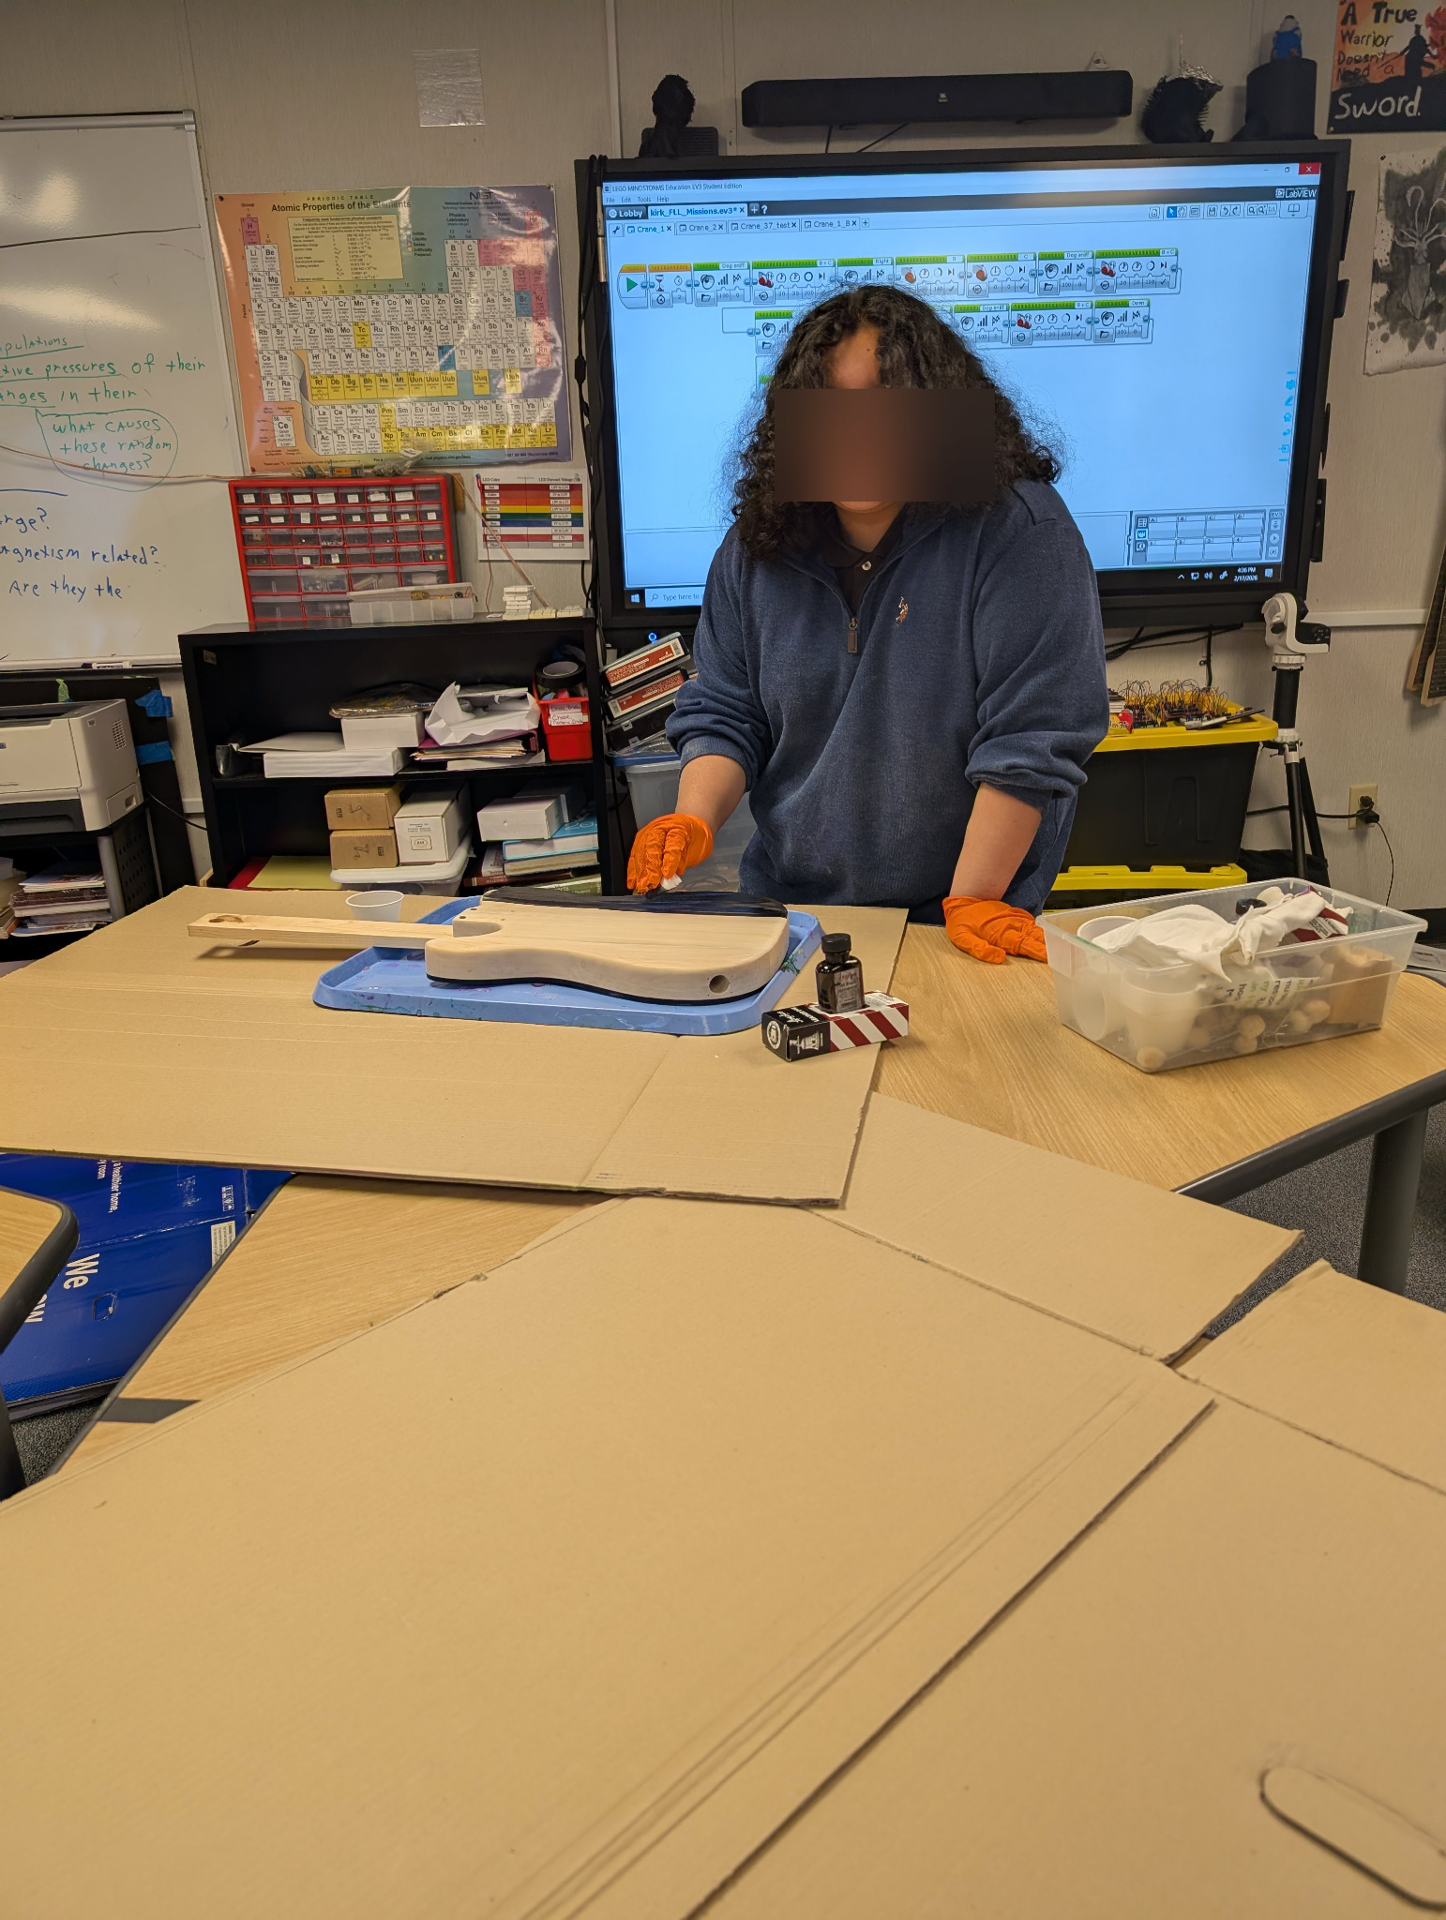
9 / THEORY
Leadership Theory
This program embodies three established frameworks for developing student leaders.
TRANSFORMATIONAL LEADERSHIP
Leaders inspire others to grow
Students inspire younger peers to think critically and become leaders themselves.
DISTRIBUTED LEADERSHIP
Leadership is shared across a group
No single teacher holds all authority — every student facilitator shares responsibility for learning.
SERVANT LEADERSHIP
Leaders serve others' growth
Older students build their own skills by prioritizing the development of younger classmates.
Students Teaching Students doesn't just teach content, it develops the next generation of leaders.
Notes:
Aspen

Slide 10
10
Summary
WHAT RESEARCH SHOWS
OUR SOLUTION
WHY IT WORKS
Active learning beats passive lectures
Student Teaching Students Program
Makes students active, not passive
Students retain more and perform better when actively participating vs. listening.
Learning through explanation and discussion instead of just listening.
Engagement drives outcomes
Students teach and support other students
Rebuilds social confidence
Participation leads to deeper retention and stronger academic results.
Regular peer interaction restores communication skills lost during COVID.
Built into existing time, no schedule disruption
Peer teaching raises scores
Addresses the root cause
Students who explain ideas to others show higher test scores and stronger understanding.
Focus on discussion, explanation, and interaction
Disengagement comes from isolation and passivity, this program directly reverses both.
Collaboration boosts confidence
Encourages face-to-face, screen-free participation
Prepares for real life
Interaction and discussion naturally increases engagement and social confidence.
Builds confidence and communication skills
Builds collaboration and communication skills students need beyond school.

Slide 11

Thank You
Questions?
Students Teaching Students · Boulder, CO · 2026

Slide 12

DISCLAIMER
Our Primary Source:
Kirk Hawks
15 year educator
alternative school for at-risk 8-12th students
This doesn't represent the student population as a whole but the problems are the same.
His students are a magnified version of the problem that is happening everywhere.
By designing a program centered around the most at risk students, we create a program that addresses the needs of all students.
Notes:
Designing for the most disabled, at-risk, or marginalized students benefits all students because it targets the highest concentration of barriers in a learning environment. These students are not experiencing different problems—they are experiencing the same challenges as their peers, but at a greater intensity: gaps in foundational knowledge, disengagement, lack of confidence, and limited access to individualized support.
When a program is built to meet needs at that level, it necessarily becomes more accessible, flexible, and responsive. The supports that help the most at-risk students—clear instruction, repetition, peer support, and multiple ways to engage—also strengthen learning for students who may be struggling less visibly.
In this way, designing for the highest level of need doesn’t isolate a subgroup; it improves the overall system. It ensures that no student falls through the cracks while simultaneously enhancing comprehension, confidence, and engagement for all learners.

