Slide 1
BetterBites
snack smarter. feel better.
Tanner Nott, Rebekah Roberts, & Anna Wagoner

Slide 2
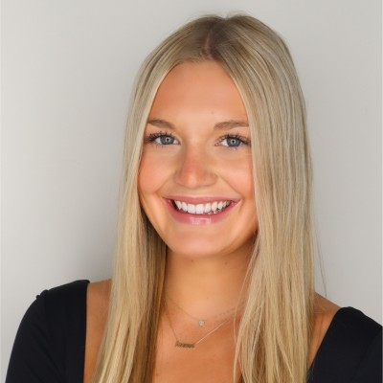
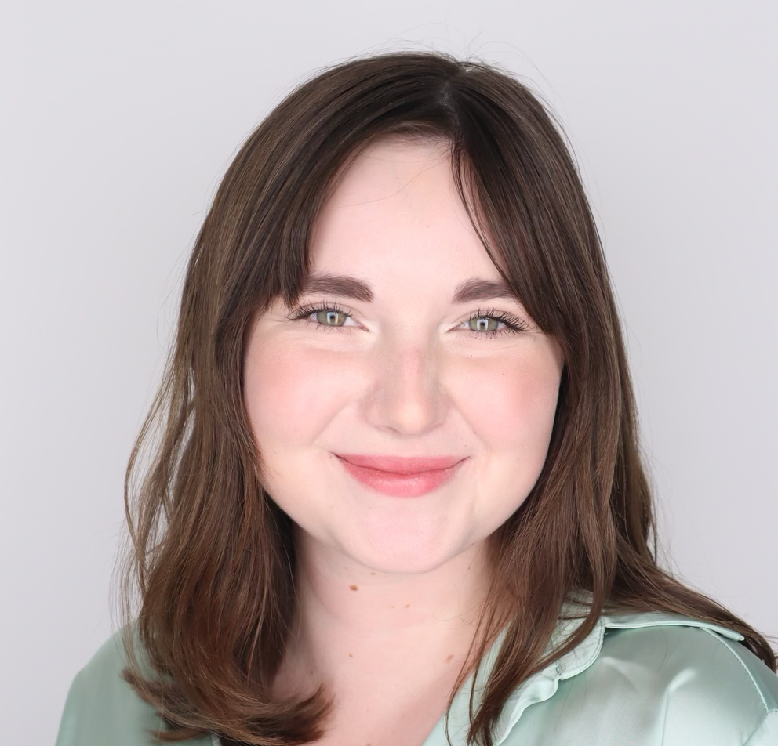
Team
Tanner Nott
Rebekah Roberts
Anna Wagoner
CEO & Founder
CFO
CMO

Slide 3
The Problem
88% of melatonin products inaccurately labeled
81% of participants crave sweets before bed
>70% of participants have issues with sleep
Notes:
We have done over 100 interviews and over 70% of our participants alone have issues regarding their sleep.
When interviewing and researching, the first solution people jump to is melatonin. We’ll show you later in our consumer validation more in depth feedback about melatonin. However, 88% of melatonin products are inaccurately labeled. This skews as much as only containing 80% of the claimed dose or having as much as 500% of the supplement. We found that over 70% of adults are overusing melatonin.
When researching the main influences on sleep health, diet is a huge one. 82% of Americans eat ultra processed foods which have been scientifcally proven to deter sleep quality. High in fat, sugar, low in micronutrients which leads to releasing adrenaline, cortisol, and higher inflammatory profile.
***3.9 days on average americans snack before bed

Slide 4
Our Solution: BedtimeBites
nutritious
+
satisfying
magnesium
transparency
Notes:
Talk abt
*benefits of magnesium
-aids in muscle relaxation and promotes recovery
-supports healthy blood sugar levels
-boasts anti-inflammatory benefits,
-soothe PMS symptoms in women
-calming properties and safe to take everyday
-may promote heart health
*magnesium content in ingredients
-Pride ourselves on being transparent, easy to understand, build consumer trust
-still allowing for indulgence, but prevent blood sugar spikes which will help with sleep
-mitigating the issue of a poor diet by supplying nutrient dense ingredients for holistic benefits
magnesium: better sleep without the pill
**30 more min of sleep with seeds vs pretzels

Slide 5
Natural Way = Best Way
Magnesium vs. Melatonin
93.1%
23.7%
Of those who tried magnesium, would use again
Of those who tried melatonin, would use again
Notes:
“Higher levels of magnesium are associated with better sleep, longer sleep times, and less tiredness during the day.” (sleep foundation)
Recommended dose is 310-420 mg for sleep. Good to aim for no more than 350
Magnesium is an essential mineral people get thru food, melatonin is a hormone produced by the brain

Slide 6
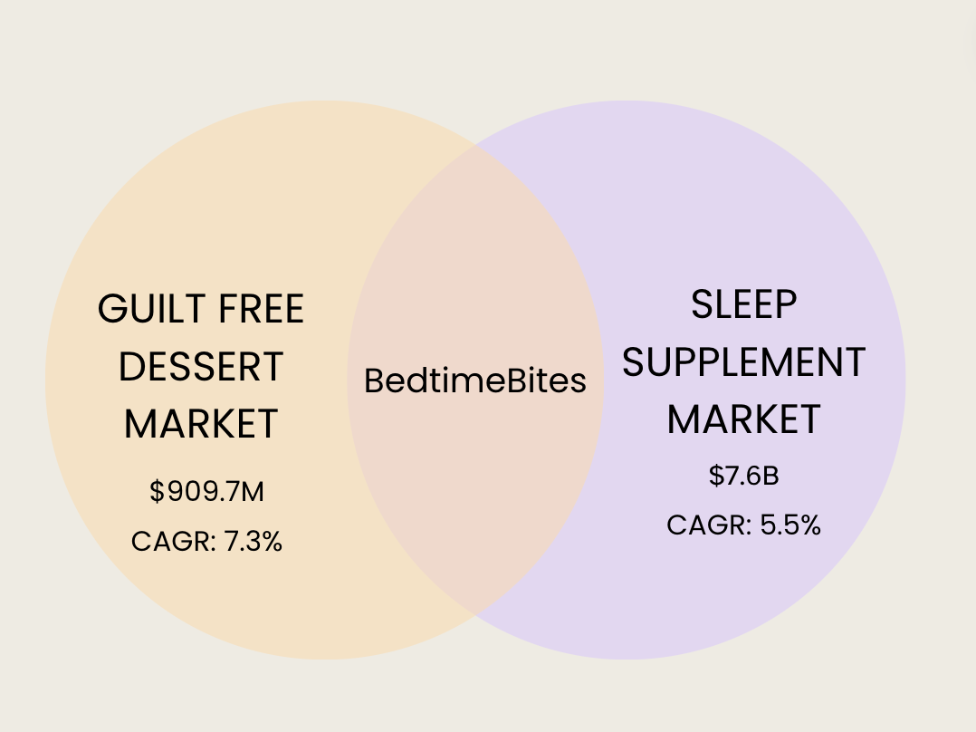
Opportunity

Slide 7
Competition Matrix
Notes:
Add growth opportunity to another competitive matrix, are we thinking about the market big enough??? Have to watch all of our competitors, keto and hail merry.

Slide 8
Timeline
June ‘24:
Finalize contracts with co-packers
Dec ‘24:
Trade shows, expand online retail
March ‘25:
Scale up: more equip.
June ‘25:
Product ext + innovation
May ‘24:
R&D + samples
Sept ‘24:
Launch sales via website
Jan ‘25:
Hotels, airports
April ‘25:
National retail exp.
Notes:
Talk about our business model here
Month 1-3 (april-may 2024): market research and product development
Conduct detailed market research to understand consumer preferences and refine product based on consumer feedback and market demands
Establish relationships with potential B2B partners
Production and packaging (june-august 2024):
Finalize production agreements with co-packers to scale up production
Develop packaging suitable for both b2c retail and b2b
Ensure compliance with regulations + labeling
September 2024: launch and initial sales
Launch bedtimebites for b2c sales through social media, website, and local markets
Begin outreach to potential b2b with product samples and presentations
Implement marketing strategies to create brand awareness and drive initial sales
December 2024:
Expand b2c sales by partnering with additional online retailers and local stores
Attend trade shows and industry events to showcase products to potential b2b
Gather feedback from initial customers and adapt marketing to strengthen brand positioning
January 2025: distribution expansion
Secure partnerships with bigger retailers - hotels, airport
March 2025: scale up
Invest in additional equipment as needed to support growth
Evaluate sales data and feedback to refine product offerings
April 2025: national retail expansion
National retail chains for placement in grocery stores and specialty food stores
Negotiable favorable terms for shelf space and promotional opportunities
Launch targeted marketing campaigns to drive consumer awareness and demand in new locations (whole foods, sprouts, target)
June 2025: potential product line extension

Slide 9
Use Of Funds
$100k
Marketing-> 20%-> $20,000
R&D-> 75%-> $75,000
Margin of Safety-> 5%-> $5,000
Notes:
From here I will estimate how much we will spend on an average cash basis

Slide 10
THANK YOU!
Questions?
hello@bedtimebites.com
bedtimebites.com

