Slide 1


JET Capstone Project ‘24:
Integrating Essay-writing Into Classes
Mohammad Rezwanul Haque Masud
PhD Candidate
Department of Political Science
April 17, 2024

Slide 2
Why?
Students are not on the same page when it comes to writing
Students' ability to follow a paper-writing structure properly is directly correlated with their chances of doing well in college or university
We often take it for granted that they know academic writing.
My project addresses this gap and proposes incorporating writing workshop(s) into the syllabus and course to better equip students with basic academic writing skills.

Slide 3
Social Justice in the Classroom
Students from specific socio-economic backgrounds, especially from marginalized ones, usually struggle to present their arguments in a well-structured manner.
They are often not responsible for their shortcomings. However, this leads to discrepancies in their grades, potentially impacting their later life opportunities.
My project seeks to create a level-playing ground by offering basic academic writing sessions/workshops in the course so that students from all backgrounds know how to write a thesis statement, a topic sentence, etc. They can use these skills in any of their courses.

Slide 4
Target Audience and Impact
Generally, this project aims to impact all undergraduate students, especially those who take intro courses.
More specifically, the project's target audience is those who did not have a chance to take any formal training/course on academic training.
One example of the project could be to dedicate one class session to introducing the basics of academic writing. An instructor could explain the concepts of thesis statements, topic sentences, introductory paragraphs, and summarizing paragraphs and let students free-write examples in the class.

Slide 5
Applicability
This project can be tailored to any course or discipline!
Why not the writing center? While that is ideal, but again, many students (especially first-gen) often feel reserved in reaching out to such services.
Such sessions can also help underline the necessity of writing centers for students.

Slide 6
Timeline
Better if it’s integrated into the syllabus
Sessions can be arranged at the beginning of the semester or before the essays are due

Slide 7
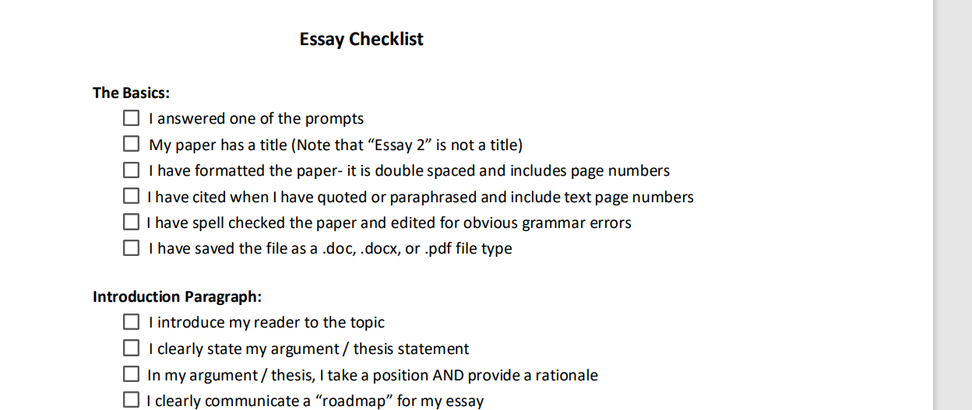
Example

Slide 8
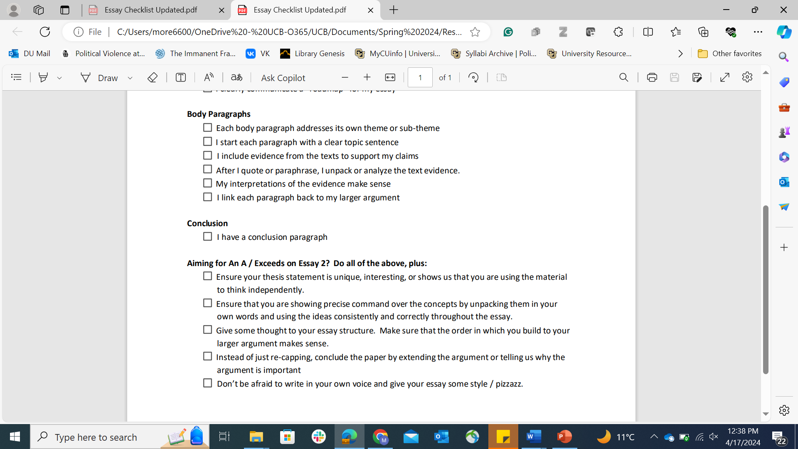
Example

Slide 9
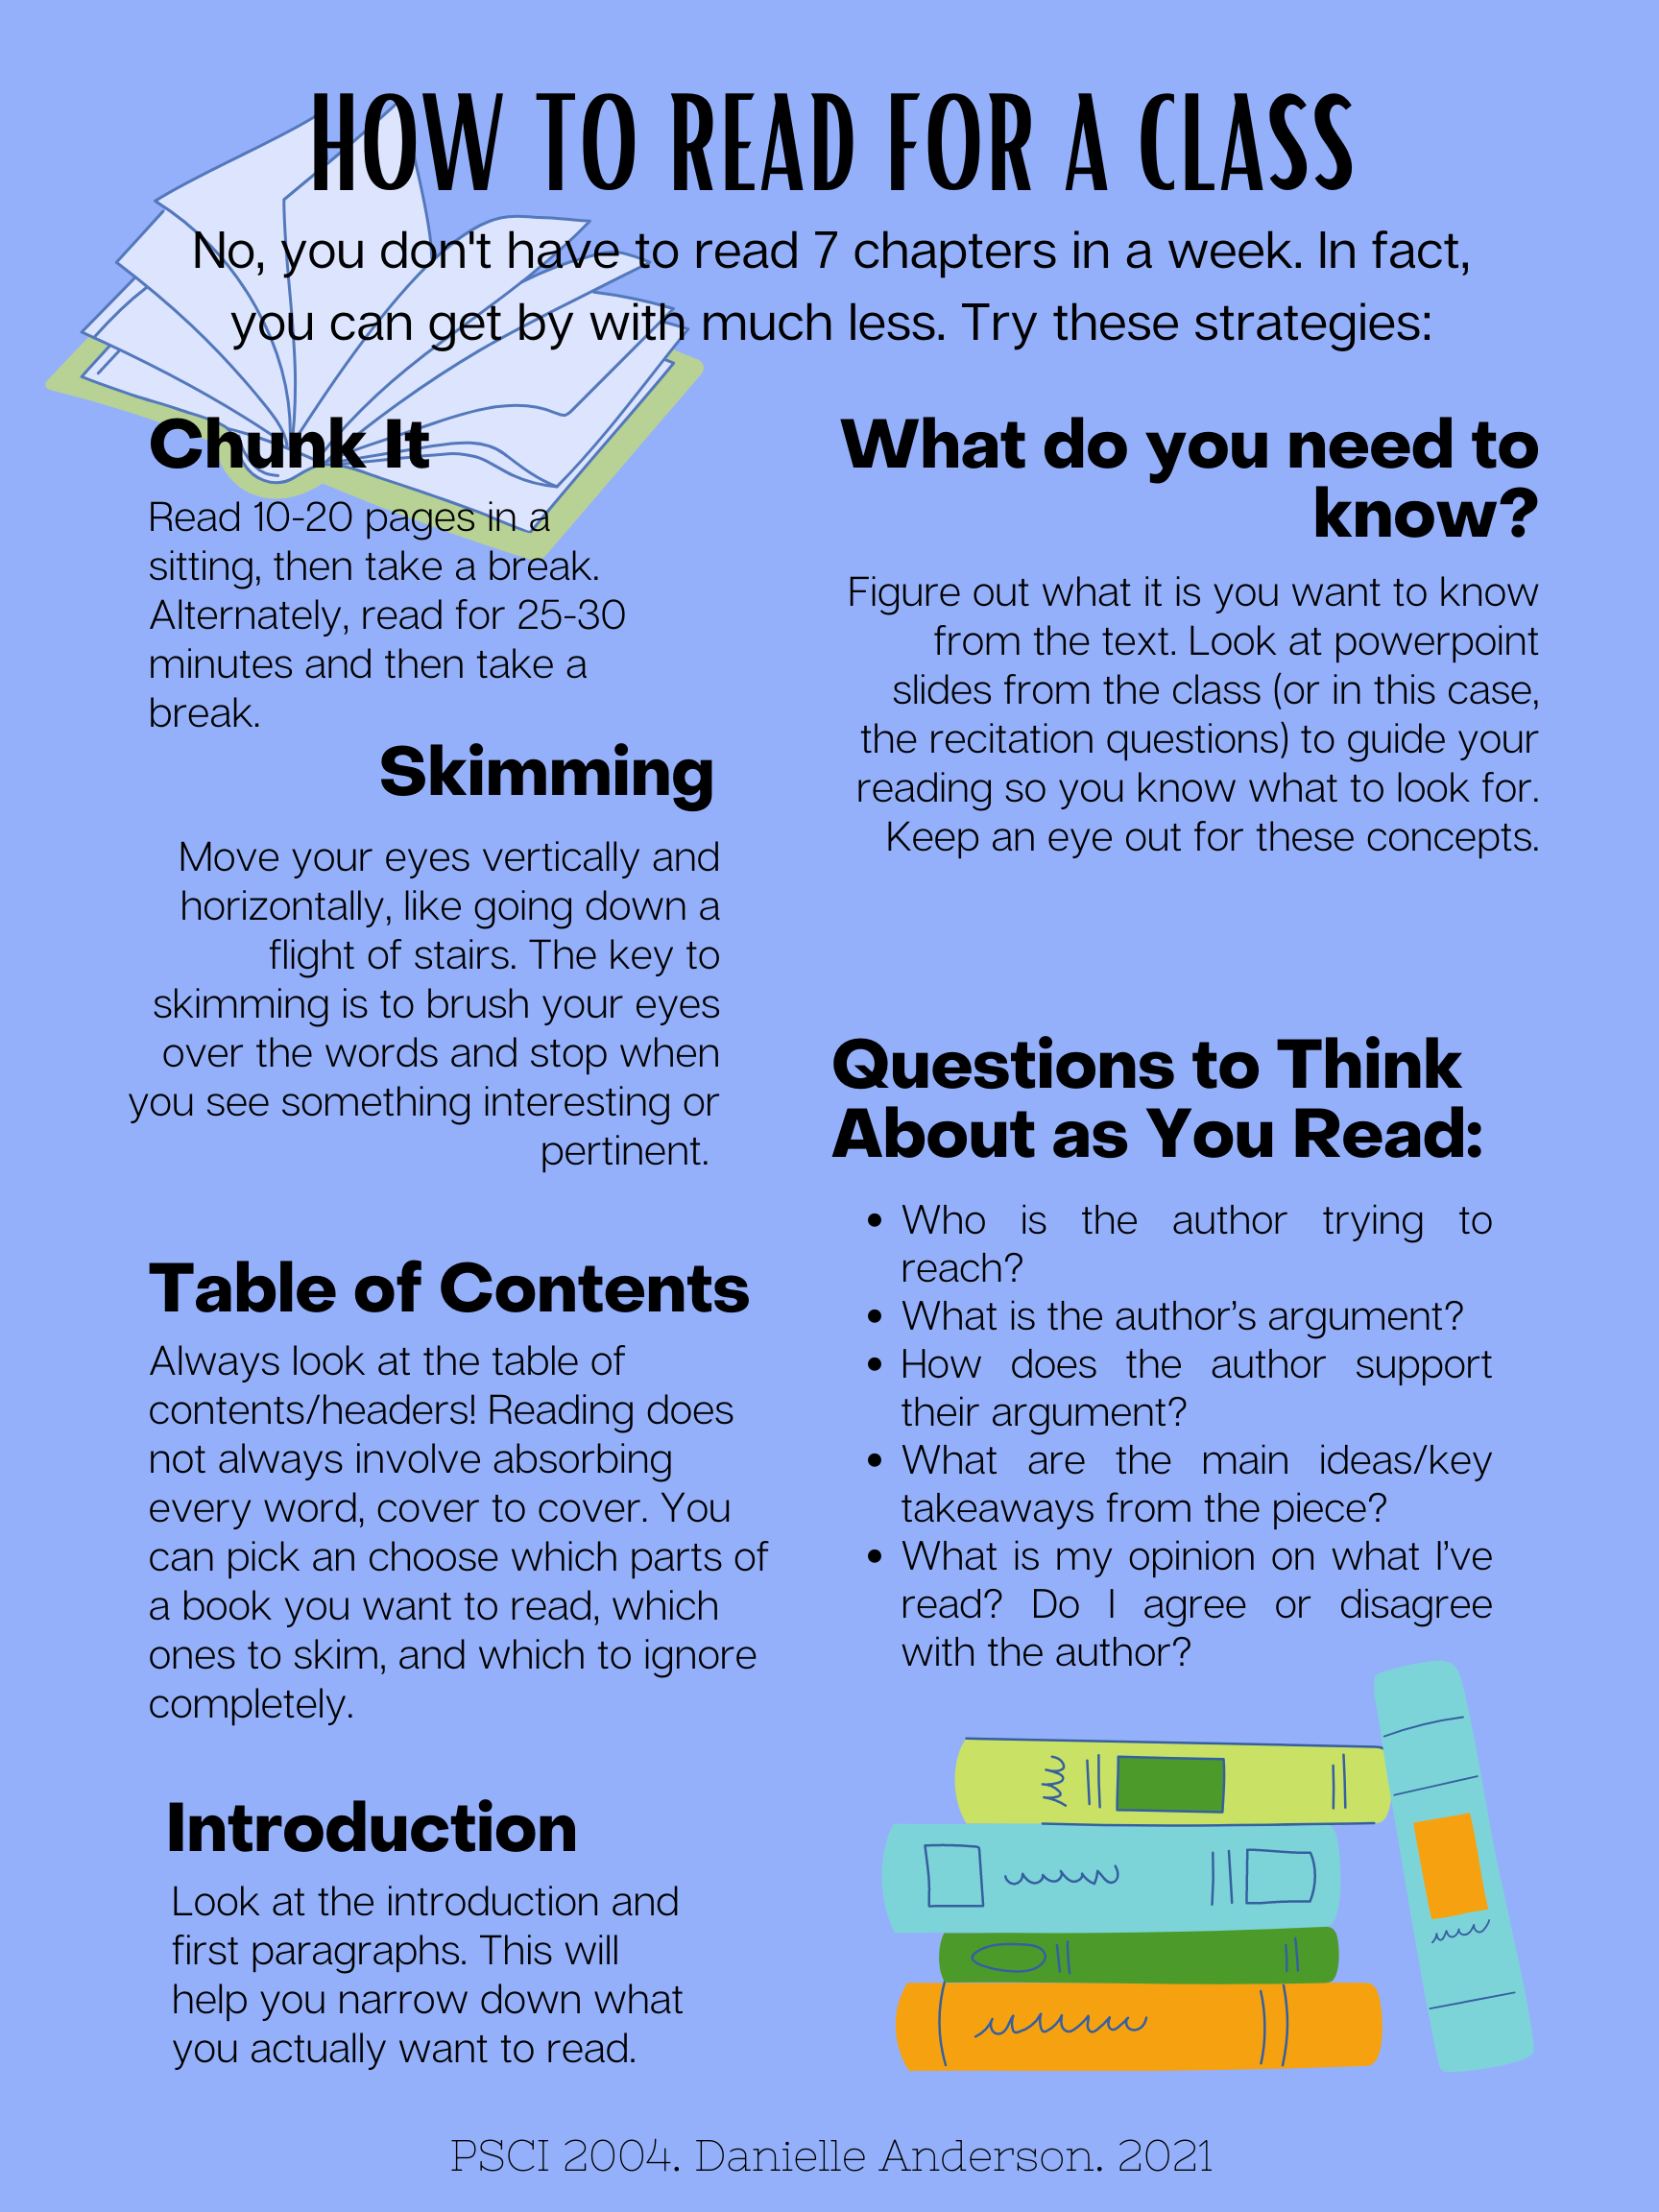
Extra Resources

Slide 10

Thank you!

