Slide 1
Transition from field mapping to small group synthesis of analytical datasets
Six datasets available
Advanced field structural data
Microstructure
Mineralogy and metamorphic petrology
Metamorphic monazite geochronology
Igneous zircon geochronology
Detrital zircon geochronology

Slide 2
What will this involve?
Tasks
Read journal article and answer some questions
Background research – understand basic foundation of data acquisition & interpretation
Draft final report
Oral presentation
Final report with revised map and cross-section
Notes:
t

Slide 3
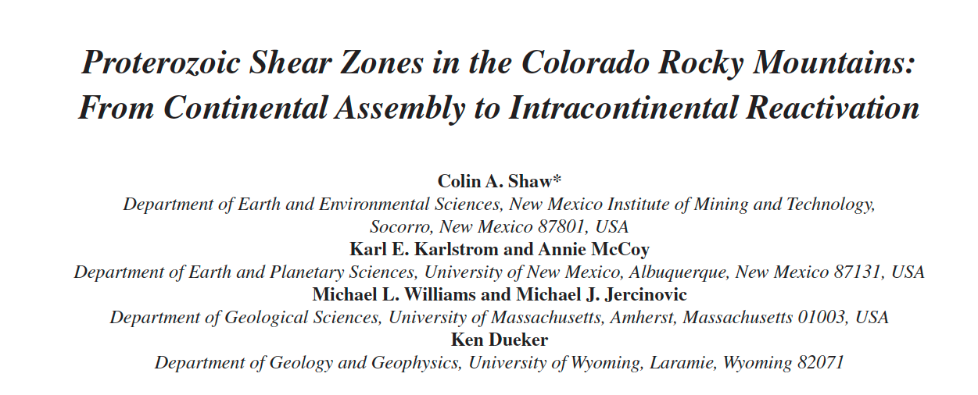
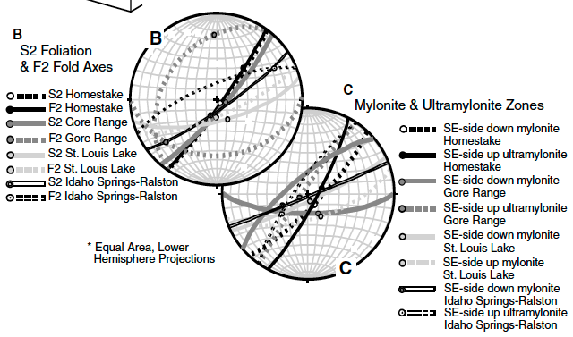
Small group synthesis
Pre-course assessment question:
How do outcrop-scale structures in igneous and metamorphic rocks and their geometries relate to one another and to larger regional tectonic histories?
Dataset 1 - Advanced field data structural analysis
The paper is:
The data is:
Shaw,C.A., Karlstrom, K.E., McCoy, A., Williams, M.L., Jercinovic, M.J., and Dueker, K., 2002, Proterozoic shear zones in the Colorado Rocky Mountains: From continental assembly to intracontinental reactivation, In Science at the Highest Level, ed. Lageson, D., GSA Field guide, v. 3
The questions are:
The full dataset of field structural data from all 110 stations – Excel spreadsheet
Improved 3-D picture of structure in area
Utility of stereonets for quantitative analysis
Value of x-sections
Tectonic implications
Uncertainties?

Slide 4
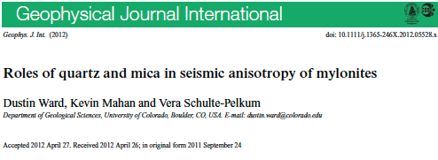
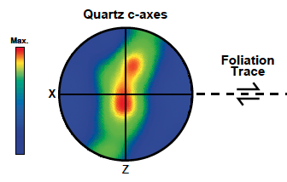
Small group synthesis
Pre-course assessment question:
How can microstructures in rocks be related to larger regional tectonic histories?
Dataset 2 - Microstructural analysis
The paper is:
The data is:
Ward, D., Mahan, K., and Schulte-Pelkum, V., 2012, Roles of quartz and mica in seismic anisotropy of mylonites, Geophysical Journal International, doi: 10.1111/j.1365-246X.2012.05528.x.
The questions are:
An Electron Backscatter Diffraction (EBSD) dataset with crystallographic orientations for dynamically recrystallized quartz in the Coal Creek quartzite mylonite
Dislocation creep
Utility of stereonets for analysis of crystal orientations
Relation to shear zone temperature conditions and shear sense
Uncertainties?

Slide 5
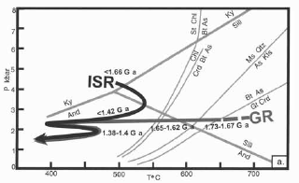
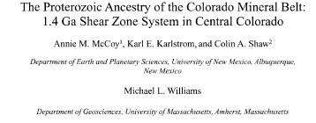
Small group synthesis
Pre-course assessment question:
How can metamorphic minerals and mineral assemblages be related to larger regional tectonic histories?
Dataset 3 – Mineralogy and metamorphic petrology
The papers are:
McCoy, A. M., Karlstrom, K. E., Shaw, C. A., and Williams, M. L., 2005, The Proterozoic ancestry of the Colorado Mineral Belt: 1.4 Ga shear zone system in central Colorado, American Geophysical Union Geophysical Monograph 154, p. 71–90.
Ward, D., Mahan, K., and Schulte-Pelkum, V., 2012, Roles of quartz and mica in seismic anisotropy of mylonites, Geophysical Journal International, doi: 10.1111/j.1365-246X.2012.05528.x.
The questions are:
What is equilibrium?
Key index minerals and assemblages?
P-T histories?
Tectonic implications?
Uncertainties?

Slide 6
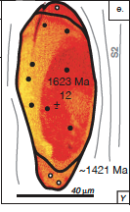
Small group synthesis
Pre-course assessment question:
What are some field and laboratory methods that can be used to determine the relative and absolute ages of metamorphic and deformation events?
Dataset 4 –Metamorphic monazite geochronology
The papers are:
The data is:
McCoy, A. M., Karlstrom, K. E., Shaw, C. A., and Williams, M. L., 2005, The Proterozoic ancestry of the Colorado Mineral Belt: 1.4 Ga shear zone system in central Colorado, American Geophysical Union Geophysical Monograph 154, p. 71–90.
The questions are:
Monazite geochronology data for Idaho Springs shear zone– Excel spreadsheet
What is monazite?
How does U-Th-totalPb geochron work?
Relation to deformation and metamorphism?
Tectonic implications?
Uncertainties?

Slide 7
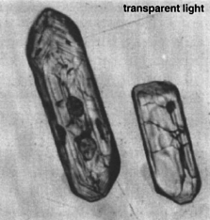
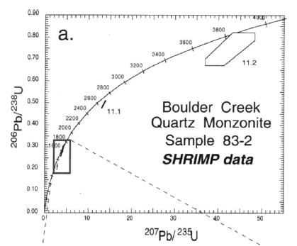
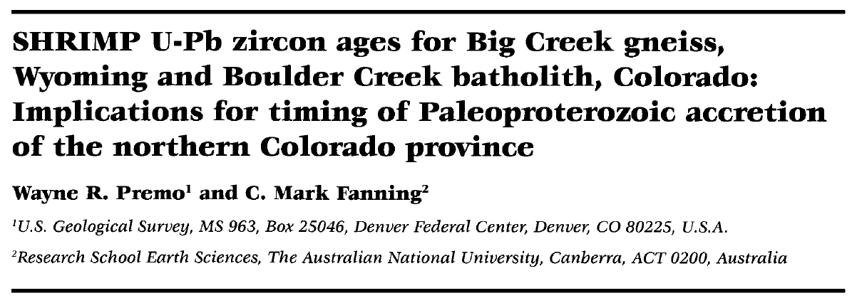
Small group synthesis
Pre-course assessment question:
What are some field and laboratory methods that can be used to determine the relative and absolute ages of pluton crystallization (or magmatic events)?
Dataset 5 - Igneous zircon geochronology
The paper is:
The data is:
Premo, W. R. and Fanning, C. M., 2000, SHRIMP U-Pb zircon ages for Big Creek gneiss, Wyoming and Boulder Creek batholith, Colorado: Implications for timing of Paleoproterozoic accretion of the northern Colorado Province, Rocky Mountain Geology, v. 35, p. 31-50.
The questions are:
Zircon geochronology data for Boulder Creek batholith– Excel spreadsheet
How does U-Pb geochron work?
How used to date igneous rocks?
What is inheritance?
Tectonic implications?
Concordia diagrams
Uncertainties?

Slide 8
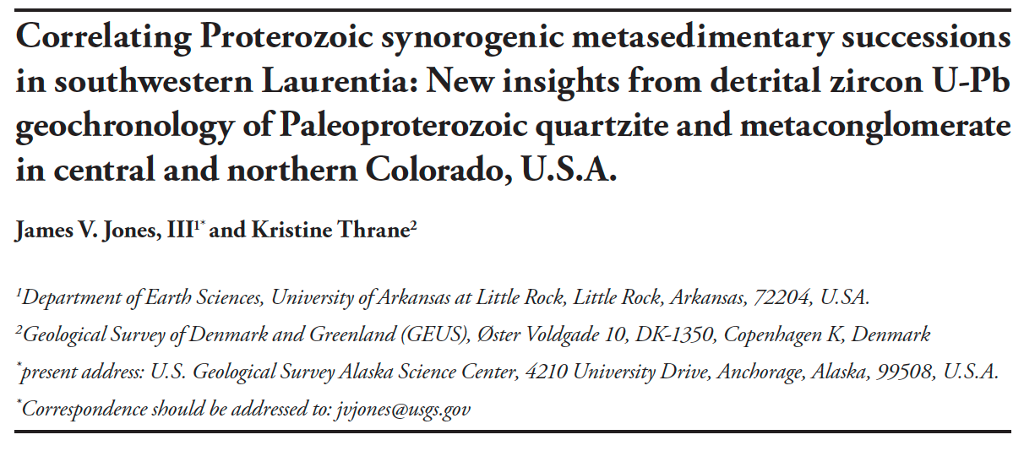
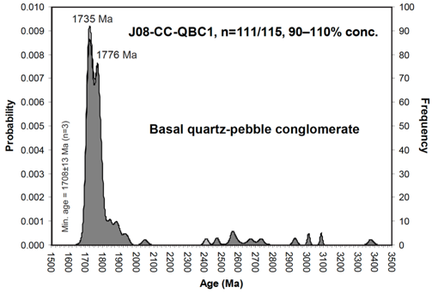
Small group synthesis
Pre-course assessment question:
What are some field and laboratory methods that can be used to determine the relative and absolute ages of deposition of sediments that are now metamorphosed in the rock record?
Dataset 6 - Detrital zircon geochronology
The paper is:
The data is:
Jones, J.V., III and Thrane, K., 2012, Correlating Proterozoic synorogenic metasedimentary successions in southwestern Laurentia: New insights from detrital zircon U-Pb geochronology of Paleoproterozoic quartzite and metaconglomerate in central and northern Colorado, U.S.A., Rocky Mountain Geology, v. 47, p. 1-35
The questions are:
Zircon geochronology data for Coal Creek quartzite– Excel spreadsheet
How does U-Pb geochron work?
How used to date sedimentary rocks?
What is provenance?
Tectonic implications?
Uncertainties?

