Slide 1

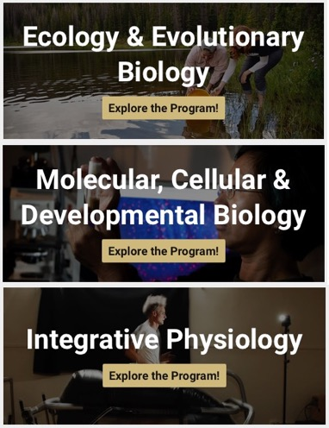
Investigating the needs of
CU Boulder’s international students in science degree programs
Zachary Hazlett (he/him) Capstone Project Action Plan
TIS Workshop – Spring ‘24

Slide 2

Identifying the gap
International students are faced with a host of challenges from cultural adjustment to overcoming language barriers
Science education presents unique challenges to international students:
Programmatic supports for international students in the dept. of MCDB do not exist
Instructors and faculty in our department are probably unaware of how many international students we serve or what specific needs they have
Technical language barriers
Historically difficult STEM courses
The “Hidden Curriculum”

Slide 3
Action Plan (8-14 weeks)
Survey:
Supporting International Students in STEM @ CU
Discipline-specific needs/challenges (open response or categorized)
Department
Undergrad/Grad Students
Year in school
Native language
Resources they would like access to
Likelihood of accessing these resources if they existed
Present info on current university supports (Ex. ISSS)
Nationality
Interview the chair of each department (2-3 weeks)
Seek support from department advisors (1 week)
Administer an anonymous survey to current international students (3 weeks)
Summarize findings; Present to dept. leaders; Develop collaborative action plan (2-3 weeks)

Slide 4


Questions?
@LabsterVirtualLab; Youtube.com

