Slide 1
Start-up Finance for First Time Entrepreneurs
The Financial Basics of Starting a Business
“Start-up Finance for First Time Entrepreneurs” by Karen Crofton is licensed under CC BY 4.0 – Slides plus supplemental Spreadsheets

Slide 2
How to use this course
This course assumes you have an idea which you have validated through customer discovery and market research.
This course also assumes you are new to entrepreneurial ventures and as such, the course provides some detailed information but highlights beginner tips to focus on so that the content does not becoming overwhelming. These tips are shown with the following book icon…
NOTE : Seasoned entrepreneurs may find the content to be simplified and may seek an alternate resource. This content is meant to be introductory.
Beginner tip

Slide 3
Financial aspects of starting a business….
Selecting a business model
Financial statements
Creating a forecast model
Selecting a legal entity
What type
What are the pros/cons
Recording ownership
Cap tables
Types of funding
Metrics to measure?
KPIs
Investor communications
What can go wrong?
Examples

Slide 4
1. Business Models
There are many great ideas, but they also need to make money!
There are many ways in which you can be paid.
The two simplest are…
One time sale – this is a one-time exchange for your product or service
Subscriptions – A repeating payment in exchange for on going use, subscriptions can come without a limit or be tied to usage
One-time sales are easiest, subscriptions are slightly harder but provide a mechanism for continuing revenue which is often preferred by investors.

Slide 5
1. Business Models
More complicated methods which may be more difficult to execute…
Rental – this is a temporary exchange for your product, because you retain ownership of the asset there are often liability issues
Licensing – this is allowing someone else to sell your product for you and you accept a small percentage, this relieves you of the responsibility of execution but also means you are relying on someone else
Fees – If your service is to connect others you can not collect payment for the asset, but you may collect a fee. This may be necessary if you are a marketplace but that means you must have fairly large volumes of activity
Advertising – you received a small amount of money for each visitor who views an ad. This requires very large numbers of transactions as the price per ad can be less than $0.01.

Slide 6
1. Business Models
Why does your business model matter?
Your business model determines..
How and when you bring in cash.
When you can spend money and if you need debt.
How many customers you need to be profitable.
The limitations of your scaling mechanism.

Slide 7
1. Business Models
Three Main Accounting Reports
Income statement, Balance Sheet, Statement of Cash Flows
All three statements are linked by line items which are transferred to the next report
Income statement
Statement of Cash Flows
Revenue
Expenses
Operating Cash
Net Income
Investing Cash
Balance Sheet
Liabilities
Financing Cash
Shareholder equity
Total Cash
Total Assets

Slide 8
1. Business Models
Together, the three main accounting reports measure the business’s health.
They are necessary to make accurate and timely decisions, such as:
How much cash do we need?
Where should we get it? Investment or Debt?
When will we run out of cash?
What are we spending our money on?
What levers are there to change our cash flows positively or negatively?
Are we spending our money on the RIGHT things?
When do we get to cash flow break even?
Can we afford to increase headcount? If so, how many? When?
Do we need to reduce headcount? If so, how many? When
How should we price Product A?
How much are we making on Product B?
Is Product C profitable?

Slide 9
1. Business Models
Please see the additional excel file associated with this course –
Startup Finance for First Time Entrepreneurs - Example Financial Models.xlsx
This file contains six tabs with the following information:
Example of inter-related Income Statements, Balance Sheet and Statement of Cash Flows
Income Statement model for subscriptions with churn
Typical Balance Sheet
Typical Statement of Cash Flows

Slide 10
1. Business Models
Assignment
Review the financial statements for your favorite company.
How can things go wrong?
Do they have enough cash?
Do they have diversified revenue streams?
Look up the following terms and check them against your company:
Working Capital
Debt to Equity Ratio
Return on Equity

Slide 11
2. Legal Entity- What IS a company? (USA)
Easy
Legal effort
Difficult
 | Sole Proprietorship | LLC | Partnership (General) | Partnership (Limited) | S Corp | C Corp
Owners | 1 | 1+, No Limit | 2+ | 2+ | <100 | 1+, No Limit
Liability | Unlimited | Limited to Owners’ investment | Unlimited Joint & Sever | Limited to investment | Limited to SHE’ investment | Limited to SHE’ investment
Equity Sources | Owner | VC & Equity offerings to owners | Owner; Friends & Family | GPs & LPs | VC & Sub S investors | VC & Common SHE
Tax Rate | Personal Rate | Personal Rate | Personal Rate | Personal Rate | Personal Rate | Corp. Rate + Dividends
Pro/Con
LLCs are easiest, if you want to take investment money you will need to be a C Corp
You can convert an LLC to a C Corp

Slide 12
3. Recording Ownership
There are several ways in which you may take money into your company:
Revenue from Sales of your product or service
Taking out a loan (bank or even using a credit card)
Grants/Prize Money
Crowdfunding
Convertible debt (Convertible Note, SAFE- “Simple Agreement for Future Equity”)
Equity Investment
Equity Investments require having a Capitalization Table (CAP Table), which can be very complicated. Thus, Cap Tables will be explained in the following slides.

Slide 13
3. Recording Ownership
A capitalization table, usually called a “cap table”, is a way to show who owns how much of the company when money is accepted as an equity investment. For a startup, the cap table is a record of all the shareholders of your company. This could include: any founders, angel investors(including friends and family), venture capitalist, and anyone like an employee or advisor to whom you issued shares.
Issued Shares may be different than Outstanding Shares or shares that have been created but not specifically assigned.
This sounds like a simple list, but once you have accepted an investment, the math can be VERY complicated! It is best to get help with accepting money.

Slide 14
3. Recording Ownership
The best way to understand a cap table is to walk through an example.
Please see the additional excel file associated with this course –
Startup Finance for First Time Entrepreneurs – Cap Table.xlsx
This file will step through three rounds of financing

Slide 15
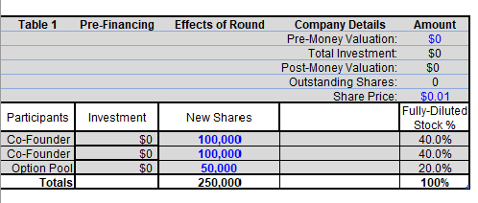
3. Recording Ownership
Table 1 is the Pre-Financing Round, the beginning of your company
Your company many not be worth anything (Pre-Money Valuation of $0), NOTE THE TERM PRE-MONEY, this is the value of your company BEFORE that round’s investment
You must select a share price, this is somewhat arbitrary but often selected as a penny or less, along with a somewhat arbitrary selection of shares (often 100,000 or 1 Million) which then determine your ownership percentage of the company.
Typically, an option pool of 15 to 20 % of shares is created so they can be given to early key employees
Lastly the ownership of each participant is calculated by dividing the number of shares by the total shares

Slide 16
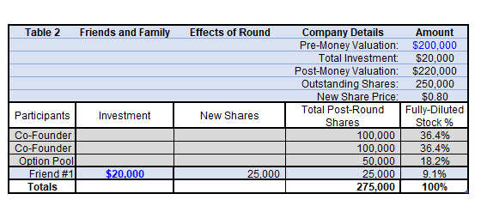
3. Recording Ownership
Table 2 is the Friends and Family Round, the beginning of fundraising
Typically, your first investment will come from people you know as they are already confident in you as a person. Professional investors will want to know you for some time (often 6 months to a year) before they invest.
At this point you must select a valuation. This is VERY difficult. It can be based on assets, or any revenue, or a potential for revenue.
NOTE THE TERM POST-MONEY which is the value of your company after you add the current round’s investment to the PRE-MONEY valuation
Cap Tables are complicated, and it is worth getting trusted help.

Slide 17
3. Recording Ownership
The outstanding shares are transferred from the previous round. This allows the new share price to be calculated by dividing the pre-money valuation by the outstanding shares, as this is the baseline we are working from.
As such, then the new investors are “purchasing” shares at that price. So the new investment ($20,000) divided by the new share price ($0.80) provides the number of new shares (25,000), which are added to the outstanding shares to create the Total Post-Round Shares (275,000).
Which allows the percentage of ownership to be recalculated by dividing owned shares by the total post-round shares.
As you can see, prior owners own less, which means they have been “diluted”

Slide 18
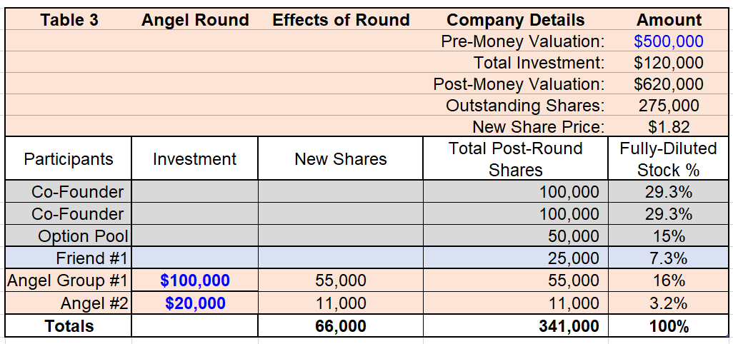
3. Recording Ownership
Table 3 is the Angel Round, this is often your first money from people you did not previously know
Once again we must determine a pre-money valuation, this is likely NOT the same as your first round of funding since you will have made progress to get to this funding round.
Then the following math to get to a post-money valuation, new share price and percentage ownership is the same
Note again, the decrease in ownership percentage of the co-founders AND the first round Friend.

Slide 19
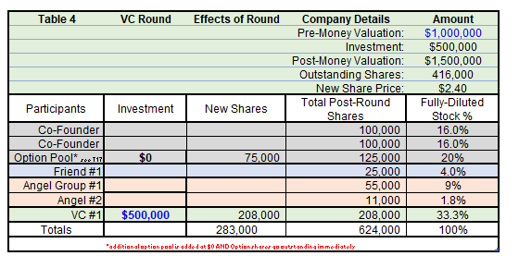
3. Recording Ownership
Table 4 is the Venture Capital Round of funding. Most companies will NOT reach this stage because they either do not need to, or are not successful enough to do so.
Once again, we select a pre-money valuation which is likely a larger increase than from Table 2 to Table 3. The rest of the math is the same
A new component is an add to the option pool. These additional shares are to maintain the 15 or 20% pool ownership range. They are NOT assigned a dollar value as cash was NOT added to the company.
Once again, observe the new ownership percentages. You can alter these values in the excel sheet and observe how valuation and investment dollars affect dilution.

Slide 20
3. Recording Ownership - Terms
Valuation – What your company is worth - * this is difficult pre-revenue or early stage
Liquidation Preference – Multiple of original purchase price on exit (typically 1x)
Participating/Non-participating – How money is returned to investors
Anti-Dilution – Prevents founders giving away ownership to make investors share smaller
Employee Option Pool – Ownership set aside for key hires at later date
Many other detailed terms
Protective Provisions – List of things you can’t do without investor approval
Warrants – Options for investors to buy more ownership at set price
Redemption Rights – Investor can force the company to convert
Information Rights – What company info investors have the right to see

Slide 21
3. Recording Ownership - Stock
Preferred vs Common Stock – Investors get preferred stock; founders get common stock. Preferred puts an order on who gets money first during a liquidation event.
Liquidation event – A trigger that causes the company to return money to its shareholders. This may be voluntary or involuntary.
Remember this can get very complicated and may be necessary to get legal advice

Slide 22
3. Recording Ownership -Liquidation Terms
Preference Multiplier
This value determine the amount an investor must be paid before the common shareholders can receive any remaining money. For example, a 1x (one time) liquidation preference means that an investor in that round must be paid back at least what they invested bore any common shareholders are paid anything. Let’s say at your round you invested $1M for 30% of the company. If the company sells for $1.2M, you receive your $1M back even though 30% of $1.2M is only $360,000. If the company sold for $900,000, you would receive all the proceeds.
In another example you have a 2x multiplier and the company sells for $3M, you would be eligible for a $2M payment despite only investing $1M.
Multiplies are typically 1x or 2x but could be as high as 10x.

Slide 23
3. Recording Ownership -Liquidation Terms
Participation
An investor may have either a participating OR non-participating liquidation preference, separate from the multiplier. In a non-participating preference, the investor has EITHER the option to exercise the liquidation preference OR convert their shares to preferred shares to common shares such that they have a define percentage of equity and will be paid based on that equity and NOT on the multiplier of investment.
Preferred to common share conversions are typically 1 to 1.

Slide 24
3. Recording Ownership -Liquidation Terms
Participation - This can be VERY confusing, so let’s pencil out an example.
You invested $1M with a 1x non-participating liquidation preference which listed you as 20% of diluted ownership. The company sold for $2M.
You may – exercise your liquidation preference and receive $1M (1x your investment)
OR you may – convert your shares to hold your 20% equity and then be paid 20% of the $2M sale price or ($400,0000)
Of course, you would choose to exercise the liquidation….unless the company sells for more than $5M at which 20% of more than $5M will be more than $1M

Slide 25
3. Recording Ownership -Liquidation Terms
Participation – But it gets MORE confusing… NOW
You invested $1M with a 1x participating liquidation preference which listed you as 20% of diluted ownership. The company sold for $2M.
Now you– exercise your liquidation preference and receive $1M (1x your investment)
PLUS you convert your shares to hold your 20% equity BUT of the remaining proceeds. So 20% of the $2M - $1M, or 20% of the remaining $1M, so $200,000.
Thus your final payout is $1.2M. At the $5M sale price you receive $1M plus 20% of $4M or $800,000, so $1.8M.

Slide 26
3. Recording Ownership -Liquidation Terms
Participation - So, its obvious participating is better, right?
Well, not really. It depends on the multiplier the sale price and another term we have not yet talked about.
Participation Caps
A participation cap was introduced to protect the entrepreneur from outsized payouts. A cap will typically be a 1 to 3x multiplier. So our $1M investment with a 1x participating liquidation preference will a 3x participation cap can receive up to $3M in total proceeds.
However, the investor may choose to convert and be paid out more based purely on the equity ownership, but they will then be paid in turn with the entrepreneur.

Slide 27
3. Recording Ownership -Liquidation Terms
Participation – Already confusing but there is one more important term
Seniority – When terms include standard seniority, liquidation preference payouts are paid in order from the last round to the first round. So later investors have an advantage.
But early-stage investors took a bigger risk, shouldn’t they be rewarded. Well, this is tough because early-stage investors make smaller dollar bets and reply on later stage investors to catapult the company to scale. Later stage investors are often in a position to provide high value to the company and in return can ask for better terms.

Slide 28
3. Recording Ownership –Exit Scenarios
Let’s look at a few common exit scenarios and see some sample math…..
You have agreed to invest $4 million ($10 million post money valuation) which means you have a 40% ownership ($2M/$5M). You are buying preferred equity that can be converted to common stock at your discretion.
INVESTOR PAYOUT SCENARIOS – so remember what that means if you are the entrepreneur!

Slide 29
3. Recording Ownership –Exit Scenarios
Sale Price | 1x liquid pref No participation | 1x liquid pref Participation With 3x cap | 3x liquid pref Participation With no cap
$2M | $2M | $2M | $2M
$10M | $4M OR (40% of $10M= $4M) | $4M + (40% of $6M)= $6.4M OR (40% of 10M = $4M) | $4M *3 = $12M, but it only sold for $10M No possibility to convert
$50 | $4M OR (40% of $50 = $20M) | $4M + (40% of 46M) = $22.4M but you are capped at $4M*3 so $12M OR (40% Of $50M)= $20M | $4M*3 = $12M + (40% of $38M) = $27.2M OR 40% of $50M = $20M

Slide 30
3. Recording Ownership –Exit Scenarios
From the previous slide if the company exits at or below your investment, it really doesn’t matter what your terms were
If the company exits for a modest amount above your investment it can matter.
If the company exits for a large amount above your investment, it will likely matter greatly.
However, it is impossible to know, so when selecting terms it is important to have an idea of what your exit might look like so you can do some math in advance.
Venture Capital firm want to make money, but they also want entrepreneurs to do well. Remember as your company does well, you may have an opportunity to restructure, but the terms in the term sheet are legally binding.

Slide 31
4. Metrics to Measure
Each business will be different, and it is critical to select the correct metrics that help you understand if your operations are supporting your company’s goals and if not which levers to pull on to make a correction.
Some Key Metrics to consider:
Customer acquisition cost (CAC) – Cost to get one customer to use your product or service, often from marketing, you can get a low acquisition cost from something like a Groupon but get low revenue per customer, so be careful
Average revenue per user (ARPU)- Average amount you bring in from each customer, this may not be a good metric if you have some customers that pay nothing and some that pay a lot, you may need to list this per customer segment
Customer lifetime value (LTV) – Amount of money for a customer over time, keep your recurring customers happy
Monthly active users (MAU) – Typically for apps, downloads are not as important as active users
Monthly recurring revenue (MRR) – Amount of revenue that repeats each month
ARPA (Annual Revenue per Account) = MRR / Total # of Customers
Revenue growth rate – Rate at which one period’s revenue is greater than the last
Gross Profit = Total revenue minus the cost of goods sold
Gross Margin = Difference between revenue and cost of goods sold

Slide 32
4. Metrics to Measure
CCR (Customer Concentration Risk) = Revenue from largest customer / total revenue
Activation Rate = Number of users taking a specific action to get value out of a product
Customer churn rate (CCR) – How often you lose customers, it is more expensive to obtain new customers than to keep existing customers happy
Revenue churn rate (RCR) - Rate at which revenue is lost from churned customers or downgraded subscriptions.
GCR (Gross Churn Rate) = MRR lost in a given month / MRR at the beginning of the month
Net Churn = (MRR lost – MRR from upsells) this month / MRR at the beginning of the month
Retention by Cohort = % of original installed base (1st month) that are still transacting
ARR (Annual Run Rate) = Projection of current MRR into the future, annualized
Sell-Through Rate = Number of units sold in a period/number of items at the beginning of the period
Loyalty – Net Promoter Score® measures customer experience and predicts business growth. See NPS site for formula
Network Effects = Effect of one user on other users, influencers can be a great marketing tool
Platform Risk = Dependence on a specific platform or channel
Direct Traffic = Traffic coming directly to your site via a link or entering the URL
Organic Traffic = Unpaid traffic from search results

Slide 33
4. Metrics to Measure
TAM (Total Addressable Market) = Revenue opportunity available for a product
Monthly Cash Burn Rate = How much money you spend per month (gross)
Runway –how many months you have before you run out of money – this is typically for early stage companies that are not making a profit from sales
Revenue per employee – Total revenue/number of employees in company
Average sales cycle length- Measures the length of time from initiating a sales contact to closing the deal, good for for something like a large asset sale to a big company, for apps Customer Acquisition is likely a better metric
Customer Service Response Time - measures how long it takes customer support staff to follow up after a customer submits a ticket.
There are many Key Metrics that can be measured, and you will likely need to prioritize different metrics based on the stage of your company.
The most important thing is to have systems in place to record data so that you can measure any of these metrics at any time. For example, you must set up an internet traffic tracking system right away, because you can NOT go back and retrieve that data.

Slide 34
5. What can go wrong?
Ok, trick question – as they say what can go wrong will. But there are some common mistakes you can beware of…
Spending money on ads that aren’t working – Social media ads or Search Engine Optimization (SEO) can sound attractive, but it can be hard to compete with larger companies ad. Be sure your ads are targeted and you are carefully measuring their return on investment
Not segmenting your customers – The same product can be sold with very different messaging which speaks to the customers need, also products can be modified to meet different price point expectations
You run out of cash – Spending too much on inventory, marketing, insurance, before you have incoming revenue can prematurely put your company out of business

Slide 35
5. What can go wrong?
Not understanding the best next alternative – unless you are developing a life saving drug/product – people aren’t dying without your product, what are they using now and how much faster, better, cheaper does your product solve their problem
Scaling too quickly – It takes some time to get employees, processes and systems in place to run a business well. Focusing on scaling can make it difficult to get the correct operations in place while staying cash positive.
Taking on too much leverage – It can be tempting to take on debt to fund your company, but starting with large debt can burden your company with paying it back instead of re-investing in your company.
Giving away your company– Television shows have made taking investor money look cool, but as per our Cap Tables you can wind up essentially working to give most of your gains to someone else.
Giving up too early – You don’t want to put good money after bad, but starting a company is hard, so be sure to be ready to persevere through tough times!

Slide 36
End of Course – Thank you.
As mentioned, this course is meant for first time entrepreneurs and seasoned entrepreneurs may find some concepts simplified.
However, the content is meant to streamline learning for the most fundamental and basic aspects of financially starting a business.
Comments welcomed and can be directed to: Karen.Crofton@colorado.edu
Author’s Thank you…
The creation of this work “Startup Finance for First Time Entrepreneurs” was supported by Open CU Boulder 2021-2022, a grant funded by the Colorado Department of Higher Education with additional support from the CU Office of the President, CU Office of Academic Affairs, CU Boulder Office of the Provost, and CU Boulder University Libraries.
This work is licensed under CC BY 4.0

