Slide 1

When “Average” Fails Students: An Equity Case for Cost of Attendance Reform
Newton Fellowship Program
UNIVERSITY OF COLORADO BOULDER
Shawn Valdez
Katie Simmons
Alex Dahm
Ariana Sosa Maldonado

Slide 2

High-Quality Education
Why It Matters
Ability to stay enrolled, focus, and grow to maximize potential
Recognizes that students have different needs and backgrounds and tailors support to each student
Serves as a solid social and academic foundation for future success
Individual: Determines whether a student can graduate and build a future
Shapes who can access certain opportunities and who is included or excluded from economic and social mobility
Notes:
We begin with the idea of high-quality education. Research on educational quality shows that infrastructure, staffing, and institutional support matter because they shape whether students can actually stay enrolled, focus, and grow. High-quality education is not just about being admitted to college. It is also about having the conditions needed to succeed once you are there. If institutions want students to reach their potential, they have to recognize that students come from different backgrounds and have different needs. This matters because higher education shapes graduation, future opportunity, and access to social and economic mobility.

Slide 3
Total Cost of Attendance
“The average annual cost of tuition and fees, room and board, books, supplies, and transportation for an institution of higher education for a first-time, full-time undergraduate student enrolled in an institution of higher education.” (20 USC § 1015a(a)(2))
At CU this includes:
  Tuition & Fees
  Housing & Food
  Books & Supplies
  Transportation
  “Personal”
    (University of Colorado Boulder, Office of Financial Aid)
This operates on the assumption that every student has the same needs and circumstances; it is not equity based and does not reflect realities of students from different demographics that deviate from the “average student.”
Notes:
The total cost of attendance, or TCOA, is the institution’s estimate of what college should cost a student in one year. At CU, this includes tuition and fees, housing and food, books and supplies, transportation, and personal expenses. The issue is that this system assumes students have similar needs and circumstances. It is built on equality, not equity. In other words, it applies the same framework to everyone, even when students’ real lives and financial demands are very different from the institutional average.

Slide 4
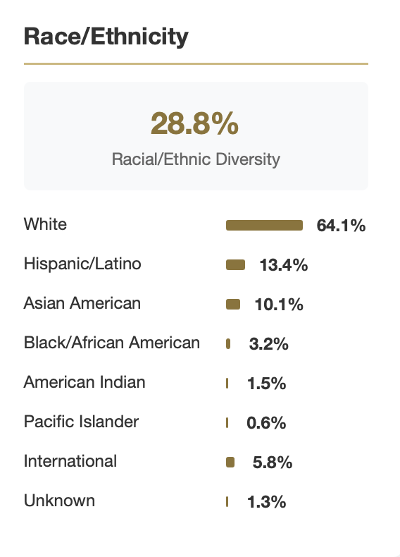
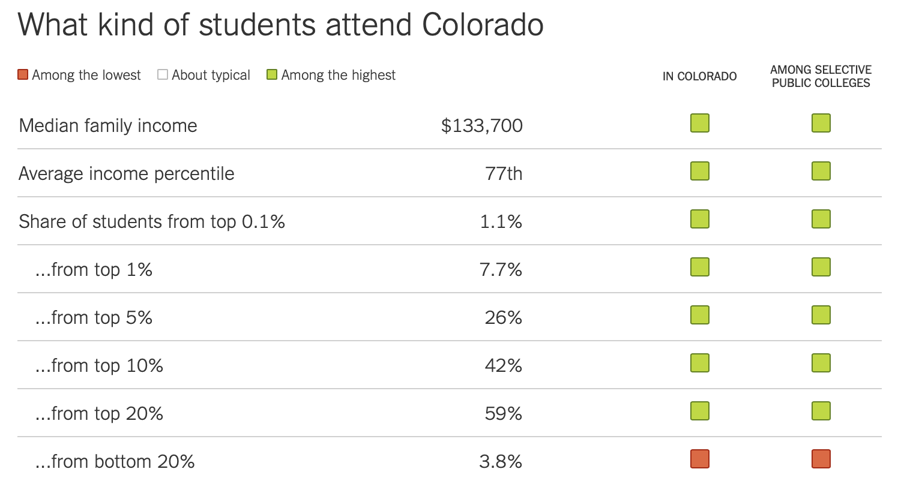
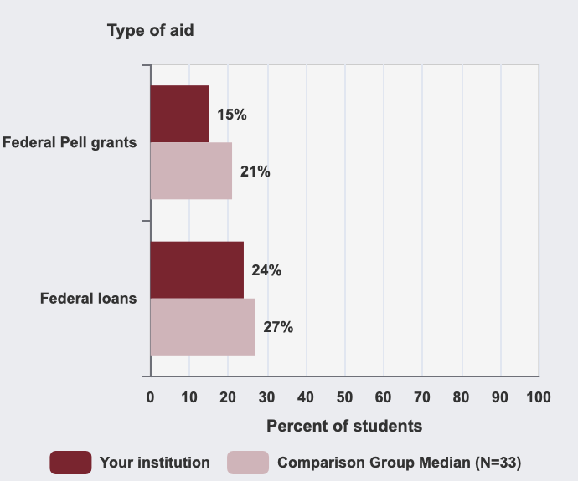
CU Student Demographics - CU’s “Average Student”
64.1% - White
59% - Top 20th percentile of annual U.S. household income
(The New York Times, 2017)
3.8% - bottom 20th percentile of annual U.S. household income
15% - Pell Recipients
(University of Colorado Boulder Office of Information Technology, 2025)
(National Center for Education Statistics [NCES], 2023)
Notes:
This becomes even more important when we look at who the “average student” at CU actually is. CU Boulder’s student population is disproportionately white and higher income. A large share of students come from families in the top 20 percent of household income, while a much smaller share come from the bottom 20 percent, and only a minority are Pell recipients. To put that into context, in 2024 the median household income in the U.S. was about $83,000. The bottom 20 percent was around $33,000 per year, while the top 20 percent had a median income of over $316,000 a year. The top 10 percent was about $510,000, the top 5 percent was about $560,000, the top 1 percent was roughly $785,000 to $820,000, and the top 0.1 percent was about $2.8 to $3.3 million. So when cost structures are based on the “average student,” they are not neutral. They reflect a campus population that is already shaped by racial and socioeconomic privilege.

Slide 5
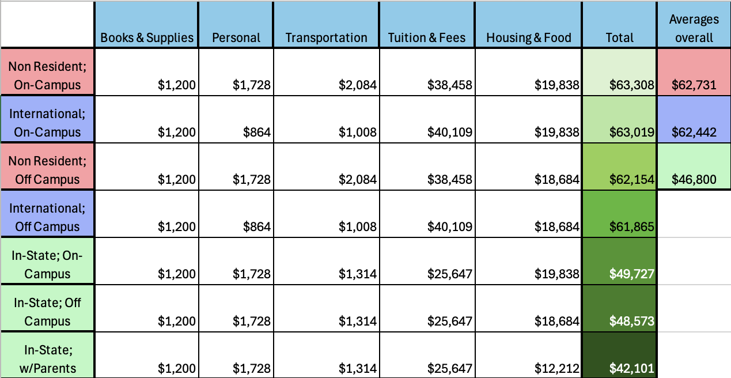
CU TCOA Policy - Breaking Down The Yearly Numbers
Cannot receive aid beyond TCOA amount
This cap applies even when aid is earned or offered through program incentives
If an unreported scholarship is discovered, it is added to your account
If that puts you over cost of attendance, you are billed and must repay it
Non-Residents → Highest
International → Middle
In-State → Lowest
$62,731 Average
$62,442 Average
$46,800 Average
Notes:
This slide shows the yearly numbers and why they matter. Students cannot receive aid beyond the total cost of attendance amount, even if that aid is earned or offered through scholarships or program incentives. If an outside scholarship is not reported and later discovered, it can be added to the student account, and if that pushes them over cost of attendance, the student may have to repay funds. The chart also shows that non-resident students generally have the highest average cost, international students fall in the middle, and in-state students have the lowest calculated total cost of attendance. But that matters because over 58 percent of CU undergraduates are in-state students, yet in-state students are assigned the lowest total cost of attendance and therefore have the least room for aid. So even though they make up the majority of the student body, they can face the tightest cap under this system.

Slide 6
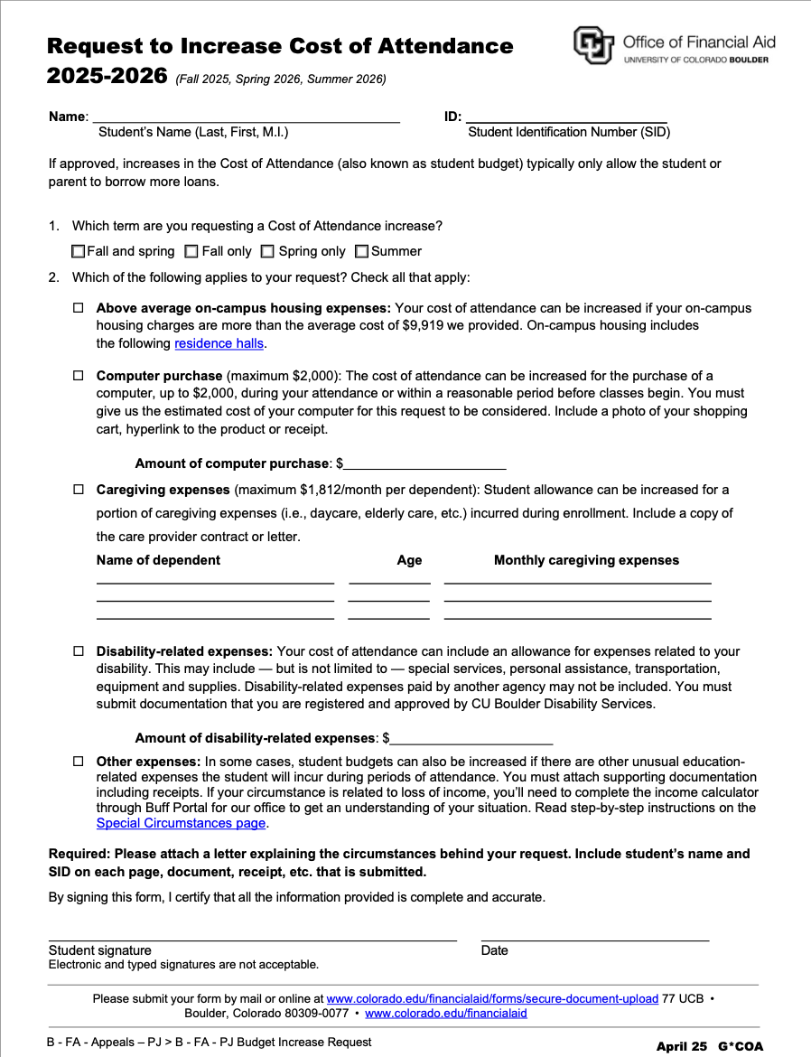
Current CU Policy
Increase Total Cost of Attendance Form
  Students must complete this form to request a cost of attendance increase
  The process requires detailed documentation of individual expenses
  Dependency criteria are very narrow and highly restrictive
  Many real household and support situations are excluded
Notes:
This slide shows the actual form students have to complete if they want an increase to their cost of attendance. The process is highly documentation-based and asks students to account for individual expenses in detail. The criteria are also narrow. For example, dependency definitions are restrictive and do not reflect many real household situations, such as support from siblings or unmarried partners. So even when students have real need, the burden is placed on them to prove it in a very rigid system. That can make support harder to access for the students who may need it most.

Slide 7
CU Boulder Endowment Fund - What is it?
A pool of donated money invested by an institution (like CU)
Principal stays invested
4% of returns used annually
Provides long term funding
Commonly used for: Scholarships, Financial aid, Research & programs
CU current fund:
Over $2.5 billion
Over 3,500 different funds
Notes:
This is where endowment funding becomes important. An endowment is a pool of donated money that is invested by the institution. The principal stays invested, while a small percentage of the returns is used each year. That makes endowments a long-term funding strategy rather than a one-time source of money. CU already has a very large endowment and thousands of individual funds supporting different priorities, including scholarships, aid, research, and programs. So the model already exists at the institution. The question is how that model could be used more intentionally to address student financial need.

Slide 8
Our Solution: Accessible Endowment Fund
Our Solution:
Total Cost of Attendance Support Fund (endowment)
Simplified application
  Fewer documents
  Less strict verification
Grants, not loans
Expands access to aid
How to Fund It:
Fundraising galas
  Ticketed events + auctions to raise large donations (millions)
Alumni outreach
Corporate partnerships
Targeted donor campaigns
Notes:
Our solution is an endowed Total Cost of Attendance Increase Support Fund. The goal would be to create a permanent funding source specifically for students whose real expenses exceed the institutional estimate and who are not adequately supported by the current process. This fund would use a simplified application with fewer documents and less restrictive verification. It would provide grants rather than loans, so students are supported without taking on more debt. To build the fund, we propose strategies such as fundraising galas, alumni outreach, corporate partnerships, and targeted donor campaigns. The idea is to create permanent, equity-based support instead of relying only on rigid case-by-case exceptions.

Slide 9
Conclusion
Quality Higher Education
Strong infrastructure, staff, and institutional support matter; it impacts and was linked to:
  Helps students stay enrolled, focus and grow
  Provided a solid social and academic foundation indicator for future success and benchmark completion
Total Cost of Attendance
Based on “average” student
Reflects what institution decides college should cost
Students cannot receive aid over TCOA
Built on equality, not equity
CU’s “average’ student = White + wealthy
Yearly Total Cost of Attendance
Trends (based on overall yearly calculated averages for all majors, housing, etc.)
  Highest: Out of state
  Median: International
  Lowest: In-state
Current CU Policy
TCOA Increase Form
  Very selective and needs lots of documentation
Endowment Funds
Pool of donated money that is invested
Designed to grow overtime and support itself
Proposed Solution: Total Cost of Attendance Increase Support Fund
Notes:
In conclusion, our argument is that the current cost of attendance system is based on an institutional average that does not reflect the full reality of students at CU Boulder. Students cannot receive aid over that cap, and the current increase process is selective and documentation-heavy. At the same time, endowment funding offers a sustainable way to create permanent support. Our proposed solution is a dedicated endowed fund that would expand access to aid for students whose needs fall outside the narrow assumptions of the current model. If CU is committed to high-quality education, then equity has to mean more than access. It also has to mean giving students the material support they need to actually stay and succeed.

Slide 10
Thank You
Questions?

