Slide 1
5 Entry Points* for UX/UI Design
Darija Medic
*Reference: Ginsberg. M. B. & Wlodkowski, R. J. (2009). Diversity & motivation. Jossey-Bass.

Slide 2
Ginsberg & Wlodkowski's
5 Entry Points*
1. Narrational Entry Point: present a story or narrative account about the concept in question.
2. Logical-Quantitative Entry Point: approaches the concept by invoking numerical considerations or deductive/inductive reasoning processes.
3. Foundational Entry Point: explores the philosophical facets of a concept.
4. Aesthetic Entry Point: emphasis on sensory or surface features that appeals to learners who favor an artistic approach.
5. Experiential Approach: dealing directly with the materials that embody or convey the concept.
*Reference: Ginsberg. M. B. & Wlodkowski, R. J. (2009). Diversity & motivation. Jossey-Bass.
Notes:
My idea for the capstone project is to incorporate Ginsberg & Wlodkowski's 5 Entry Points for learners into my Intro to UX/UI Design course. The benefit of these points is that they support different aspects of learner self efficacy. They involve providing accessible stories to bring a concept closer, connecting learning materials to the students' own experiences and backgrounds, stimulating students intellectually and encouraging critical thinking, encouraging students to use their creativity in learning processes. I'm interested in implementing the different entry points both on the level of lecture/teaching the material (more implicitly) and on the level of assignments (explicitly) for a sample of the course.

Slide 3
UX/UI Design
1
Just and Equitable Learning
User interface (UI) refers to the interactivity, look, and feel of a product screen or web page, while user experience (UX) covers a user’s overall experience with the product or website.
2
Just and Equitable Design
Notes:
The field consists of many professions and is only growing in scope - people with different abilities, affinities and preferences can find their place, which is not how this type of course is usually presented.
The subject is conventionally not taught through a just and equitable lens in terms of designing for just and equitable UX. I am interested in applying the 5 entry points in a way that would facilitate both a just and equitable learning environment as well as fostering a just and equitable design mindset in students.

Slide 4
“Accessibility is not something we add to a website, but something we start with and risk losing with each enhancement. It is to be retained.”
— Scott Jehl
Notes:
I will focus on for this project is (web) accessibility and universal design, which is most commonly taught from a technical design and development perspective in UX/UI Design.

Slide 5
JET goals / impact
Learner Equity
The 5 Entry Point system challenges various inequalities of learners by diversifying access to the course material and student expression within assignments.
Design for Accessibility
The intervention will be especially valuable in order to provide a more holistic way of addressing wide ranging issues of web and digital accessibility.
Design Justice
Designing the context of the 5 entry points to specifically focus on diversifying examples outside of the US context
Notes:
In addition, I want to incorporate a design justice approach in designing the context of the 5 entry points and specifically focus on diversifying examples outside of the US context.

Slide 6
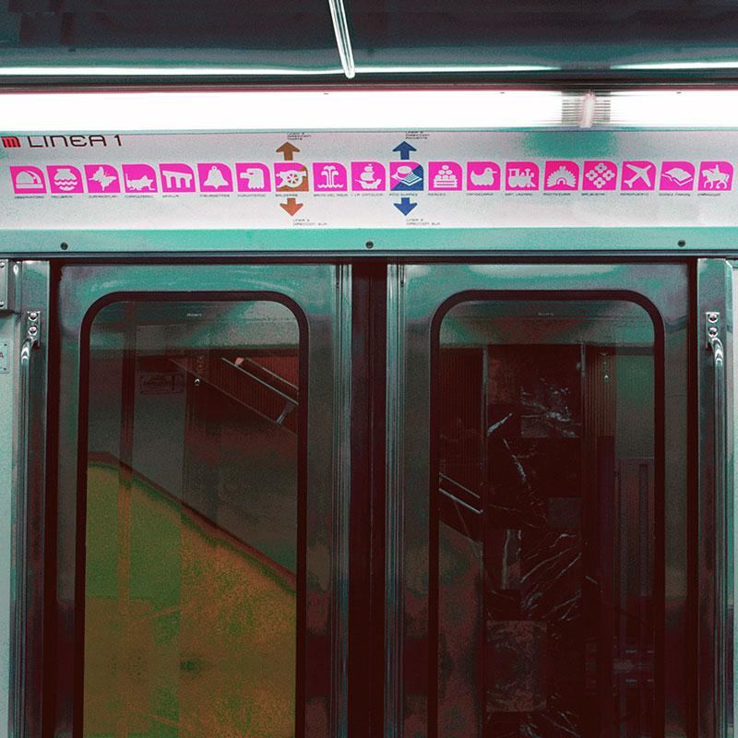
A picture is worth a thousand words
Example of the Mexico City Subway design, originally developed by Lance Wyman in 1969
Notes:
Global South example for a narrative entry point to the course material: The Mexico City Subway design, originally developed by Lance Wyman in 1969, is renowned for its distinctive and innovative approach to wayfinding and visual communication. One of the most special aspects of Wyman's design is the use of unique pictograms for each station. These symbols are not only visually engaging but also serve as a practical navigation tool, especially in a city where literacy rates at the time were extremely low (). Each symbol reflects an aspect of the station's location, history, or name, making them meaningful as well as decorative.

Slide 7
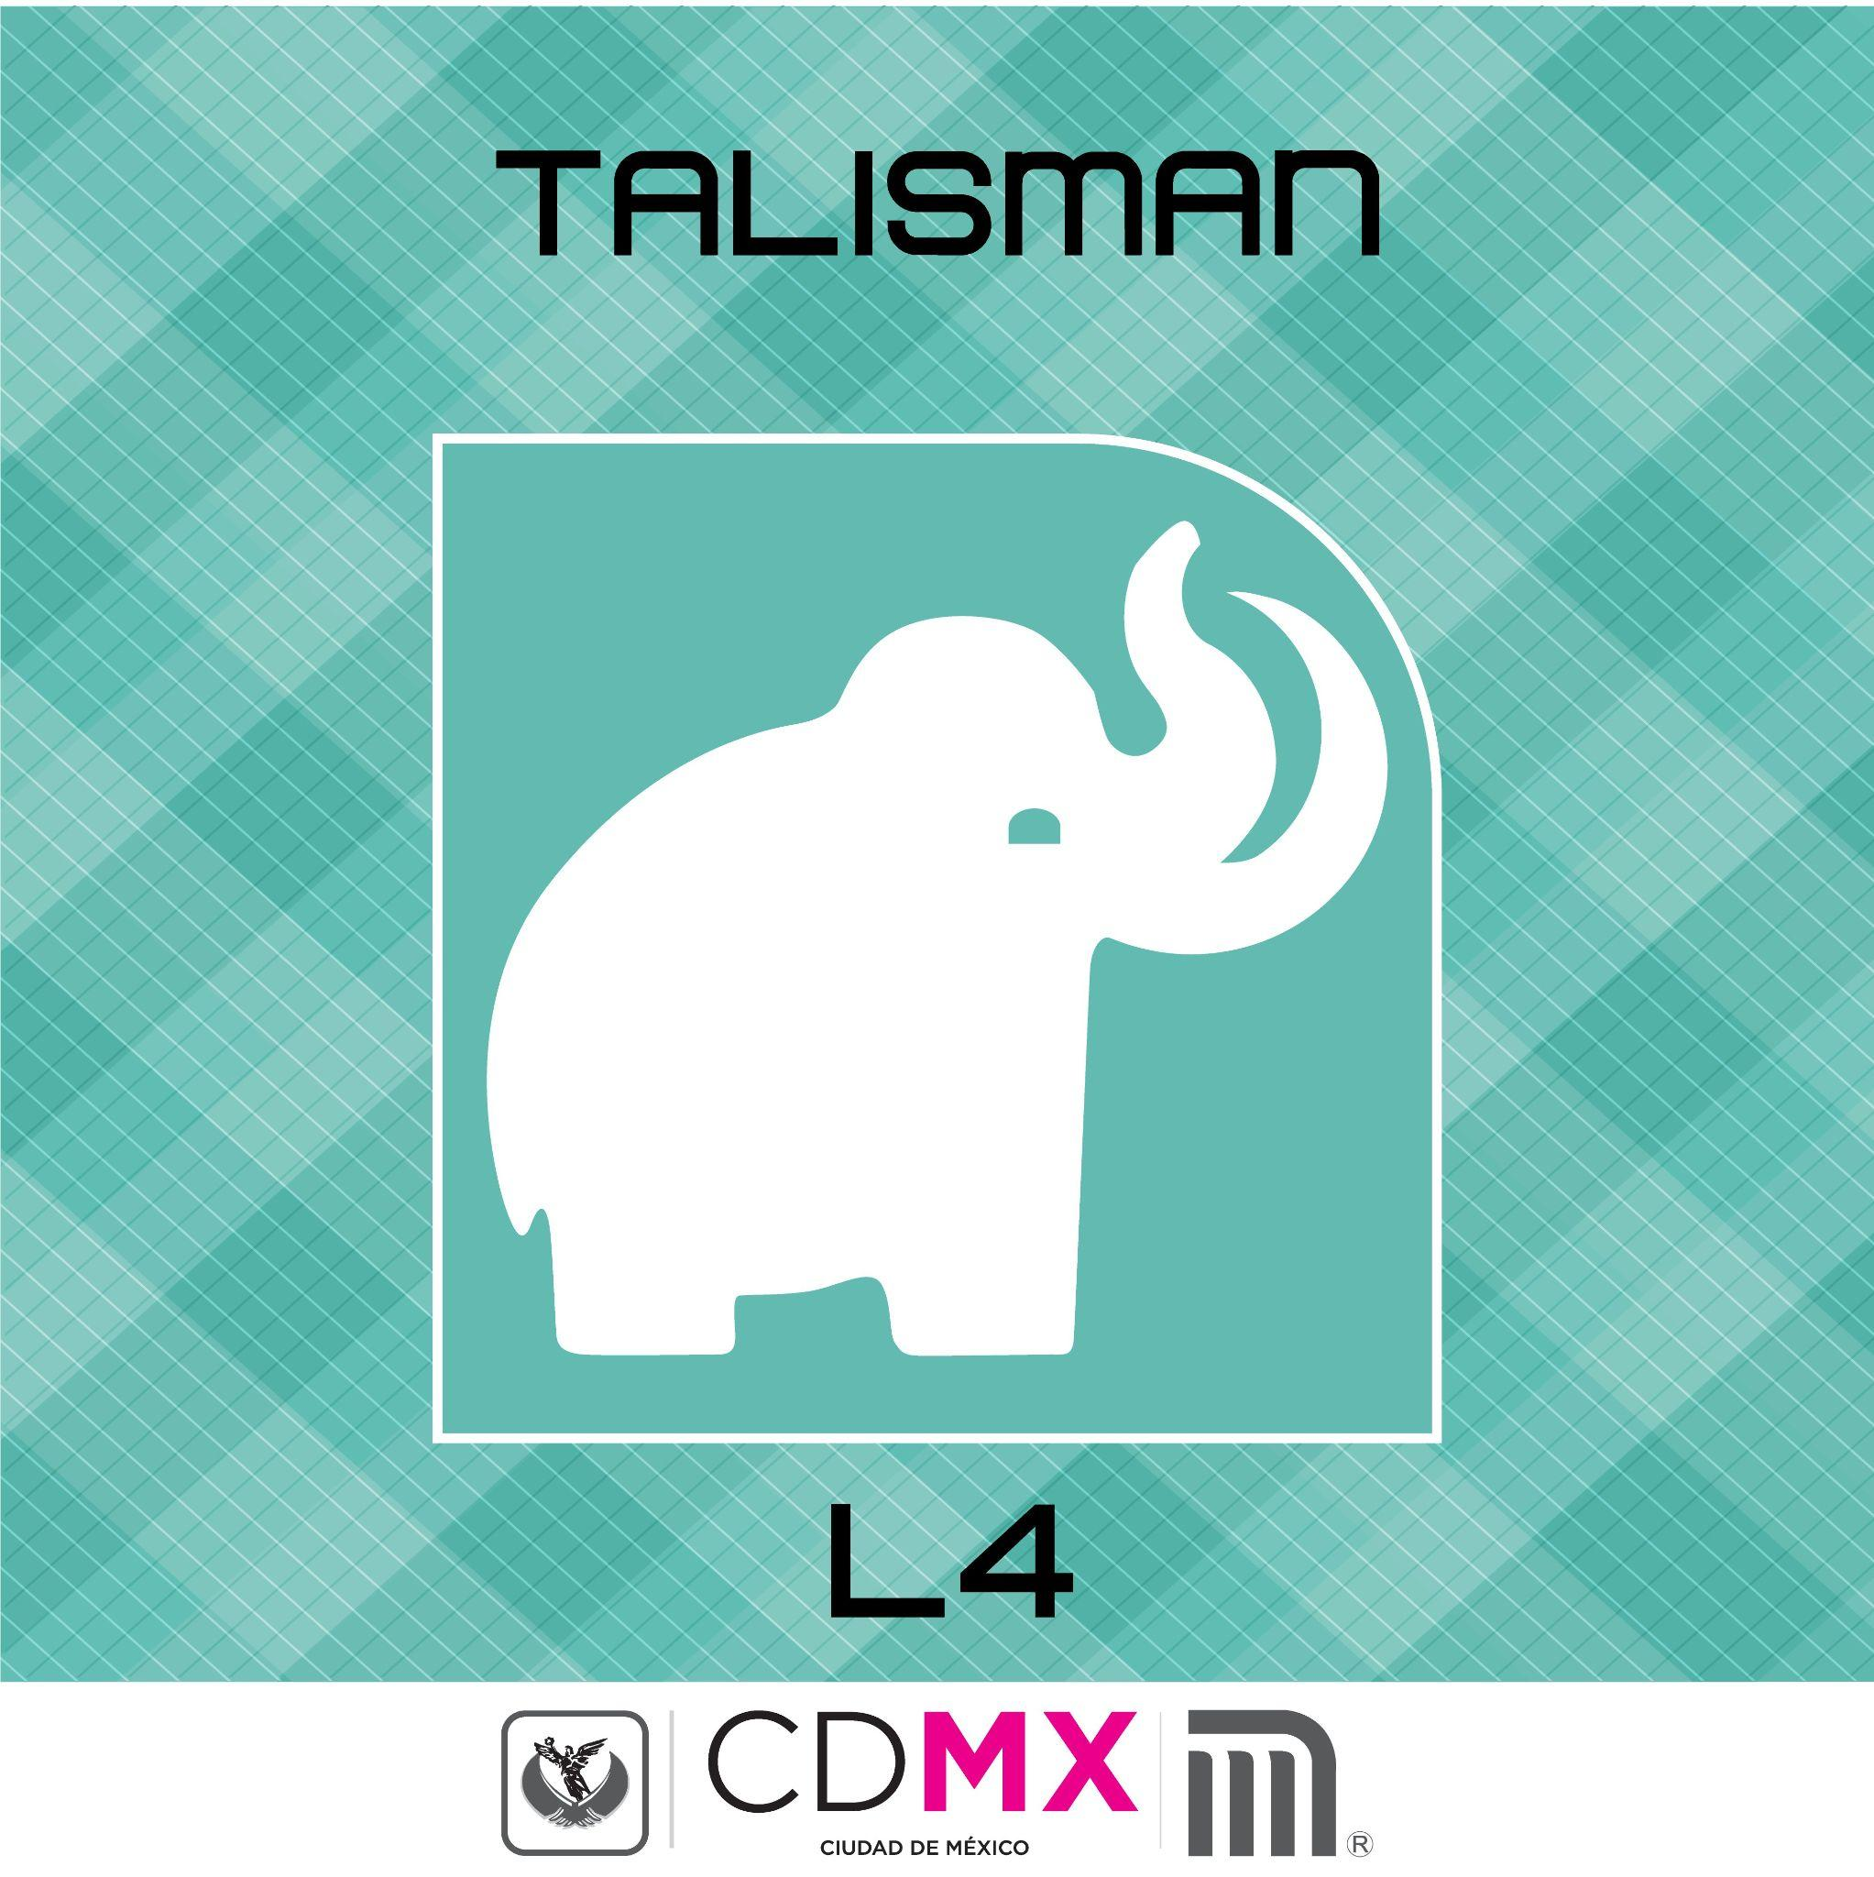
Why is Talismán station represented by a mammoth? Because workers discovered the remains of one while excavating the site

Slide 8

Notes:
Images from the original pictograms and the elements from the subway station location they depict.

Slide 9
Colorblind-friendly palettes throughout the whole course
implicit
Which students will find out about and examine in the color module
Notes:
As an implicit aesthetic entry point for the course material, I will structure the course material in colorblind-friendly palettes: magma, plasma, inferno, viridis. The students will find this out only when the color module comes up. In that way they will train their eyes to get used to these palettes so that they will feel more familiar and accessible when we explicitly arrive to that point in the course.

Slide 10
Roadmap
Draft ideas for entry points for each of the modules
Adapt and revise content (assignments + material)
Test run of the course and obtain feedback
1
3
5
2
4
6
Test ideas out with a group of people
Design the course + delivery of course material
Implement feedback for next iteration of the course

Slide 11
Timeline
Draft ideas for entry points for each of the modules
Adapt content and revise where it could be applicable (assignments vs material)
Test run of the course and obtain feedback
APR
MAY
JUN
JUL
AUG
SEP
OCT
NOV
DEC
Test ideas out with a group of people
Design the delivery of course material in colorblind friendly palettes
Implement feedback for current and next iteration of the course

Slide 12

Thank you!

