Slide 1

Just and Equitable Teaching Capstone
Resume Workshop
Date: April 13,204
Submitted by: Wendy Martin

Slide 2
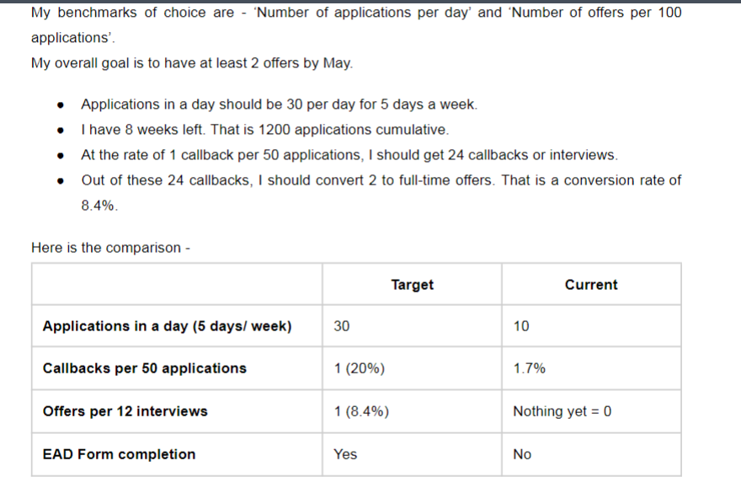
The Issue
One of my international students submitted a benchmarking plan for obtaining employment in the U.S.
Although the plan was well presented, it also presented an opportunity for cultural adjustment and inclusion.

Slide 3
The Issue
After reviewing several student resumes, I observed that each resume was not being tailored to the positions to which they were applying.
Hence, they were not matching for positions for which they are qualified.

Slide 4
The Goals
Support students’ cultural adjustment to U.S. job application processes
Build community by promoting student interaction outside of class
Be as U.S. Business Cultural Informant
Support language development through noticing
Increase confidence

Slide 5
Action Plan
Hold a resume workshop for all graduate students in my Quality Management course as a pilot program
Ask for their input prior to the workshop for other ideas to include
Conduct a pre and post survey to measure confidence related to the learning outcomes

Slide 6

Learning Outcomes
Create a resume from scratch
Understand key word blocks and their importance
How to choose the right resume format
Understand the parts of the resume, and what information goes into those parts
Create a “STAR” story
Per student input, interviewing tips and LinkedIn tips were also included

Slide 7
Resume Workshop
Held on Friday, April 12, 2024
8 attendees, 7 out of 8 were international students
The meeting was recorded and shared to all students, as not all could attend
Slides were also shared

Slide 8
Results

Slide 9
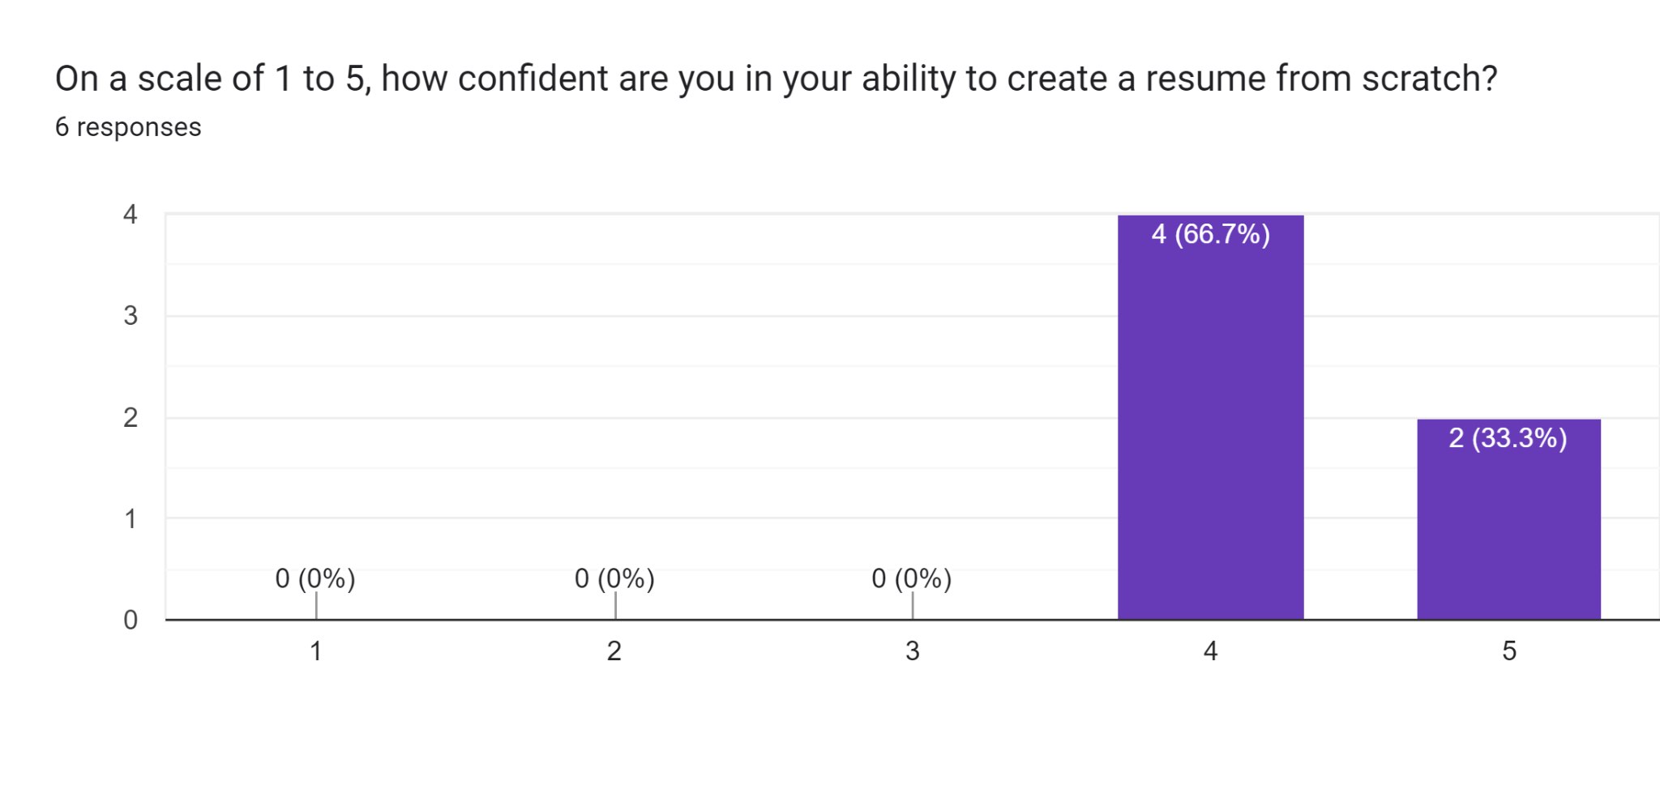
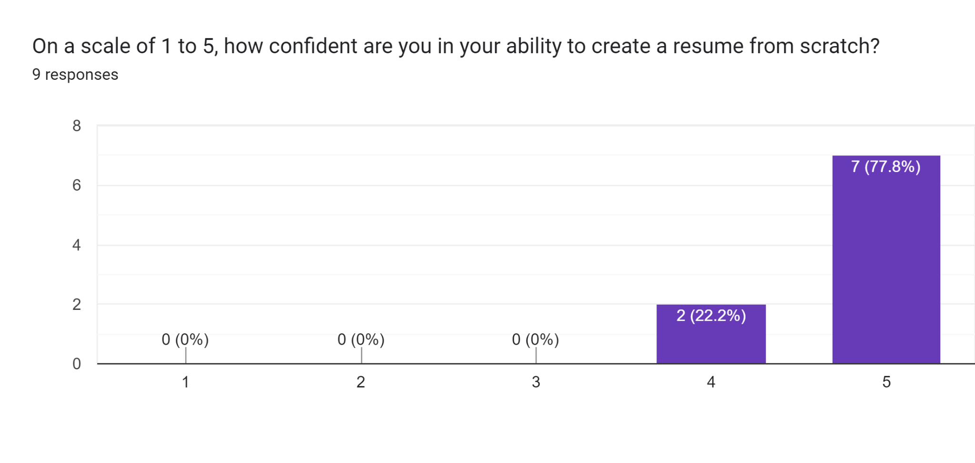
On a scale of 1 to 5, how confident are you in your ability to create a resume from scratch?
Before Training
No statistically significant difference here, but…
After Training

Slide 10
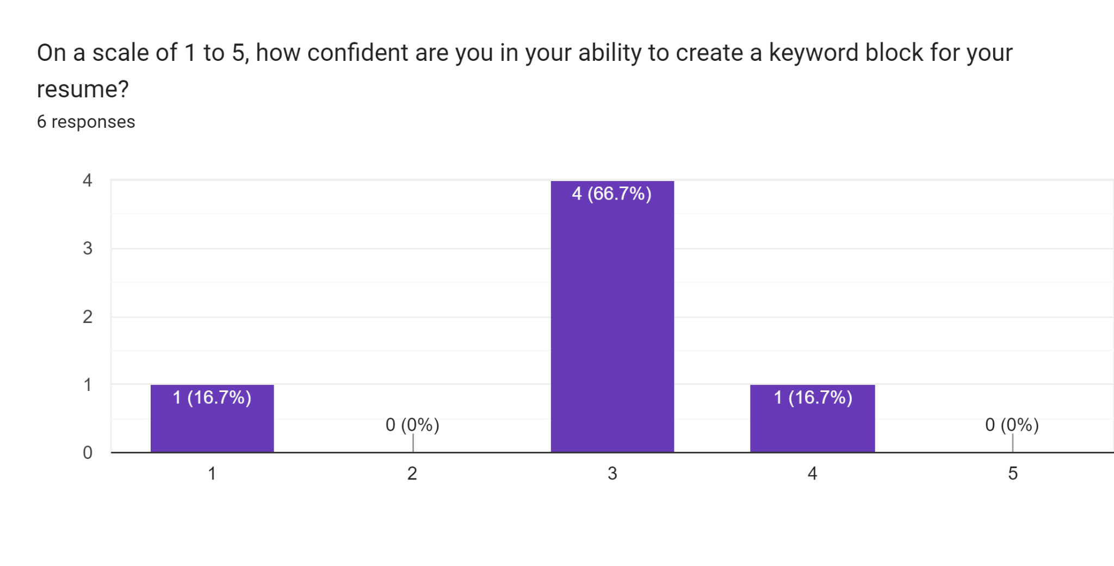
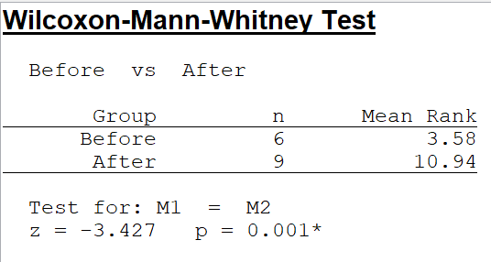
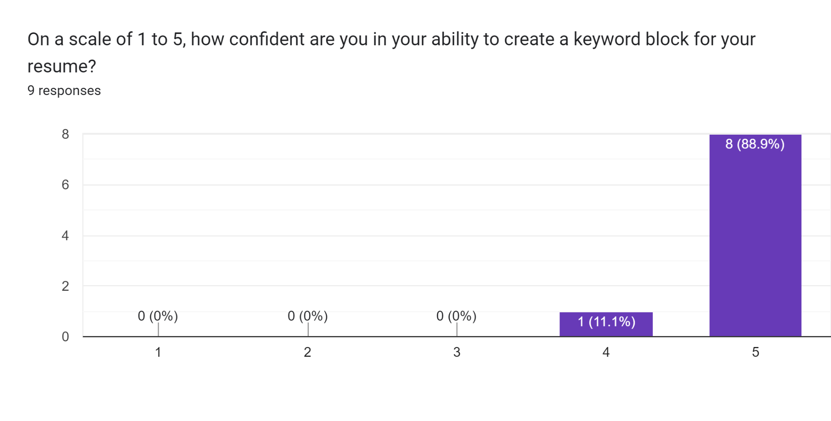
On a scale of 1 to 5, how confident are you in your ability to create a keyword block for your resume?
Before Training
After Training

Slide 11
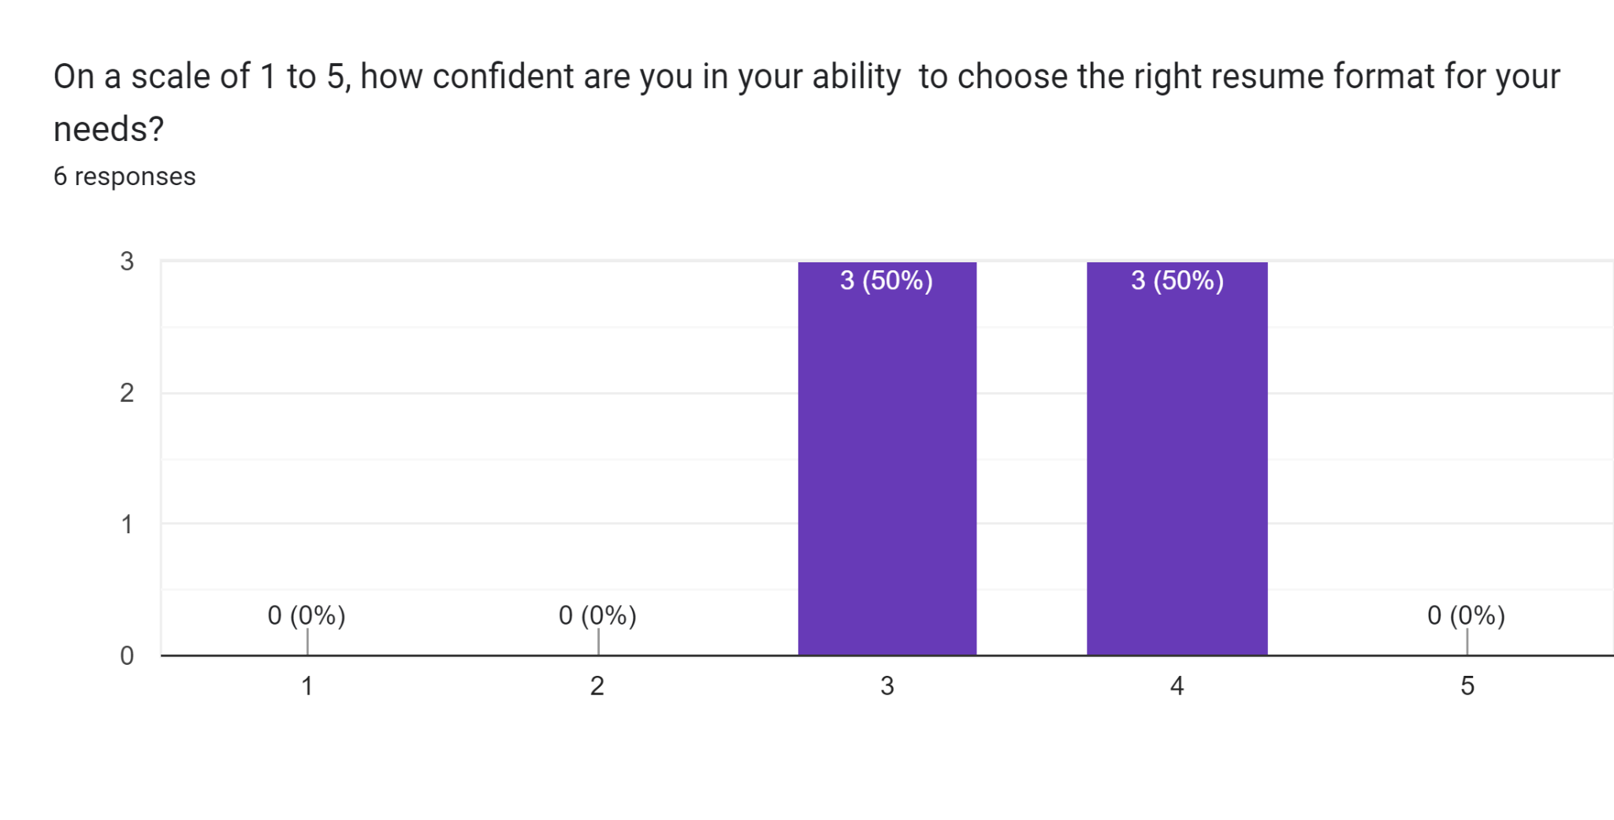
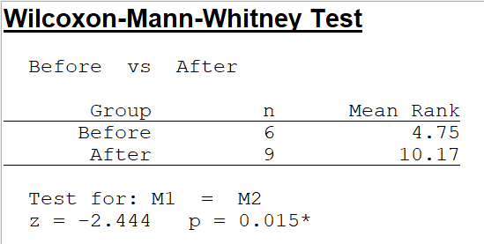
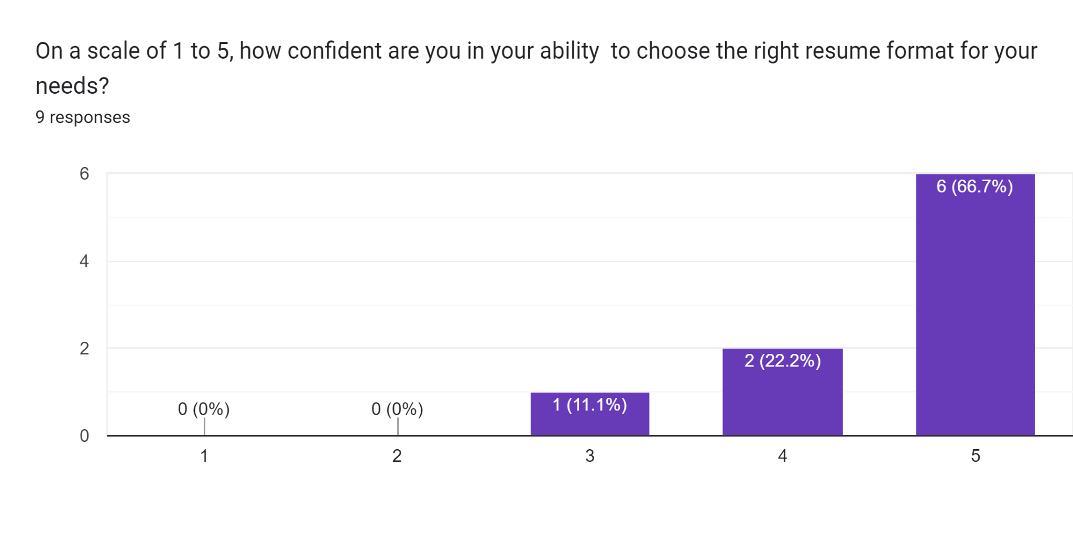
On a scale of 1 to 5, how confident are you in your ability to choose the right resume format for your needs?
Before Training
After Training

Slide 12
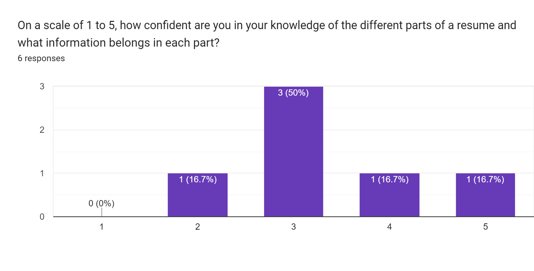
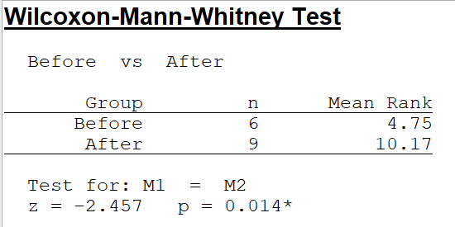
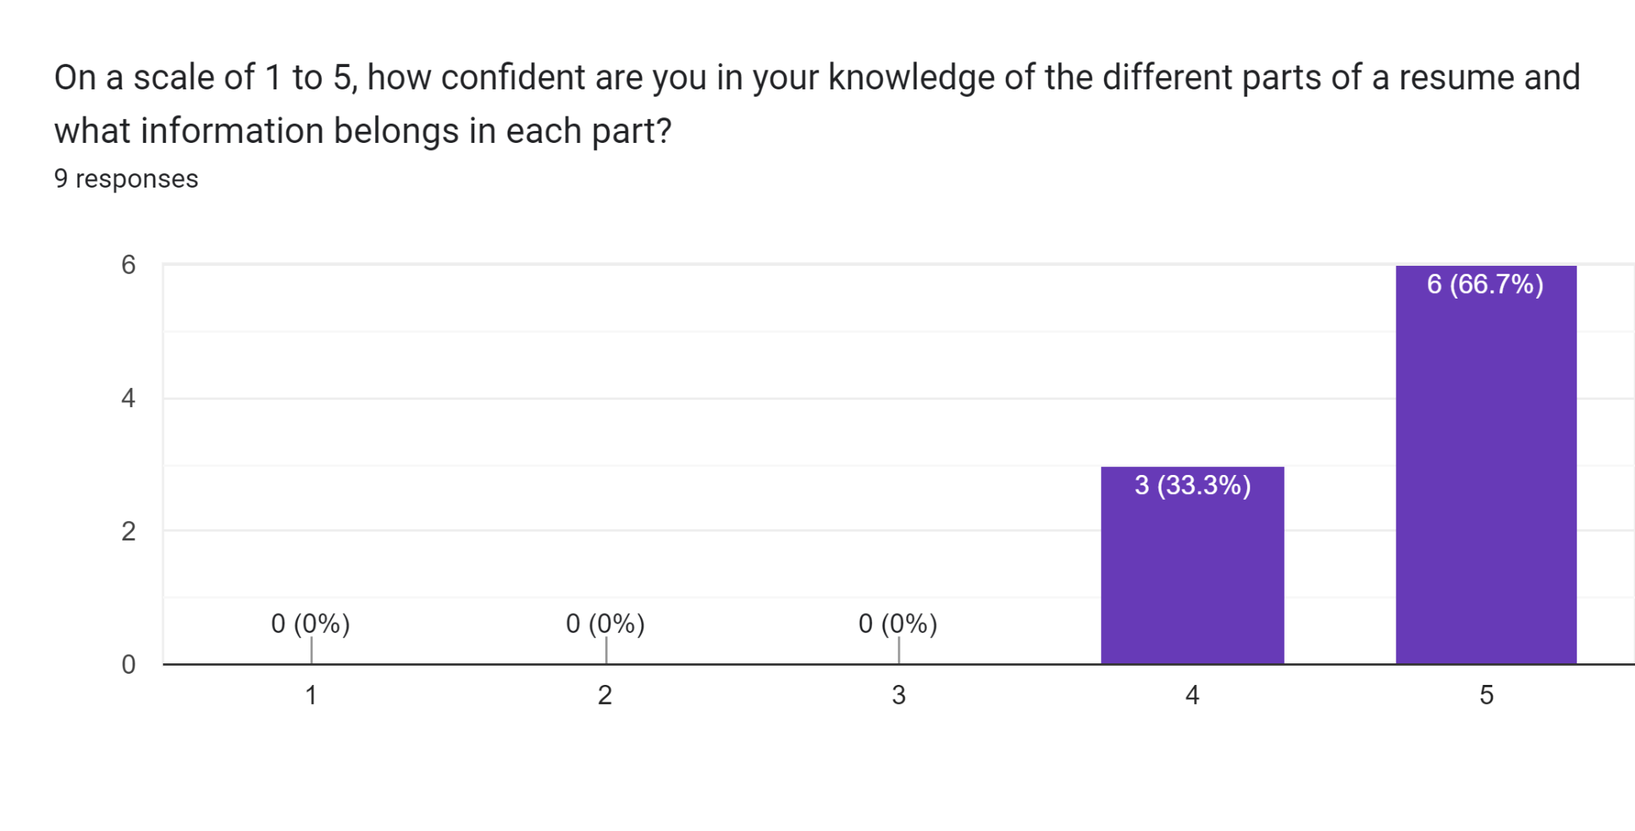
On a scale of 1 to 5, how confident are you in your knowledge of the different parts of a resume and what information belongs in each part?
Before Training
After Training

Slide 13
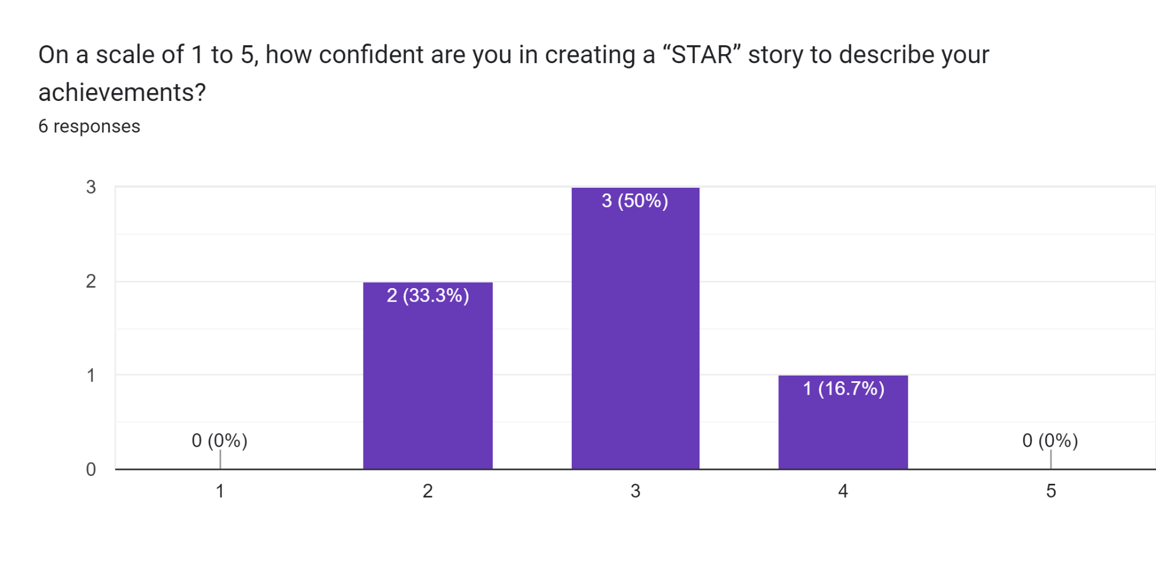
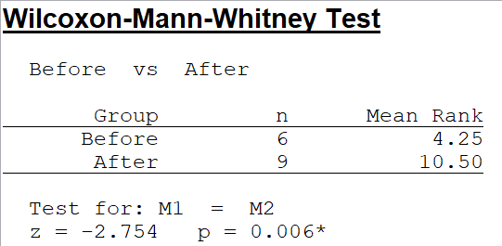
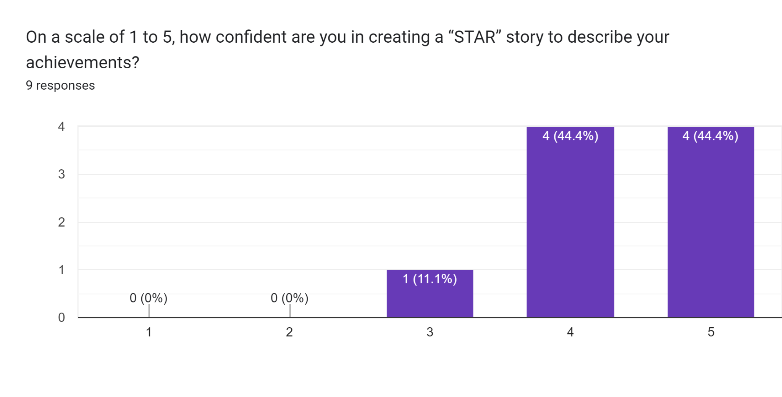
On a scale of 1 to 5, how confident are you in creating a “STAR” story to describe your achievements?
Before Training
After Training

Slide 14
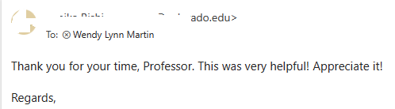
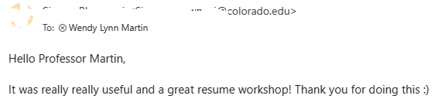
What part of the training was most helpful?
“Key board Block”
“Creating keyword blocks”
“Noting keywords for the summary”
“The keyword block and using AI to create it”
“Keyword block”
“entire thing”
“Create the keyword block”
“The summary part and STAR method, as writing the job role on the top was new and interesting to me! I will definitely use all these things”

Slide 15
What improvements can I make for next time?
“Not sure you need the breakout rooms, but the example share-out is really useful”
“Education, and the order of each section in the resume”
“Maybe just maybe you can search up some AI tools for fastening this same process but it was all perfect really”

Slide 16
Next Steps
I will run this again in the Fall semester and expand the workshop to multiple courses
More time would have been helpful for sharing and modeling the process of creating

Slide 17
Questions?

